Slide 1

HCL O365 Capabilities
As part of Enterprise Productivity Services

Slide 2




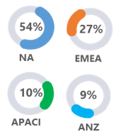
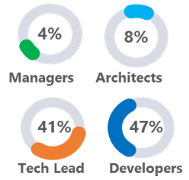
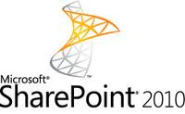
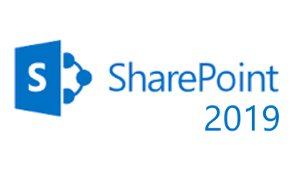
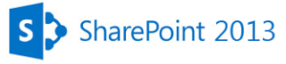
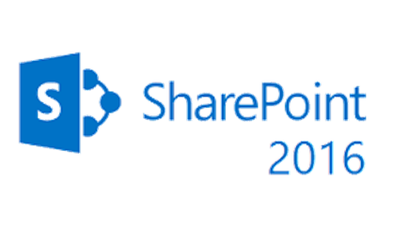






O365 Practice Snapshot
Headcount
Experience
Engagements
Customers
15+Yrs
3500+PY
850+
300+
100+
ONSITE PRESENCE
ROLE BASED PROFILE DISTRIBUTION
TECHNICAL EXPERTISE
SPO Modern Sites
**O365 Mailbox Migration, Skype for Business & Yammer not covered in our services portfolio

Slide 3








SharePoint Implementation Capabilities
    Architect
    Architect, Design, Development and Testing of SharePoint Solutions
    Build & Transform
    Transformational guidance within Application boundary of the solution towards better adoption
PowerApps
    Manage
    Technical Management of Development and Enhancement work on SharePoint Technology
Modern
Sites
Microsoft Flow
    Leverage
    Use of latest standards including SPFX, Power Apps & MS Flow, Modern Experience etc.
SharePoint Framework Extension
Add-in

Slide 4





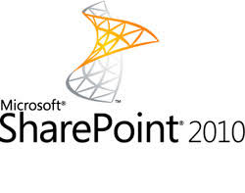
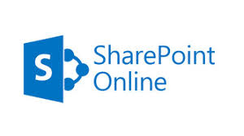

Migration Capabilities
SP Legacy to SP 2013 / SP 2016 / SP 2019
SP on Premise to SP Online
Other Platform to SharePoint
Hybrid / Others
Source can be SharePoint 2013, 2016, 2010, MOSS 2007, SharePoint 2003 and sometimes CMS 2002
Can be As-Is Upgrade or Reengineered Upgrade
Upgrade components include Data, Application, Customization
Can be On Premise to On Premise, On Premise to Cloud
Transformational Migration as decision of DC movement is involved
Compliance, Security, Performance are critical factors
Office 365 SPO is the most popular target, however Azure or other hosting providers can be options too
Source can be any Content Management platform with Lotus Notes being the most popular amongst all, SP is target
Migration includes Data, Customization and Application
We have matured offerings around migration to SharePoint ? SPO from Lotus Notes, Hummingbird, Documentum etc.
Migration from SP On-premises to O365 SPO for non-sensitive content and to SP 2019 for sensitive content
Migration of highly customized SharePoint Apps to Azure
.
.
.

Slide 5












ASM Capabilities
SERVICE CATEGORY | SERVICE GROUP | KEY SERVICE ACTIVITIES
L2 & L3 Support Activities | Incident Management | Critical Bug Fixes/Fix for Fails.
 |  | Investigate, Analyze, and Resolve support incidents.
 |  | Incident triage and escalation.
 | Problem Management | Collect and document problem information.
 |  | Link incidents to problems, perform RCA and escalate as appropriate
 |  | Perform deep technical investigation and analysis of problem(s)\known errors.
 |  | Communicate resolution updates to business and interested parties.
 |  | Manage and document the resolution of high impact problems.
 |  | Manage and publish reports on the problem list at defined intervals.
 | Problem Prevention | Perform trend analysis as part of problem identification.
 |  | Perform problem risk analysis and cost benefit of fix assessment.
 |  | Identify, prioritize, and schedule for future releases.
Enhancements | Minor Change Requests | Do analysis and provide estimates.
 |  | Minor Functional Enhancements.
 |  | Application Code related Performance improvements.
Knowledge Management | Knowledge Maintenance | Maintain Knowledge Base documentation.
 |  | Review and Signoff new Knowledge Base Articles (KBA) as they are added.
 | Knowledge Documentation | Document core procedures, health checks, and application specific information.
 |  | Document training materials required for new users through the support team.
 |  | Document Problems and Known Errors information.
Non - Ticketing Activities | Service Review and Reporting | Capture & monitor relevant KPI and Metrics and SLAs.
 |  | Publish status reports periodically.
 |  | Review service operating state.
 |  | Identify Service gaps and Recommend service improvements.
 | Other Activities | Application monitoring and configuration management
 |  | Liaise with Microsoft for any product bugs.
 |  | Training new team members (if any)
Release Management | Application Release Planning | Operate, manage, and schedule application release deployments.
 |  | Review application release deployment plans.
 |  | Request and review communication plans for future releases.
 |  | Request and review testing signoff for future release deployments.
 |  | Request and review stakeholder signoff for future release.
 |  | Sign-off application release deployments.
 | Application Release Deployment | Confirm stakeholder approvals and issue communications during release(s).
 |  | Deploy application release as defined in release plan.
 |  | Escalate if any issues and implement rollback plan (if necessary).
 |  | Sign-off release as successful and set system live (if appropriate).
 |  | Inform Level 1 support to monitor application closely following release.
 | Post-deployment Checks | Conduct post deployment checks and confirm system live status.
 |  | Raise incident reports as necessary.
 |  | Initiate back-out plan as appropriate.
 | Post-release Review | Participate in post implementation review.
Various Services Provided Under ASM Track
Client Interface Management
Stats & Reports
SP Related Channel Configuration
Partner Access Management
L2 & L3
SP Related Network Configuration
App Store Maintenance
Farm / DC Management
Monitoring
User Management
Infra Management
Device Management
App Maintenance & Enhancement

Slide 6




Administration Capabilities
Installation & Configuration
Farm and Site Collection Administration
Continuous Monitoring & Reports
User & Authorization Management
Security and Compliances
Ticket based Troubleshooting
+
+
Approach / Methodology
HCL Proprietary Monitoring Tool
DocAve
ControlPoint
3rd Party
SP Admin Tools

Slide 7
SharePoint Frameworks & Accelerators
CAF
NotesPoint
File O Cloud
Academy Hub
Quantitative Framework for optimal collaboration Adoption in Enterprise enriching Organization Balanced Scorecard.
Migrate suite for Legacy to SharePoint transition
End to End File Migration Suite for Legacy source to 5 different Targets
Academy Hub is an onboarding portal for the account teams helping the accounts to manage account related information at one place
SP Digitalization
Reusable Assets
Productivity
SPCoEaaS
Platform & Device independent. Framework to surface SharePoint contents
100+ Reusable Components addressing common needs for both on premise and cloud
Speech conversion, Gamification, Advanced Search Collaboration Decision-making, Employee Influence Index
Productivity Suite enforcing Factory Model in SharePoint Delivery through various enablers
Our SharePoint Modernization Portal http://sptoo365.azurewebsites.net/ offers end-to-end guidance on SharePoint upgrade
Notes Point Suite has been used to successfully migrate legacy Lotus Notes Application to SharePoint/SharePoint Online for global majors
Our 100+ re-usable components have been leveraged across SharePoint /SharePoint Online implementations
We offer smart productivity enablers like Chat bots, gamification components, Decision Tools etc.

Slide 8








Lotus Notes to SharePoint Migration Offering
NPAD - NotesPoint Application Disposition
NPA – NotesPoint Analyzer
Owner Identification
Application Decommission WF
Application Archival WF
Application Migration WF
Import Schema in PMA
Analyze schema
Reporting
NPD – NotesPoint Discovery
NPE – NotesPoint Estimator
Reads Lotus Notes Database
Exports Application Inventory
Exports Schema in XML format
AS-IS Estimation
Archetype based Estimation
NPMS
NPTF – NotesPoint Test Factory
NPCM – NotesPoint Content Migrator
Pre-defined test scenario
Pre-defined test cases
Pre-defined test strategy
Pre-defined test methodology
Form Mapping
Field Mapping
Schedule Migration
Monitor Migration
Re-run Migration
NPRE – NotesPoint Reverse Engineering Tool
NPWCM – NotesPoint Web Content Migrator
Page mapping
Schedule Migration
Monitor Migration
Re-run Migration
Identifies and converts views
Identifies and converts scripts
Identifies and converts agents

Slide 9


Microsoft Power Platform POV
We effectively orchestrate the power of Power Apps, MS Flow and Power BI to develop simple, rich and powerful applications
Microsoft Flow allows for creation of powerful workflows that can be used to integrate and update data, synchronize files, get notifications and more across O365 / SharePoint apps
Power Apps allow for quick construction of simple yet powerful workplace / collaboration functionality that can be plugged into O365 SharePoint Online
Manage Processes
Surface / Capture Data
Power Apps allows for creation of informative reports and dashboards that can be published on websites, in SharePoint or Teams.
Gain Insights

Slide 10
O365 Automation Options
Activity | O365 Component | Automation
CI/CD | SPFX Web Part / SP Add-in | An Azure DevOps CI/CD pipeline can be implemented for automating Deployment to O365 SPO. An Azure CI/CD pipeline integrates and orchestrates automated build, automated unit testing, automated code coverage testing, automated code quality testing, automated deployment and automated functional testing
Site Provisioning | SharePoint Site Provisioning | A SharePoint Site Request Form is used to create requests. Submitted requests once approved invoke a Site Provisioning script which creates a site in accordance with request attributes in the specified environment (SharePoint Online or SharePoint 2019)

Slide 11



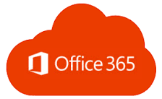

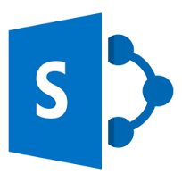













SharePoint DevOps on Azure (1 of 2)
PLANNING & MANAGEMENT
CONTINUOUS INTEGRATION
CONTINUOUS DELIVERY
Azure DevOps
Azure DevOps
User stories,
Issues, CR
Build Pipeline
Deploy Pipeline
SharePoint Online
Code Quality
OR
Testing
Developer- IDE Tool
(SP Custom App)
Repository
Azure DevOps
Build Template
Unit Testing &
Code Coverage
Notification
Defects & Incidents
Centralized Dashboard
Azure DevOps
Dashboards

Slide 12
SharePoint DevOps on Azure (2 of 2)
Phase | Tools | Purpose
Project/Test/Defects Management | Azure Boards | Agile Project Management, Scrum Dashboard, Log Defects, Manage Test Cases , Change Request
Development IDE Tools | Visual Studio | Development IDE tools to develop Custom Components
Continuous Integration | Build: Azure DevOps Build Template Code Quality: SonarQube Unit Testing & Code Coverage: NUnit / NDepend / Jest | Build, Unit Test and Perform Code Quality Checks
Continuous Deployments | Deployment: PnP CLI for O365 / PowerShell | Perform Automated deployments to Dev/Test/UAT/Production
Functional/Regression Testing | Azure Test Plan / Selenium | Automated Functional and Regression Testing

Slide 13







Automated SharePoint Site Provisioning
Workshops with users evokes interest in SharePoint capabilities and interested employees can request for a demo
Form Submission saves request to a SP List and triggers an approval workflow
Upon approval the saved request is flagged as ‘Approved’
Sites are created against Approved requests. Users are notified upon site creation
Interested users request for a site for their team/department
User Fills out Provisioning Form hosted on SP 2019
Workshops with Employees
1
SP Site Demo
2
Site
Requestor
3
Site Request Form
4
Approval Workflow
5
Site Creation Engine
6
Notification

Slide 14
Thank You

