Slide 1
Microsoft Office 365 Administration
Our Capability
May, 2017

Slide 2
Contents
Introduction
Office 365 – Overview
Pain & Challenges
How we can help
Typical Challenges and our approach
Solutions and assets
Support Model
Automated assistant for O365
What to expect
Key benefits to the client
Value adds and differentiators
Practice Overview
Relationship with Microsoft
Case Studies
Appendix

Slide 3



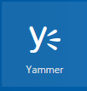
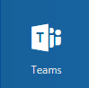

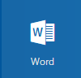



Introduction
“HCL offers basic to advanced Office 365 administration support and operations management embedded with reporting, monitoring and enriched Application Performance Management across the entire stack of Office 365 offerings”
Setup & Configuration
O365 Administration
User & Authorization Management
Vendor Communication
Security and Compliances
Continuous Monitoring & Reporting
User Trainings
Ticket based Troubleshooting

Slide 4
Office 365 – Overview
Microsoft Office 365 is a Web-based version of Microsoft's Office suite of enterprise-grade productivity applications.
Office 365 is subscription based and delivered to users through the Cloud.
Exchange Online
SharePoint Online
Skype For Business
Yammer
Anywhere, Anytime access for your emails, Contacts and Calendars
Secure content and document management store to share and collaborate
Communications platform including presence, instant messaging & online meetings
Company’s private social network connecting people and information
OneDrive For Business
Office 365 Pro Plus
Office Delve
Video
One place for all your files so you can work whenever and wherever you want
Suite of your familiar Office applications including Word, Excel, PowerPoint & Outlook.
Helps you discover the information that's likely to be most interesting and relevant to you
Dynamic video portal to enable easy upload, sharing and playback of video messages securely.

Slide 5
Office 365 - Benefits
Highly scalable
Proven scalability and high availability
Savings on the server & Infrastructure maintenance
Guaranteed 99.9% uptime
World-class enterprise data security
Automatic data backup
Latest features always available
Anytime anywhere access
Spam and Malware protection
Faster upgrade cycles
Supports BYOD
Affordable storage

Slide 6
Pain and Challenges
Data Security & Company Security Policy
License Management & Optimization
Governance & Administration
Retention and Recovery
Office 365 exit & reverse migration
Managing Hybrid
Frequent updates
User trainings
Cloud Usage Visibility
Self-help and support
Setup and configuration
Customizations and branding
Notes:
Data Security & Company Security Policy: O365 can potentially be hacked from any internet connected device, also the security policies of Microsoft may not comply with company's security policies.
Governance & Administration: The infinite opportunities that O365 provides comes with its own risks. Governance and administration on the cloud therefore becomes even more important than ever.
Retention and Recovery: O365 is governed by Microsoft's backup and retention policy and at times may conflict with a company's retention and restore policy.
License management & Optimization: Microsoft's complex licensing makes it difficult to chose the correct license. That combined with the changing terms and conditions makes it further complicated.
Office 365 exit and reverse migration: Unfortunately there are not too many options for a migrating the content and applications to SharePoint On-Prem or to some other provider.
Managing Hybrid: A hybrid setup has its own complexities and it still far from being a seamless experience for the users and for the administrators.
Frequent updates: Microsoft's Office 365 is far from being "matured" and is still "work in progress". New updates being released at a fast pace making it difficult for the users to keep up.
User Trainings: One of the key challenges for an organization is to train users on the application, tools, policies and procedures they need for their day to day work both for new joiners and existing users.
Cloud Usage Visibility: Enterprises currently do not have the visibility or control of their cloud usage with details such as which project consumed the services and the spend details.
Self-help and support: Absence of a well designed and easily accessible help and training site adds to a lot of pressure on the support teams, while adding to a negative user experience.
Setup and configuration: some of the applications like OneDrive and MS teams and not easy to setup and users may get lost while setting them up or using certain features
Customizations and branding: Limited customizations are allowed on the O365 and the usual way of developing solutions on premises may not work on the O365.

Slide 7
Other Contributing factors
Ineffective use of Office 365 features.
Alternate ways of sharing corporate data.
Lack of tools to enable workers to collaborate and communicate quickly and easily.
Undermining user experience.
Business not relying and having trust in IT.
Lack of industry best practices for compliance and safety.
Emergency situations affecting business continuity.
IT not aligned with the business requirements and expectations.
Lack of value adds to reduce operational cost.
Absence of business processes optimization
Notes:
These are some of the other contributor factors that add to the challenges.
Organizations makes substantial investments in O365 hoping that the features it brings along will go a long way in enhancing user productivity, more often it is noted that not all users efficiently use all features resulting in loss of investment.
Owing to strict IT policies or limited IT support users often find alternate ways of sharing corporate data risking it falling into wrong hands
Users often feel that the companies fail to supply necessary tools that enable workers to collaborate and communicate quickly and easily.
User experience is of prime importance yet undermined. Most of the time customer tools and solutions are not designed keeping user experience in mind, one major reason why they fail.
In most organizations business usually does not completely trust and rely on the IT. One of the major challenges of the IT team is to explain the reasons for a particular policy to the business users.
Lack of best practices by the IT team can lead to serious compliant and safety issues.
Emergency situations and outages can result in huge financial loss to the company. A competent and capable IT team goes a long way to ensure critical applications can be restored in minimal time and business continuity is maintained.
IT has become a key a key business function for an organization, it however is seen as merely an implementation tool and not really involved in shaping strategy.
Value adds in the form of cycle time reduction or process optimization are efficient means of cost reduction. Lack of value adds in a way adds to the liabilities.

Slide 8
How we can help
Advise, support, plan, maintain, and manage the applications and users on O365.
Advise and help in choosing the right O365 plan.
Help in unlocking the full power of O365 by leveraging max features.
License optimization and streamlining admin processes to save cost
Help you maximise the value and ROI from O365 investments.
Drive adoption to enhance user experience.
Assist in preparing a roadmap for O365 migrations and implementation.
Increase end user learning through trainings and self help.
Ensure security and compliance through best practices and established service management processes
Value add for process improvement, cycle time reduction and cost saving.
Manage and respond to outages, disasters and emergency situations and help you sleep
.

Slide 9
What we do
Setting up complete Office365 package (Exchange Mail, Skype for Business, SharePoint, Yammer, OneDrive etc.)
Managing and maintaining Office 365 environment at L1.5, L2 and L3 levels.
Providing end-to-end support for users and services .
Managing and optimizing licenses in O365.
Collaborating with Microsoft and other support teams to resolve issues within specified SLA.
Management of Incidents, Service requests, Problems and Change Request.
Providing proactive and on demand usage and quality reports.
Monitoring and alerting of service issues and outages.
Performing bulk operations leveraging HCL's repository of scripts and automation tools.
Reactive and advisory services from SME and advanced engineers
Assisting in other project activities related to O365.
Implement and manage automated assistant for L1 and L1.5 issues and requests.
Leverage and maintain knowledge base to efficiently resolve repeated issues.

Slide 10
Typical Challenges and our approach
O365 Track | Typical challenges | How HCL will address
All | "How Do I" queries & tickets | HCL's Automated assistant can be leveraged to take care of general queries and SOP based L1 & L1.5 tasks. HCL's Help Manager for self help, general information, trainings and FAQ HCL's in-house Knowledge Base for faster and efficient issue resolution.
All | Policies and procedure unawareness
All | Checking ticket\issue status
All | Delay in closing tickets
All | Repeated tickets
All | Efforts spent on L1 & L1.5 tasks
All | User training
All | Governance Issues | HCL's O365 Governance contains rich set of governance policies, guidelines and templates and can be leveraged for drafting a solid and effective O365 governance policy
All | Backup and recovery | Analysis, Comparison, recommendation and support for 3rd party backup tools. Analysis and recommendations on O365 inbuilt functionalities to safeguard data loss. O365 Governance for governance policies, Retention policies & Archiving policies.
All | Monitoring | O365 service health dashboard monitoring HCL’s O365 Monitoring Tool for alert based monitoring. Analysis, comparison, recommendations and support for 3rd party monitoring tools.
All | Reporting | O365 Activity and usage reports for high level usage of O365. HCL’s O365 Reporting Manager for automated reports Analysis, comparison, recommendations and support for 3rd party reporting tools

Slide 11
Typical Challenges and our approach
O365 Track | Typical challenges | How HCL will address
Exchange | Active Sync Issues | Monitoring of underlying problems through O365 Monitoring Tool. Reporting for advance issue identification and insight into issues using O365 Reporting Manager Help Manager for supported devices and self help.
Exchange | Performance | O365 Governance for quota management, archiving policies Maintenance and operational task scheduling
Exchange | Sharing sensitive information | O365 DLP policies to track and protect sensitive information from falling into wrong hands.
AD | Password resets | Self service password reset tool, Automated Assistant for password resets Help Manager for password reset process and tips.
AD | Account lockouts | HCL's Account unlock tool & Automated assistant for account unlock Help Manager for account unlock process and tips.
AD | User on boarding and off boarding | HCL's User on boarding tool for automation of tasks needed for on boarding or off boarding of an employee
Skype for Business | Call Quality | Analysis of poor call quality reports and call ratings. Analysis of the network bandwidth, Skype features and devices.
Skype for Business | Outlook integration | Help Manager for common issues and solutions
Skype for Business | How to use a particular feature | Help Manager for self help, trainings and FAQ including short videos and quick tips.
Skype for Business | People don’t use it | HCL's Gamification solutions for Skype for Business adoption

Slide 12
Typical Challenges and our approach
O365 Track | Typical challenges | How HCL will address
SharePoint | Storage Quota issues | O365 Monitoring Tool for quota alerts. O365 Reporting Manager for storage reports to identify sites that are approaching storage limits.
SharePoint | Site Creation and disposition | Automated site provisioning with site expiry Content disposition tool for disposition of unused and inactive content
SharePoint | High volume of permission related tickets | Permissions checker tool for service desk\end user to check the user permission on SharePoint sites.
SharePoint | Adoption - people don’t use it | Gamification solutions for SharePoint adoption
SharePoint | Findability | Search configuration with metadata filtering, personalized content delivery.
SharePoint | Sharing sensitive information | O365 DLP policies to track and protect sensitive information from falling into wrong hands.
Yammer | People don’t use it | Gamification solutions for Yammer adoption
Yammer | How to use a particular feature | Help Manager for self help and support for trainings, FAQ and common issues including short videos and quick tips.
Onedrive | Sync failures due to storage | O365 Reporting Manager for OneDrive storage reports to identify accounts that are approaching storage limits. User notifications for proactive resolution.
Onedrive | Certain files do not sync | Blocked files type policy and invalid characters information on the Help Manager. O365 Reporting Manager for insights, issue fixing and planning.
Onedrive | Outdated Onedrive clients | O365 Reporting Manager for browser, OS and OneDrive client version reports to identify outdated clients.

Slide 13
HCL’s O365 Solutions
*O365 Reporting Manager
Automated reports from SharePoint Online, Exchange Online, Azure AD, Skype for Business and other O365 components to provide insights into your Office 365 environment.
*O365 Governance
Set of policies and procedures defined in order to align the use of Office 365 with company goals. It provides guidance on how a company will use Office 365 over the long term.
*O365 Monitoring Tool
Alert based monitoring of O365 components to detect, diagnose and fix performance issues service degradation and outages.
Help Manager
Help feature for the O365 users that can be easily accessed by all users to quickly get to the Self help content including FAQ, common issues and solutions, training and manuals, tools etc.
Scripts Repository
Extensive repository of O365 scripts for configuration, reporting and task automation aiming at faster execution, effort reduction and avoidance of human error.
Access Management Dashboard
Shows SharePoint user and group permissions along with the unique permissions in a single dashboard.
+
Many More
Automated Site Provisioning
Approval process driven site provisioning on O365 based on a request initiated through online site request form.
Approval Dashboard
Shows aggregates assigned tasks at a single place. It covers tasks assigned to both individual user and all users and offers seven views -upcoming tasks, by status, by author, by assignation etc.
* In Progress

Slide 14
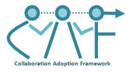





Tools / Frameworks / Accelerators
Collaboration Adoption Framework (CAF) is a framework covering end-to-end strategic and operational perspective of Office 365 implementation in an Enterprise through unique quantitative fashion
SharePoint Modernization Suite is a
Framework to take SharePoint environment to Cloud (SaaS) i.e. Office 365 in a systematic and guided way
Gamification Is a mechanism of using game Mechanics in Non-Gaming environments to improve “Efficiency”, “Engagement” & “Motivation” to meet “Desired Outcomes”. Gamification employs game concepts to engage users and change behaviour by changing habits..
Virtual Assistant is used to carry out routine tasks that require limited intelligence.
Efficient and fast in executing routine tasks.
Efficient in digging historical data, logs.
Proactive information delivery
Work over various channels.
Knowledge Exchange Framework (KxFrx) offers end-to-end Knowledge Exchange strategy and implementation covering Knowledge Element Management, Knowledge Governance, Knowledge Exchange Plans & Strategy, Knowledge Exchange Performance Monitoring etc.
All to Cloud is a multi facade end-to-end solution to migrate files from on premise file share or Office 365 (SP Online and One Drive for Business)
+ Other Reusable Assets / Accelerators

Slide 15


HCL’s O365 Support Model
End Users
HCL O365 Admin team
Phone Skype, messenger web-chat
Call, Email
SMS
Chat
Service Desk log a calls, assigns the ticket to the HCL’s O365 admin team and sends an email Notification
Devices & Clients
Work upon tickets triaged from service desk and alerts
Service Desk
Service Desk
Ticket
HCL O365 Admin team
Email/Call/Chat
Monitor alerts and take appropriate action
Service Management Tool
Events
Events
Share usage and quality reports with the management
Users & groups
Website
Application
Storage
Access
License
Office 365
Escalate tickets to Microsoft and other third-Party Vendors
Security & Compliance
Mail
Content
updates
Backup
Training
Security & Compliance
Follow up with the third party vendors and drive resolution
Third-Party Vendors
Monitoring & Reporting
Microsoft Tools
Management Tools
Security solutions
Backup solutions

Slide 16

Support Flow
START
Issue logged by the user
Issue addressed by L1 support.
Mix of O365 Admin Engineers
Yes
Yes
Issue resolved ?
No
Connect with O365 COE and Experts
No
Issue addressed by L1.5 or L2 support.
Document & Knowledge Base made available by O365 CoE
Customer satisfied with response?
Yes
Issue resolved ?
No
Helpdesk Tool with Process Management
Issue addressed by L3 support + HCL CoE
Yes
Yes
Issue resolved ?
No
Knowledge Management Tool for Faster Discovery of O365 Solution
STOP
Support team updates case logs and closed the ticket
Issue escalated to Microsoft support

Slide 17
Categories of Support – L1-L3
Classification | Definition | Samples
L1 | Service Desk Event management Information gathering | ‘How to’ queries like configure Voicemail, sign-in to mailbox, sync OneDrive files, create and join Yammer groups. Add new channels in MS teams etc. Login issues General Information
L1.5 | Low Complexity Incident & Service Request Fulfilment Batch Monitoring | SOP and KEDB based issue resolution Access & Login issues Sync issues Add/upload documents Skype features Update profile information. Mailbox quota
L 2 | Medium to high Complexity Issues/Incidents and Service Request management. Incident Management Service Request Fulfillment Problem Management Change Management Availability Management Configuration Management License Management | O365 feature not working Search not working Email not delivered. Poor call quality. Workflow is not working Unable to schedule or join a meeting Site not accessible. Online presence not displayed
L 3 | High complexity Issues, changes & configurations High impact, high risk changes License optimization | Multiple sites down. Unable to access O365 resources Users unable to make Skype calls Emails not being delivered. Noticeable performance issues Reports not working

Slide 18




Key Support Roles for O365
Roles | Responsibilities
Team Lead | Monitor and guide the HCL support team Enhance the support functions and continually analyze to improve/optimize further Analyze Change Management process & Global Administration tasks To interact with business users to understand reported tickets where required Ensure Service quality and SLA compliance. Responsible for all the deliverables associated with incidents, errors & service request Interact with business to ensure proper change management Attend, chair team meetings Provide technical guidance and mentorship to the team members Task Management Communication with Customer contacts and clarifications of all issues Status tracking of all HCL Support related activities Implement and monitor processes compliance across the tasks Prepare / Review / Update KEDB, Technical, Functional Documents Co-ordinate with Customer/Product Vendor(s) where required. Support and monitor Incident, Service and Change Management activities Keep track of changes in Microsoft roadmap.
Office 365 Administrator | Setup, configuring, maintaining and managing Office 365 tenant. configuring Office services and components, enable or disable O365 features Assign user license for O365 services. Creation and management of sites, mailboxes, user accounts. Assignment of required permissions for all users to Office 365 resources. Planning, co-ordination and communication for maintenance activities. Responsible for monitoring and reporting activities. Issue resolution through the incident management process. Service request fulfilment through the Service requests management process. Providing resolution with in the agreed SLA ,dispatching Incidents to appropriate teams Attend support related calls / meetings Co-ordinate with Help Desk and concerned Customer IT teams Participate in L2 Support Activities & or L3 coordination activities as appropriate Prepare / Review / Update KEDB, Technical, Functional Documents Participate in Change Management activities where applicable

Slide 19
Key Support Roles for O365
Roles | Responsibilities
O365 Consultant | A techno functional consultant with rich experience on Office 365 solutions. Understanding Customer’s business processes for in-scope applications. Understand Customer’s existing O365 environment and applications and use it in the support processes Understand Customer’s existing support functions and continually analyze to improve/optimize further Understand Incident and change Management process & Global Administration tasks Understand the Responsibilities of all the deliverables associated with incidents, errors & service request Participate in the O365 planning and setup activities. Review license usage reports and advise on license optimization. Prepare / Review / Enhance KT, KEDB, Technical, Functional Documents Co-ordinate with Customer/Product Vendor(s) where required. Participate in Change Management activities where applicable. Understand the existing process to Keep track of changes in Microsoft roadmap. Participate in the impact analysis of the change for the Customer implementation and business and inform Customer. Participate in the Root Cause Analysis of critical incidents and outages.

Slide 20
Automated assistant for O365 – what it does
Execute tasks
Fetch reports
Get help
Get access to common Solutions
Get process information
Investigate issues
Seek Approvals
Get Monitoring reports
Schedule tasks
Provide real-time information
Get Intranet updates
Get latest announcements and news
Apply for leave & reimbursements
Create a ticket
Access and update critical tasks
Set Out of Office
Automated Assistant
Users

Slide 21
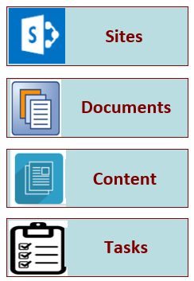




Automated assistant for O365 – how it works
Office 365
Travel
Leave
Help desk
Policies hub
More…
Users
BOT Connectors
BOT Service
Business Apps
Messaging Channels
Exchange, Skype for Business, SharePoint OneDrive for Business, Yammer, Delve

Slide 22
HCL’s O365 support - What to expect
Direct contact with the support team through phone, email and chat
Admin support and management of your O365 environment
Expert help with setup, configuration and issue fixing
Access to our knowledge base and help portal
24/7 support with SLA
Root cause investigation for outage and performance issues
End to end support for all components of O365 (Exchange, SharePoint, Yammer, Skype for business etc.)

Slide 23
Key benefits to the client
Reduction in license cost
Avoidance of compliance & regulatory issues
Risk Mitigation
Optimized usage of Office 365 features
Application integration and orchestration
Process simplification and automation
Support Cost Optimization
Enhanced End User Productivity
Professional support for emergency situations
Support for the distributed workforce
Better user experience
Increased process compliance

Slide 24
Our differentiators
15+ year old practice with over 300 global projects successfully executed
Expert team in all aspects of O365 administration and management
Faster resolution of tickets and proactive Issue Identification
Support latest communication channels
Comprehensive repository of tested frameworks, artifacts & reusable assets
Documented challenges, known issues, solutions and workarounds
Minimal Business Disruption
In-house knowledge repository of FAQ & knowledge base
Ticket handling through automated assistant
Gold partnership with Microsoft for quick support on product issues

Slide 25
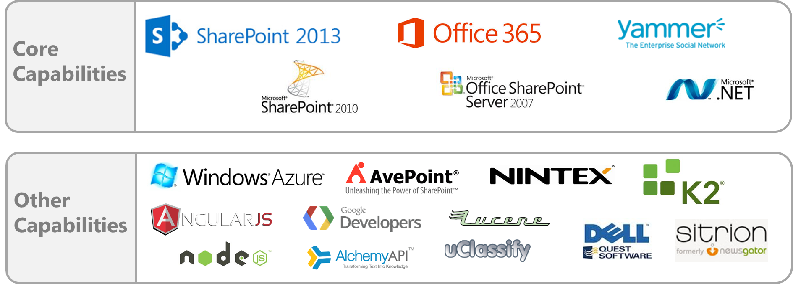























































































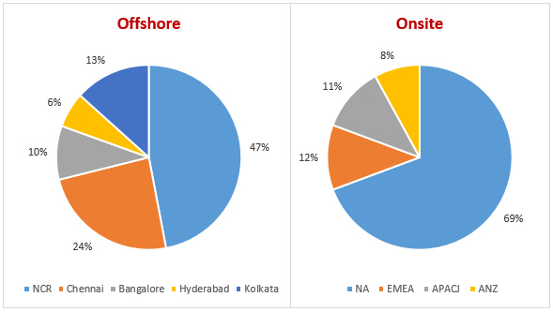
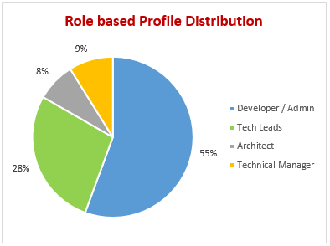

Practice Overview
Overall Headcount – 850+
20+ Yrs. ECM Exp.
10+ Yrs. SP Exp.
3500+ PY of Exp. In SharePoint alone
Knowledge of product limitation better to design perfect solution
Optimal sync between business & technology

Slide 26

Relationship with Microsoft
Part of SharePoint Partner Advisory council (PAC)
One of the 28 Global alliances managed by global alliance group of MS
One among six managed Global System Integrators for MS Dynamics
Business Partnership in areas such as Dynamics CRM, SharePoint and Win7, Azure across geographies
Structured training. Over 12000+ Microsoft professionals at HCL
Customer Experience Management Solutions – FinEdge CRM for Retail Banking, Insurance and Payer
GamEdge – CRM for Gaming Industry developed over Dynamics CRM
UCM tool for content migration from one platform to another platform
Xpress Migrate frameworks for migrations to Win7
Dot Net based solution for Loan Origination.
Azure based solutions
IP’s and Framework
Development
OEM Partnership
HCL as a Customer
Partner Advisory
Go To Market
Both HCL companies – HCL Info systems and HCL Technologies run on MS Product Suite
MS Academy for Product and Services Engagements
Product Development and Service Support center at USA, UK, India
Microsoft SharePoint Online Code Analysis Framework (MSOCAF)
Self Service Portal – Automates the process for service requests for SharePoint Online environments
End to End Services includes implementations, rollouts, upgrades and migration covering OS and Office, SharePoint, Dynamics CRM & AX, Azure, Office 365
Vertical solutions across Banking, Insurance, Healthcare – Payer – FinEdge Suite , Retail, Manufacturing
Horizontal Solutions across Share Point, Win 7 migrations
TAP Partner in key areas
PEAT Support in Proposals & Projects
HCL is one of the largest OEM Partner of Microsoft
R&D Partnership across products in the MS Stack
Services to MSIT across Infrastructure, CRM and other key applications
HCL is a key EA customer of Microsoft
HCL Training Academy enables internal training and certifications across the Microsoft stack
HCL Internal Productivity Platform, Collaboration and Wiki Portal run on Microsoft technologies

Slide 27
.
Case Study 1: Leading Manufacturer of toys, Denmark
Customer Profile
Client is a leading manufacturer of toys and teaching material for children. The customer headquarters is at Denmark.
Domain
Hitech and Manufacturing
Business Area
Admin Support & Maintenance
GEO
Europe
Support Type
Support and Maintenance of Office 365
Project Description
The objective is to support and maintain the Intranet and extranet sites hosted on Microsoft Office 365, SharePoint 2013, SharePoint 2010 and MOSS 2007 and provide quality of service to the client’s end users.
Migration of the sites to O365 in an efficient manner with minimal downtime and user impact.
O365 admin support for 300+ sites with 1+ TB data (~4TBs of data including OneDrive for business)
Sites accessed by different business units like Corporate IT, Education, Marketing, Brand development etc.
O365 roll out to other business units and departments is in the pipeline.
HCL’s Solution
Provide Admin support for sites hosted on O365 and SharePoint 2013 along with the development of new functionalities and migration to Office 365.
Optimization of processes by implementation of governance and information architecture.
Implementation of new solutions like Marketing Hub, Legal portal and promotion ticketing to add more value to business.
Expert and dedicated team consisting a project manager, Senior Technical lead, Lead and support engineers.
Challenges
Uncontrolled growth of data and unused sites\content resulting in extra storage costs, findability issues and compliance issues.
Collaboration and ownership issues between support teams in supporting functionalities that involves multiple tracks e.g. MS teams involving components of SharePoint, Exchange and Skype for Business.
Limited backup capabilities and reverse migration in Office 365. .
Benefits / Value Added
Overall increase in efficiency and productivity of the system and processes.
Provided value adds in order to achieve business benefits, including the proposal of an app to locate the stores for a particular product. Which would also help in better reporting and insights.
Developed tools and utilities to better manage the O365 environment.

Slide 28
Case Study 2: Resource & Energy Major, Australia
Customer Profile
The client is Australia’s one of the most reputed engineering companies. It delivers projects, provides expertise in engineering, procurement and construction and offers a wide range of consulting and advisory services. Company has about 20k employees all over the globe and has offices in all major countries.
Domain
Resource and Energy
Business Area
Admin Support and Maintenance
GEO
AUS and USA
Support Type
Support and maintenance of SharePoint Online, SharePoint 2013, SharePoint 2010 and Moss 2007.
Project Description
Support and Maintenance of the Moss 2007, SharePoint 2010, SharePoint 2013 and SharePoint online Production environments. The Intranet Portal & various other applications ate hosted on the SharePoint Online.
Support for the SharePoint video portal and Power BI and other Office 365 tools.
Supporting a total of 5000+ sites with 120 site collections, 10 TB content with a user base of 20k users.
Support for both Intranet as well as Extranet sites.
HCL’s Solution
Provide Application & Platform Support and Management, which includes availability, capacity planning, maintain the business continuity and business stakeholder management
Offshore team is divided into two categories – Application Support and enhancement & Platform Support
Platform Support team supports for the all the production environments & the application support team provides support and enhancement development capabilities in SharePoint 2013 and SharePoint online.
Challenges
Governance in SharePoint Online
SharePoint online backups
Automated tools for SharePoint monitoring is not available e.g. SCOM
Analyzing the impact of an enhancement for live applications.
Resource availability for different technologies.
Benefits / Value Added
HCL is helping the client in migrating data from obsolete platforms to SharePoint online which helped them in reduction of maintenance costs of by 50-60%
Helped the client in setting up hybrid environment in SharePoint on-premises and SharePoint online
Stabilized the SharePoint environment resulting in reducing the ticket count from 550 service request a month to 400 a month
Implemented automation of Site creation in SharePoint online
O365 Message center integration with Dashboard.

Slide 29
Appendix

Slide 30
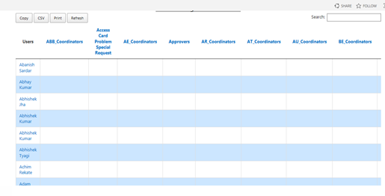
Access Management Dashboard
Business Needs
Need to have a list of all users/groups with access permissions on sites and lists
Solution and Benefits
Sandbox solution implemented using REST, JQuery and HTML
User don’t need to be go to multiple places to know users and groups on the site
User is able to check unique access permission details on site and its child object using this dashboard
Ability to export in CSV format
Ability to print dashboard

Slide 31
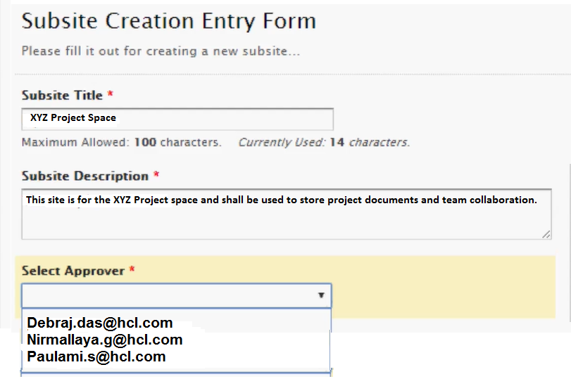
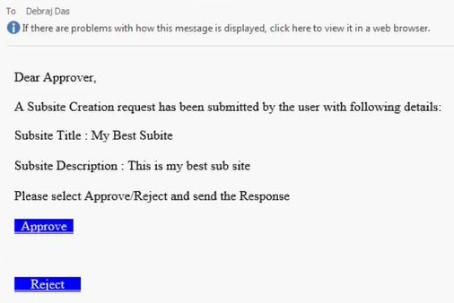
Automated Site Provisioning
Business Needs
Quick and easy provisioning of SharePoint sites through automated approval mechanism
Solution and Benefits
Rule based provisioning of sites based on user form submission.
Site approval goes through an automated enterprise email based approval
Site gets provisioned in matter of mins.
No admin intervention required for the site provision.
Site quota, site owners , site template etc. can be set as per governance policy.

Slide 32
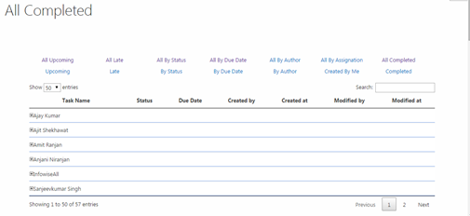
Approval Dashboard
Business Needs
Ability for end users to view all assigned tasks
Solution and Benefits
Sandbox solution implemented using REST, JQuery and HTML
Aggregated view of all tasks assigned to a user in a site collection (sites and its sub-sites)
Ability for user to take appropriate action without opening corresponding task lists

Slide 33
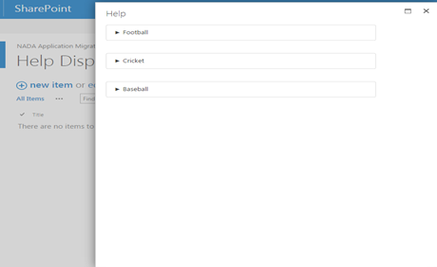
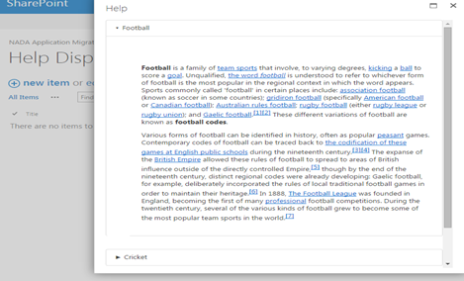
Help Manager
Business Needs
Custom help functionality to help end users understand the functionality
Solution and Benefits
SharePoint 2013 Site Collection help feature with custom FAQ templates and custom JS
Complete content help solution for SharePoint users
Content Help in titles view
Reduced training effort and reduction in support tickets

Slide 34
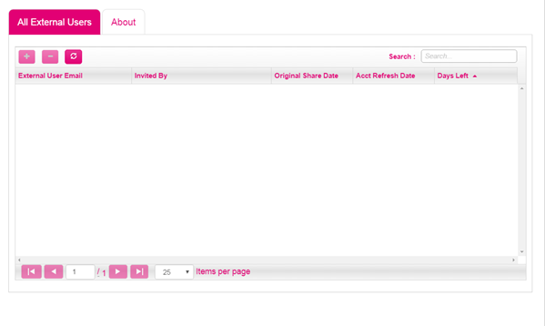
Governance App
Business Needs
Ability to manage external users access on a site collection
Solution and Benefits
Provider hosted app with Azure Web Jobs for Notification
App to keep track of external sharing of users on a site collection for limited period of time
Sends Notification to admins with list of users whose expiration date is approaching
Automatic removal of external users after expiration date is arrived

Slide 35
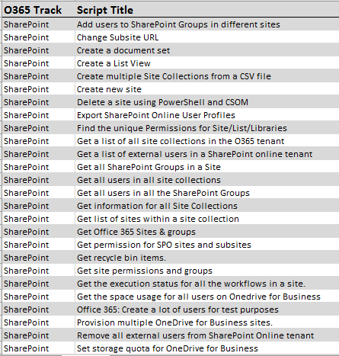
Scripts Repository
Automating the configuration, management and monitoring of Windows Servers, companies can decrease the time IT workers spend on manual maintenance.
Business Needs
Solution and Benefits
Set of readymade PowerShell Scripts that helps in automating tasks and admin activities in a project
Helps reduce effort for admin, support & implementation teams

Slide 36
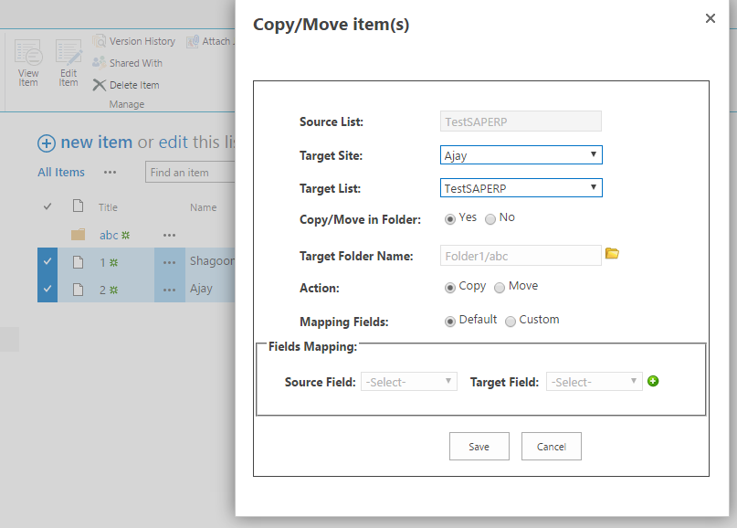
SharePoint Content Transfer
Business Needs
Ability to copy and move item from one list to another list
Solution and Benefits
JSOM based solution to copy and move item between lists
Ability move item from one list to another list
Ability to copy item from one list to another list

Slide 37

Alt- ASM
HCL’s philosophy of ASM: ALT ASM takes you to the next generation in application outsourcing
Traditional ASM
ALT ASM
Technology aligned silos leading to reduced efficiency as # of apps increased
Business Aligned Target Operating Model for
increased engagement Efficiency
Reactive IT leading to poor Agility
Proactive problem management and service request management leading to increased Agility
Increased risk with limited ability to support dynamic business demand
Flexibility in staffing educing the risk of business fluctuation
IT led KPIs; IT focused on run the business
activities
Business Led KPIs: IT focused on Business Advantage
Stagnation in operational gains due to effort driven cost management
Committed Operational Gains from year 1 with optimal service levels through LEAN and ITIL processes

Slide 38
HCL’s Transition Framework - ASSeT™
Total 350+ transitions done using ASSeT™
90+ transitions in past 2 years from other service providers
96% transitions in the past one year have been completed within 5% schedule variance
98% HR transfer offer acceptance rate
Visibility
  Into business processes and associated technology landscape that enable those processes
  Application portfolio classification (Complexity, Stability, Longevity, Criticality)
Velocity
  Scientific approach to Knowledge Transition planning, execution, monitoring & risk mitigation
  Real time Transparency of operations
Value
  Targeted approach for minimal business disruption
  On time transition with improvement opportunities for Steady State
Toll Gate based
Minimal Business Disruption
Foundation for IT Transformation
Independent Audits

Slide 39
ASM Operations Framework
Discover
Plan & Design
Transition
Steady State
Continuous Improvement
Define O365 Operations Strategy
Identify O365 Services Needed
Define Service Levels
Define support boundaries
Plan for Communication
Plan Governance
Plan O365 Policies
Plan Budget & Finance
Identify Team Resources
Scope & Vision Identification
Design Service Delivery
Determine Areas Requiring Policies
Identify Environments & Applications
Discover Existing SLAs (if any)
Transition Planning & Support
Incident Management
Change Management
Configuration Management
Problem Management
Release Management
Service Validation
Evaluation
Knowledge Management
Maintain O365 environment
Support Users & Manage Incidents
Manage Change Requests
Manage Problems
Regular monitoring and reporting
Establish Governance
Monitor Service Performance
Identify Improvements
Implement Improvements
Manage Roles & Responsibilities

Slide 40
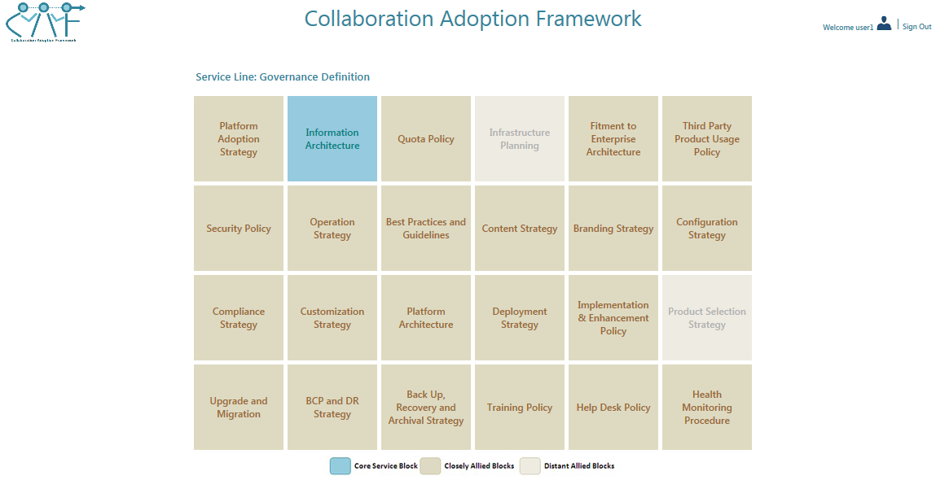
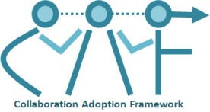
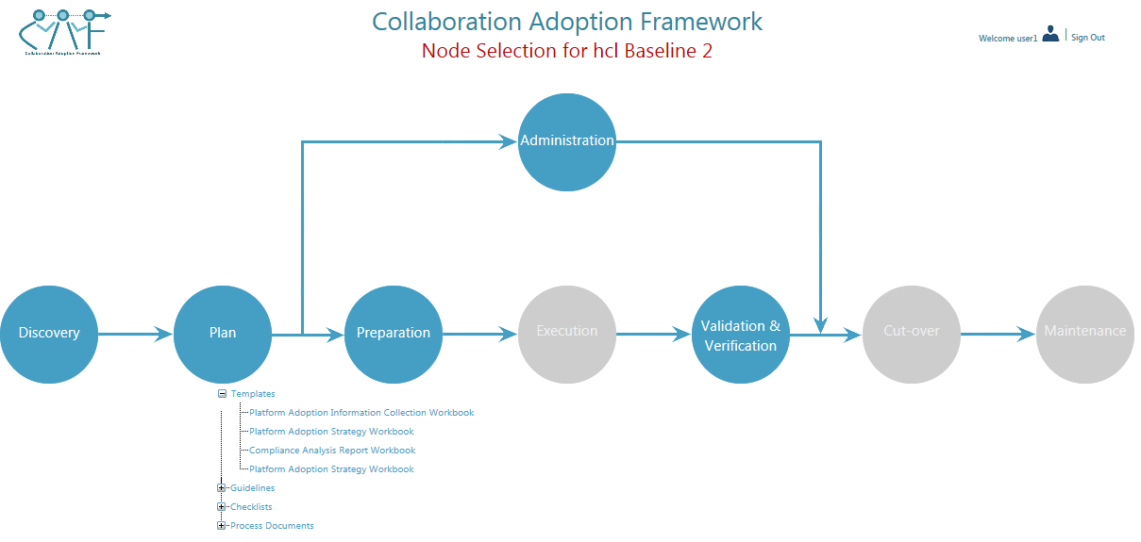
Operational Governance Services
Offering Summary
Execution of activities around Governance set up and regular related activities including Setup, configuration, communication and management, overall delivering an end-to-end guidance to Governance Design, Implementation and Maintenance.
Key Features
Covers SharePoint Governance under 3 segments – Information Governance, IT Governance, Application Governance – around 120 Governance areas are covered under these 3 categories
Scope of activities limited to the role designated to the executor
Often executed following Strategic Consulting or SPCoEaaS
Approach / Methodology

