Slide 1
Application Lifecycle Management – Best Practices for SharePoint and Office App development
November 2015

Slide 2
Agenda
1
Application Lifecycle Management
2
Continuous Integration
3
ALM with TFS
4
Development Components
5
Deployment Approach
6
Testing Process

Slide 3
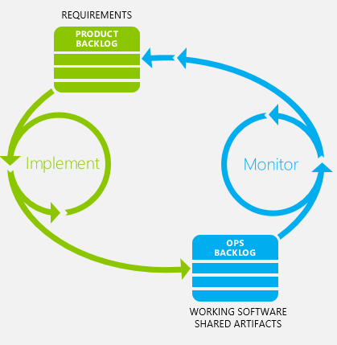
Application lifecycle management
Requirements definition
Architecture planning
Development
Testing
Continuous integration
Change management
Release management
Monitoring and feedback
Maintenance

Slide 4
Agenda
1
Application Lifecycle Management
2
Continuous Integration
3
ALM with TFS
4
Development Components
5
Deployment Approach
6
Testing Process

Slide 5
Previous challenges of build
Needing SharePoint binaries on the build server
Continuous integration hard to script for both VSTO and SharePoint server side code

Slide 6
Visual Studio Online Build Engine
Define builds for CI, test and deployment builds
New browser based build system allows more flexibility in approaches

Slide 7
Continuous Integration-SharePoint Hosted App
Visual Studio
online(browser based build system) or TFS
Storage of the source code
Automated builds
Coded UI / Build verification Tests
Deployment automation with PowerShell and build definitions
SharePoint Online
Testing tenant or isolated
site collection in production depending on app functionality
1
4
2
3

Slide 8
Continuous Integration Provider Hosted App
SharePoint Online
Testing tenant or isolated
site collection in production depending on app functionality
Visual Studio
online or TFS
Storage of the source code
Automated builds
Coded UI / Build verification Tests
Deployment automation with PowerShell and build definitions
4
1
5
Microsoft Azure
Provider hosted code is
deployed as automated process to the cloud platform
2
3

Slide 9
Agenda
1
Application Lifecycle Management
2
Continuous Integration
3
ALM with TFS
4
Development Components
5
Deployment Approach
6
Testing Process

Slide 10
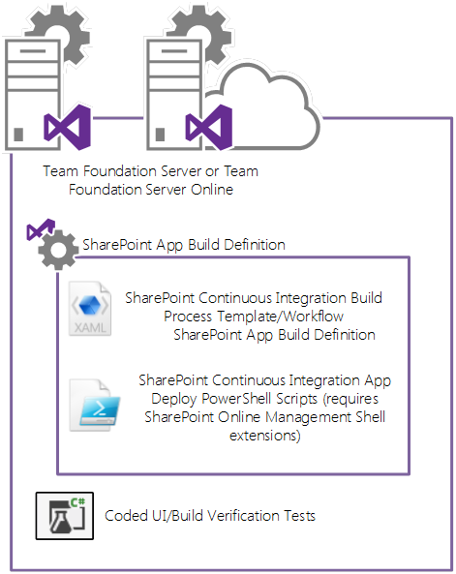
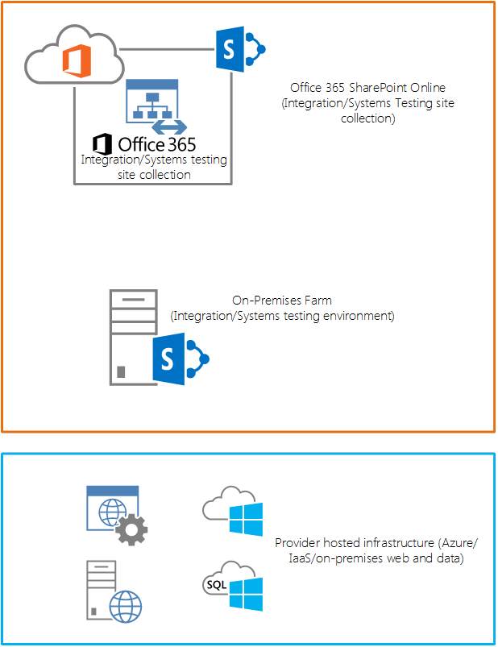
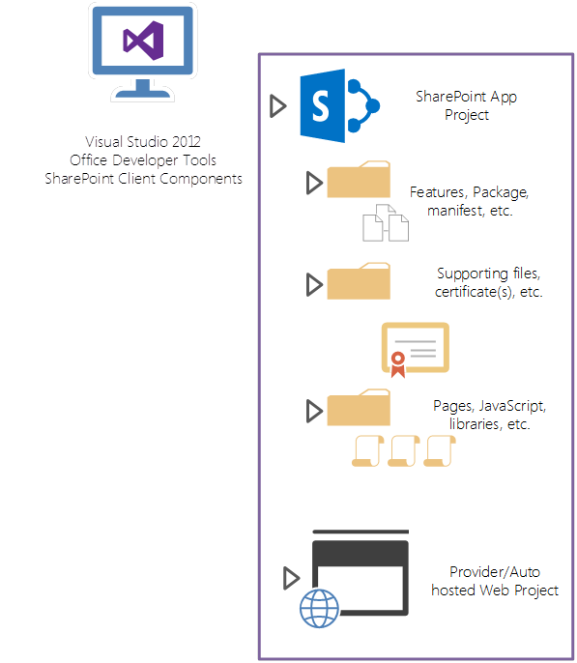
ALM with VS TFS
App Trust Level Approval
Check in to TFS
Trust Execution

Slide 11
Agenda
1
Application Lifecycle Management
2
Continuous Integration
3
ALM with TFS
4
Development Components
5
Deployment Approach
6
Testing Process

Slide 12
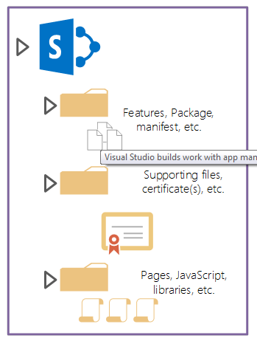

Development Components - I
SharePoint Hosted App
Visual Studio 2013
Office Development Tools
SharePoint Client Components

Slide 13
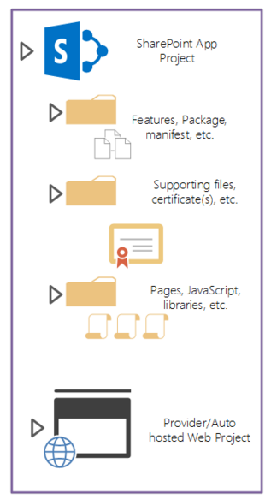
Development Components - II
Provider Hosted App
Visual Studio 2013
Office Development Tools
SharePoint Client Components

Slide 14
Single Tenant Based Approach (3 different Site Collections)
ADFS integration with O365 using DirSync Tool [Sync only Single Tenant]
Yammer Enterprise integration with O365
DAM integration with O365 (if required)
Nintex Workflow Online integration with O365(if required)
Client
Dev
(dev.xxx.com)
Test
(test.xxx.com)
Production
(prod.xxx.com)

Slide 15
Pros and Cons of Single Tenant
Easy to deploy from one site collection to another.
In this approach, all site collections like Dev/QA/PROD in same tenant and there is no isolation and it is not suitable if we have provider hosted app.
An App catalog will be shared across the site collections, an any update to app may impact the other site collections as well.
DirSync tool is available only for syncing AD server to single tenant. But there is some improvements available over AADirSync and by using tool, we can synch single AD into multiple tenants.

Slide 16
Multi Tenant Based Approach (3 different Site Collections)
ADFS integration with O365 Multi Tenant using AADirSync Tool
Yammer Enterprise integration with O365
DAM integration with O365 (if required)
Nintex Workflow Online integration with O365(if required)
Client
Dev
(dev.-tenant.xxx.com)
Test
(QA-tenant.xxx.com)
Production
(Prod-tenant.xxx.com)

Slide 17
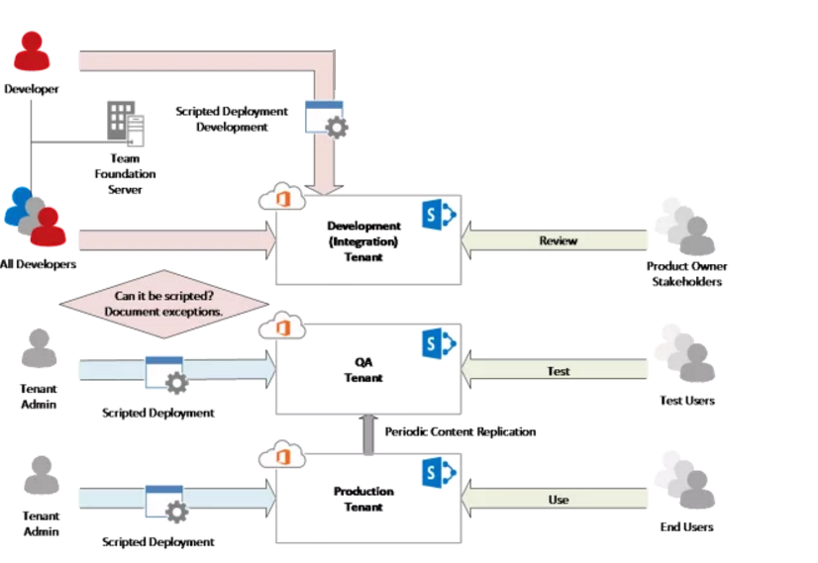
Multi-tenant based Development/Deployment

Slide 18
Pros and Cons of Multiple Tenant
Syncing Dev/QA/Prod tenant is quite complex.
Consistent development and isolated environment
If user access from multiple regions, Microsoft built the consistent way to access the site to load and perform faster.
In this approach, all site collections like Dev/QA/PROD in different tenant and there is isolation and it is also suitable for provider hosted apps.
Using AADirSync tool, single AD server can sync with multiple tenants.
Keeping developers out of Production tenant is a key principle for stability
Isolating tenants in this way that it ensures no global configuration changes during development impact production.
Search Scope / crawl will not impact the other tenant.
Good for Build / Release management

Slide 19
Agenda
1
Application Lifecycle Management
2
Continuous Integration
3
ALM with TFS
4
Development Components
5
Deployment Approach
6
Testing Process

Slide 20
Deployments for Office and SP add-ins
Provider hosted add-ins can be deployed to Azure websites / OnPrem Server
Deploy script resources for all add-in types to websites or CDNs
Use different websites or deployment slots for dev and test purposes

Slide 21
Deployment Approach in SPO(1 of 2)
1) Using Microsoft PnP Engine
    Customize the site using SP Designer/Browser and then using PnP Provisioning Engine for moving the customizations from Dev to QA/Prod. Office PnP team released Provisioning engine to move customization from one Site Collection to another.
Microsoft PnP Engine
Dev
QA
Prod

Slide 22
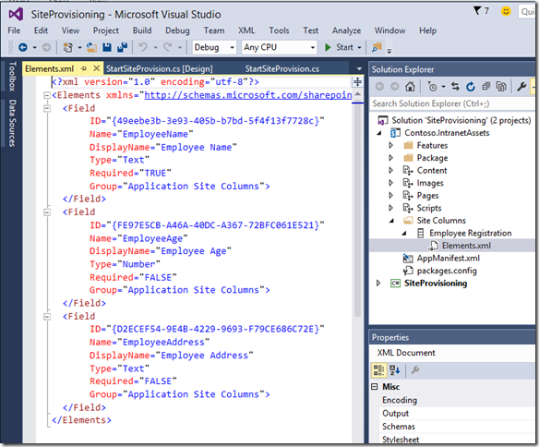
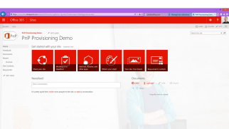
Deployment Approach in SPO(2 of 2)
Remote Provisioning using CSOM
  A custom utility (CSOM) / PowerShell script to provision the elements(like Lists/Library/Pages/Content Types et) from one environment to another environment.
Dev
QA
Prod

Slide 23
Agenda
1
Application Lifecycle Management
2
Continuous Integration
3
ALM with TFS
4
Development Components
5
Deployment Approach
6
Testing Process

Slide 24
Quality Assurance environment
SharePoint Online
Testing tenant or isolated
site collection in production depending on app functionality
Microsoft Azure
Provider hosted code is
deployed as automated process to the cloud platform / OnPrem Server

Slide 25
Testing process in high level
SharePoint Online
Testing tenant or isolated
site collection in production depending on app functionality
Execute Tests
<<deploy app>>
C#
3
<<deploy app>>
1
2
Microsoft Azure / OnPrem
Provider hosted code is
deployed as automated process to the cloud platform / OnPrem
4

Slide 26
Testing with multiple environments
Integration testing
Isolated separate tenant
or site collection depending on the app specifics
For frequent automated testing
Visual Studio
online or TFS
Storage of the source code
Automated builds
Coded UI / Build verification Tests
Deployment automation with PowerShell and build definitions
2
<<deploy app>>
3
Build definition
User acceptance /
Quality assurance
Isolated separate tenant
or site collection depending on the app specifics
For user acceptance before production usage
1
<<deploy app>>
Release manager
4
5

Slide 27



