Slide 1
SharePoint Online
Development
Best Practices
November 2015

Slide 2
Agenda
1
Best Practices for Add-In Model
2
Best Practices – SPO Development
3
Business User Driven Template
4
CSOM Based Customization Strategy Checkpoints

Slide 3
Best practices for add-in model
#1 – Use remote provision for site template and to push configurations to sites
#2 – Avoid custom master pages, if possible
#3 – Avoid feature framework and sandbox solutions
#4 – Use “remote timer job” pattern for scheduled and batch operations
#5 – Take advantage of the add-in model in both on-premises and in Office 365

Slide 4
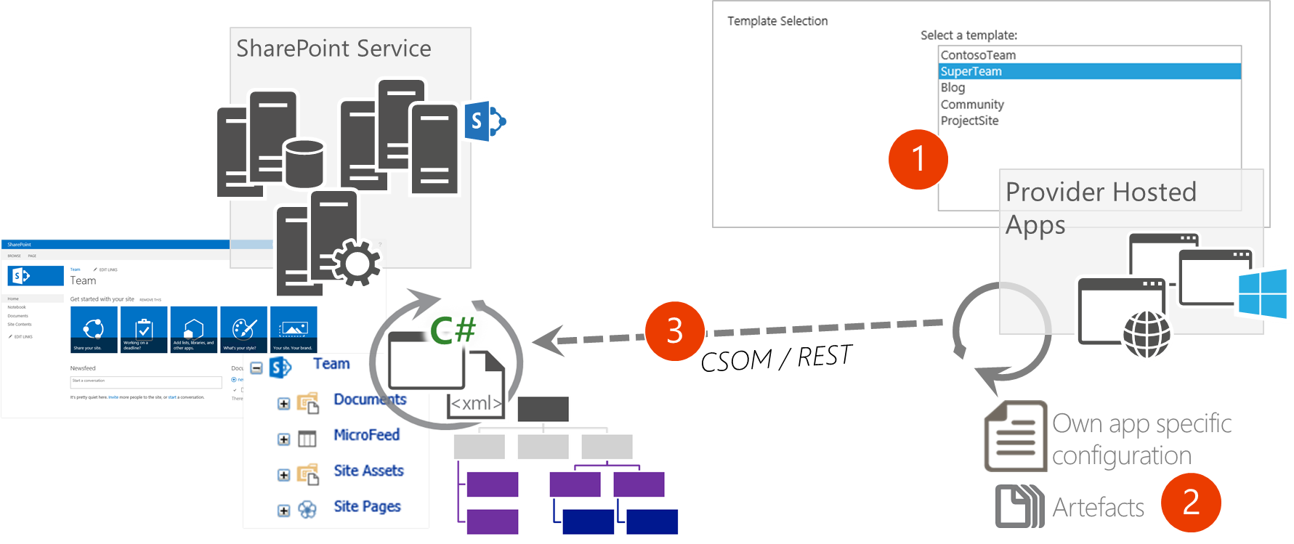
#1 – Remote provisioning
Provision site collections and sub sites remotely to provide different templates
Provider hosted, PowerShell, Console applications
All artifacts and customizations are pushed to the sites using remote APIs

Slide 5
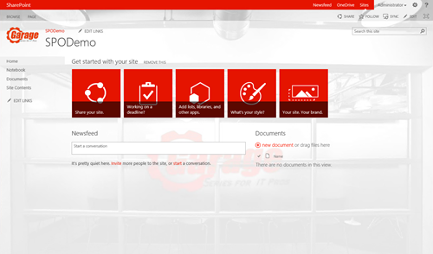
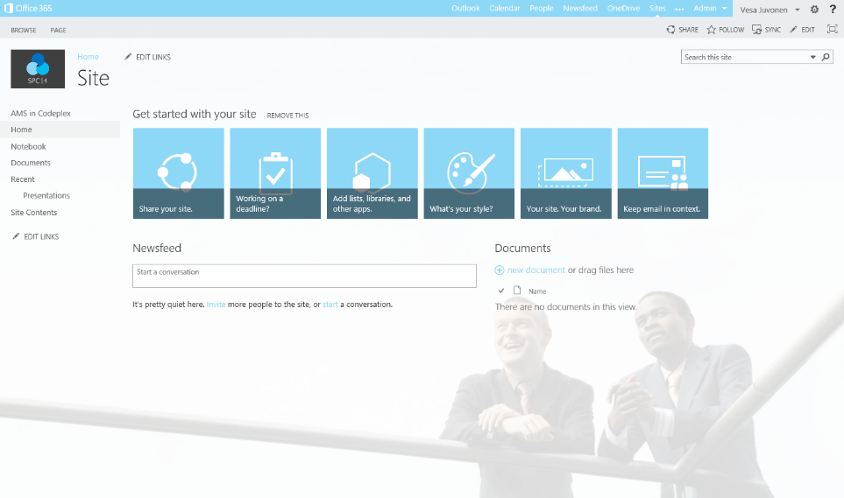
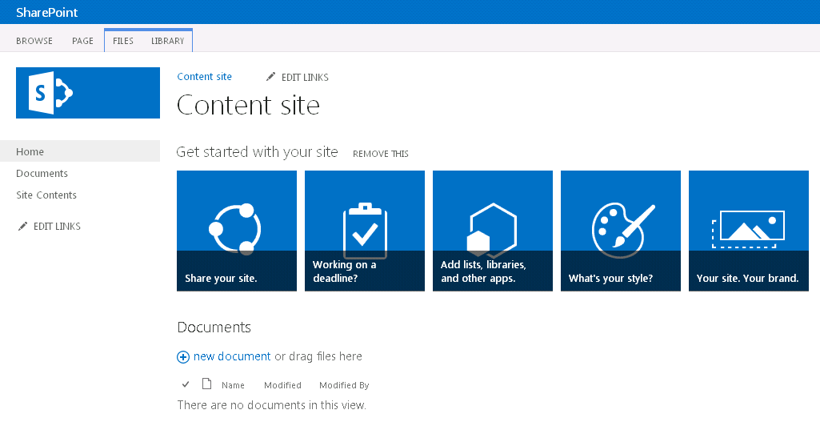
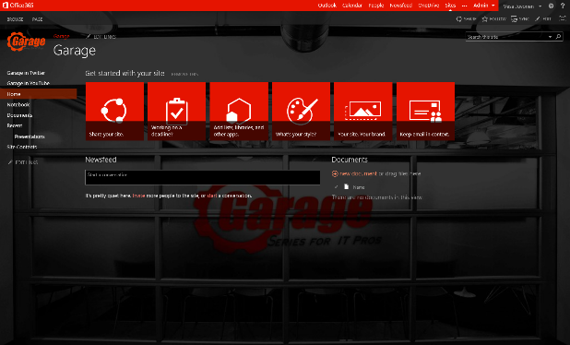
#1 - Provisioning time logic
  Initial provisioning based on the out of the box site. Usually either team site or publishing site.
  Assets are uploaded from the provisioning engine using CSOM/REST
3
Project site
1
Remote timer job
2
3
Organizational
Assets and config.
  Apply the needed changes (configurations etc.) on top of the out of the box site based on the user selection.
  This is the specialization part, but since we start from oob site, we always get the latest improvements to it as a base line.
Branding Images
JavaScript files
Page Layouts
Other settings
3
Workgroup

Slide 6
PnP Provisioning Engine
Framework for easily doing Remote Provisioning
Part of the OfficeDev PnP Core component
Object oriented engine for easy and fast Remote Provisioning Capabilities
Automated Remote Provisioning
Easy Site Template Generation/Extraction
Available in Microsoft .NET
There are PowerShell extensions for common tasks
Export/Import of templates in a formatter-independent manner
XML Schema
JSON
Whatever else…

Slide 7

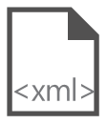
Site provisioning framework
C#
// Get template from existing site
template = ctx.Web.GetProvisioningTemplate();
1
XMLFileSystemTemplateProvider
Site A
2
// Save template using XML provider
XMLFileSystemTemplateProvider provider =
new XMLFileSystemTemplateProvider(@"c:\temp\", "");
string templateName = "template.xml";
provider.SaveAs(template, templateName);
// Load the saved model again
ProvisioningTemplate p2 =
provider.GetTemplate(templateName);
Connectors
3
XMLAzureStorageTemplateProvider
4
// Apply template to existing site
ctxTarget.Web.ApplyProvisioningTemplate(template);
Site B
XMLSharePointTemplateProvider

Slide 8

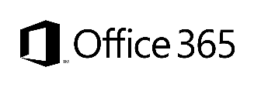
#2 - Branding
Custom Master Page
Alternate CSS
Theme
Office 365 Themes
  Full control on how the site is rendered
  Applied to each site, except for publishing sites
  Any updates to oob master pages are not automatically reflected on the sites
  Possible challenges with service updates
  Can be used to override whatever CSS settings
  Control to color, fonts and even layout settings
  Configuration applied to each site
  Can be used to control branding, fonts and background image of the sites
  Configuration applied to each site
  Can be used to centrally control branding cross all services in the Office 365
  Limited settings currently
  Can be overridden in site level
  Only in Office 365, not in on-premises
Options
Support
only
Unlimited
Good
Average
Fair
Flexibility

Slide 9
#3 – Avoid sandbox solutions
Code behind sandbox solutions are deprecated
No centralized control for sandbox solutions
No enterprise level capabilities for controlling available solutions
Possible orphan issues with deactivation
  Still based on feature framework with it’s caveats
  “We deployed custom default.aspx and now things are broken”
Update operations will require code anyway

Slide 10
#4 - Remote timer job
  Scheduled execution which accesses the needed resources from the SharePoint service and performs the required automation.
  Can use either specific account for connection or oAuth based app-only token approach
SharePoint
Service
2
Provider Hosted Apps
1
Remote timer job

Slide 11
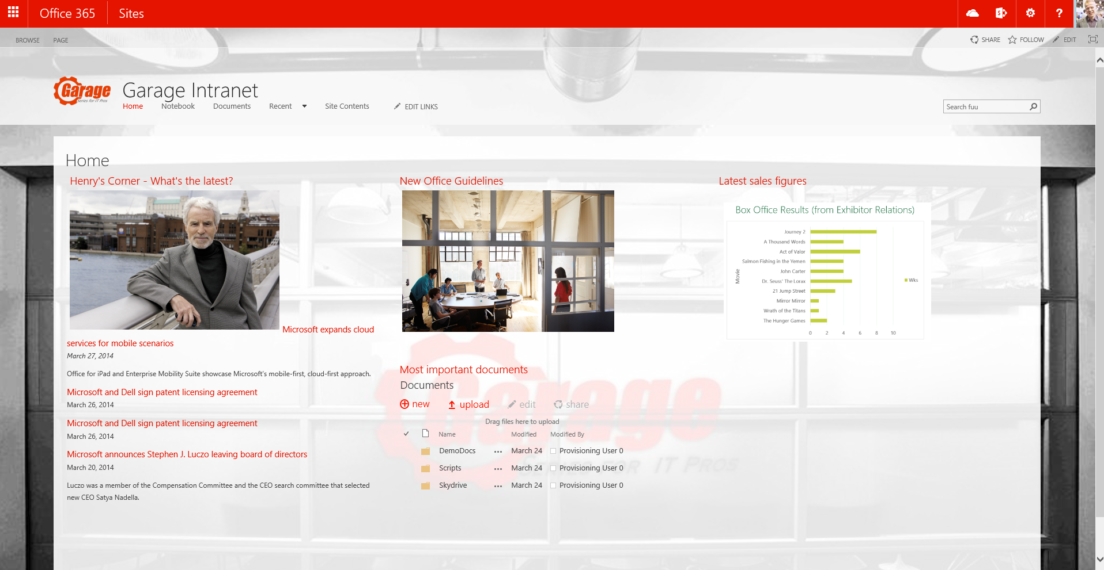
#4 - Asynchronous pattern with WebJobs
Provider Hosted Apps
2
SharePoint
<<Run app functionality>>
<<Add message>>
Storage
Queue
1
3
<< Perform needed actions>>
WebJob
<<instantiate>>
4

Slide 12
#5 – Add-in model for on-premises
Write once, use it in both worlds
Add-Ins recommended model for on-premises as well
Add-in development can be similar as with Office 365 with one time configuration for local farm
No additional headaches with certificates and developers do not need to understand insights of token model
Provider hosted as the preferred model
Requires 2 new servers like Office Web Apps since SP2013 release

Slide 13
Agenda
1
Best Practices for Add-In Model
2
Best Practices – SPO Development
3
Business User Driven Template
4
CSOM Based Customization Strategy Checkpoints

Slide 14
Best Practices - SPO Development

Slide 15

Remote timer job
  Scheduled execution which accesses the needed resources from the SharePoint service and performs the required automation.
  Can use either specific account for connection or oAuth based app-only token approach
SharePoint
Service
2
Provider Hosted Apps
1
Remote Timer job

Slide 16
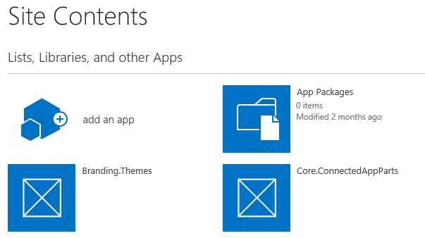
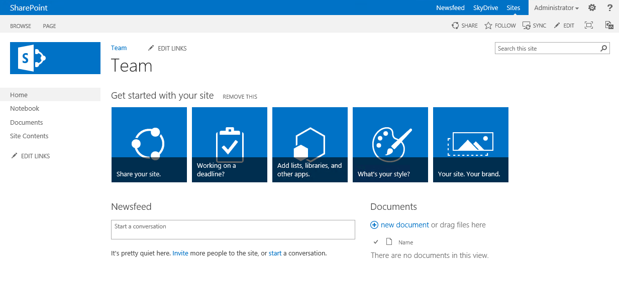
Page Modification
  Execution of the needed modifications based on needed event. Can be done based on app installed, part of provisioning or based on end user request
1
SharePoint
Service
Provider Hosted Apps
CSOM / REST
2

Slide 17
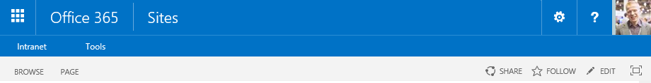
JS Injection
  Association of JavaScript Injection (user custom action) to the site, so that code is executed during site processing
SharePoint
Service
1
Provider Hosted Apps
CSOM / REST
2
js
<<Reference>>
3
  UX component or elements are rendered using CSOM with JavaScript stored either in SharePoint or centrally in the provider hosted app side.

Slide 18
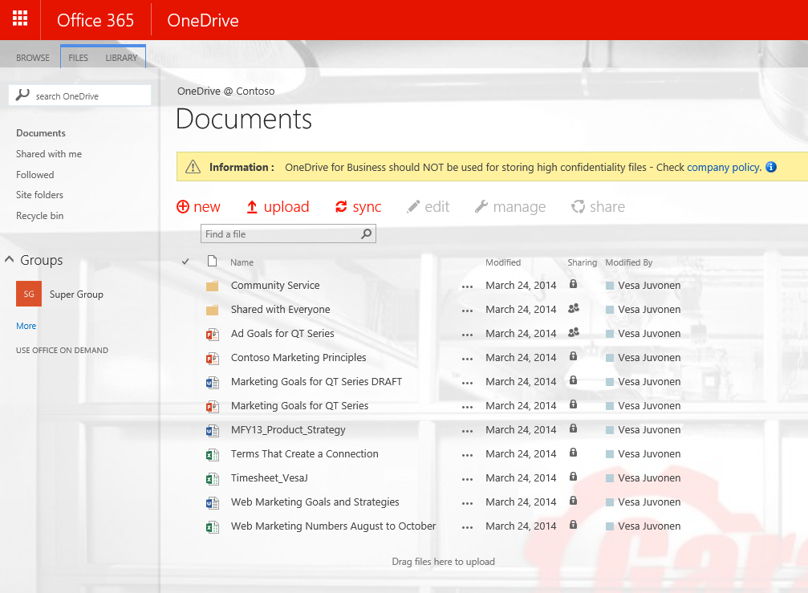
JS injection for messages
SharePoint
Service
  Association of JavaScript Injection (user custom action) to the site, so that code is executed during site processing
1
Provider Hosted Apps
CSOM / REST
2
<<Reference>>
js
3
  UX elements are rendered with JavaScript by using with script stored either in SharePoint, centrally in the provider hosted app side or in some CDN. Preferable in one location for easy update cross all instances.

Slide 19
App Script Part
SharePoint
Service
SharePoint
1
App Script Part
<div id=“”/>
Provider Hosted Apps
2
<<Reference>>
3
js
  Out of the box script or content editor web part with the needed reference to JavaScript in the provider hosted app side
4
  UX component or elements are rendered using CSOM with JavaScript stored either in SharePoint or centrally in the provider hosted app side (preferred).

Slide 20
App Popup
SharePoint
Service
SharePoint
1
App Popup
Provider Hosted Apps
2
<<Load Page>>
aspx
3
4
  Usage of out of the box pop up technique to show modal popup for the end user. Can be started from link in a page or for example from custom action.
  Provider hosted application is presented in the popup and it can perform needed operations based on the requirements.

Slide 21
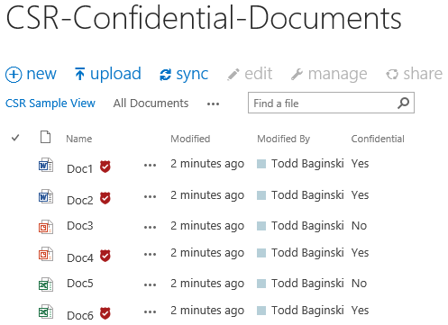
Client side rendering
SharePoint
Service
1
  Association of client side rendering Injection to field, view or web part, so that client side library is included to the rendering process when content is viewed.
Provider Hosted Apps
CSOM / REST
2
<<Reference>>
js
3
  UX component or elements are rendered using CSOM with JavaScript stored either in SharePoint site or referenced from provider hosted app side.
  JavaScript will override the detault read or edit experience of the functionality.

Slide 22
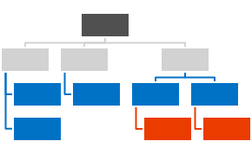


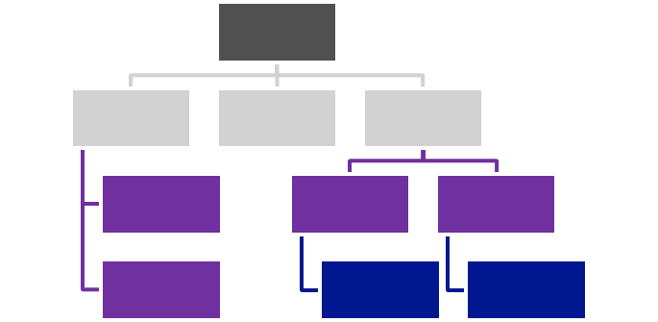



Centralized Asset Deployment
https://xxx.sharepoint.com/sites/site
https://xxx.sharepoint.com
<<Reference>>
https://xxx.sharepoint.com /sites/site2
<<Reference>>
<<Reference>>
<<Reference>>
Provider Hosted Apps
<<Reference>>
https://xxx.sharepoint.com/sites/site3
<<Reference>>

Slide 23
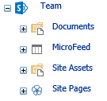
User profile sync and usage process
Customer
SharePoint
Service
Azure
Active Directory
1
Active Directory
2
4
5
  Standardized set of attributes which are replicated to the SharePoint user profile store.
3
LOB
System
Custom
synch tool
  Functionalities can use the user profile properties to show information or to change the end user experience.
  Custom synchronization tool for extended attributes what needs to be sync'd to SharePoint User profile hosted in Azure, on-premises or in both depending on needed actions
  On-premises LOB system for possible extended attributes

Slide 24
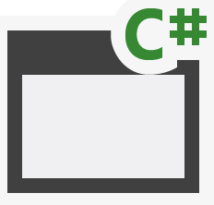
Provisioning Apps
SQL Azure
Azure Web Sites
Azure Data Market
aspx
png
master
js
SharePoint Online
CSS
Host Web
App Web

Slide 25
Controlling master page and page layouts from app
1
Provider Hosted Apps
SharePoint
Service
CSOM/REST
3
Upload master page
Upload page layouts
Set site master page using CSOM
Set page layouts
Set allowed site templates
Branding assets
2

Slide 26
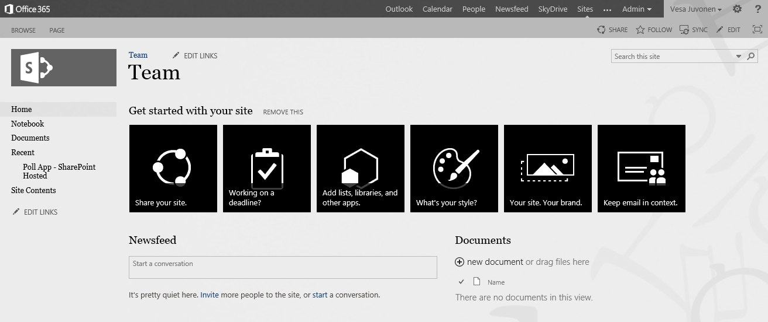
Handling themes from SP Apps
1
Provider Hosted Apps
SharePoint
Service
CSOM
3
Upload needed files
Set theme to site
(Set master page to site)
Theme elements
2
Color file
Font file
Background image
(Master page)
Notes:
App is started from the web by end user or process is started during provisioning
App side has the needed theme elements and other assets for sites, which will be published
App drives the modification of the host web by applying the needed customizations to host web

Slide 27
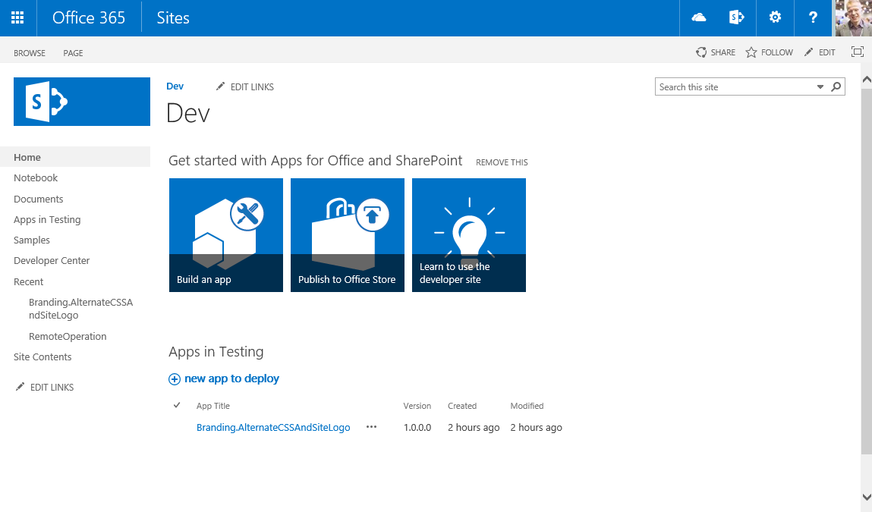
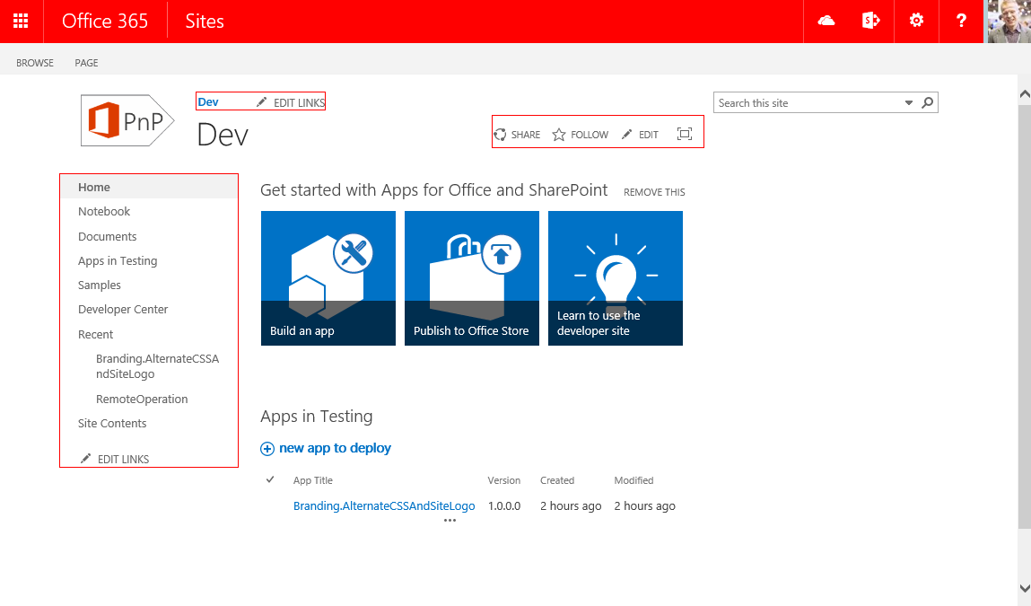
Controlling CSS from App
1
Provider Hosted Apps
SharePoint
Service
CSOM/REST
3
Upload CSS
Set alternate CSS for the site
Assets
2
CSS file
Images

Slide 28
List templates from apps
1
Provider Hosted Apps
SharePoint
Service
CSOM/REST
3
Creation of oob list
Add lists
Add content types and site columns
Add other configurations
Configuration
2

Slide 29
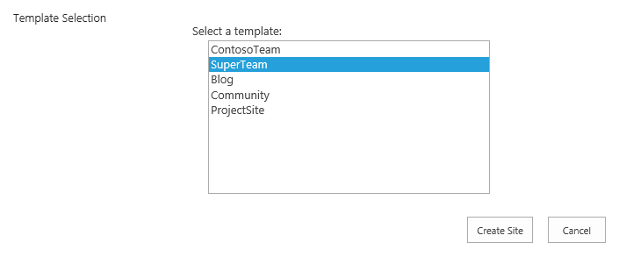
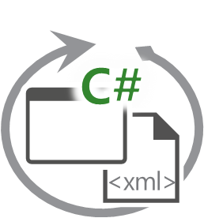
Async pattern for site collection provisioning
2
Provider Hosted Apps
SharePoint Service
<<Add message>>
<<Run app functionality>>
Storage
Queue
1
3
<<instantiate>>
WebJob
5
<< Create site collection>>
4
Branding Images
Master Pages
Page Layouts
Other settings
https://xxx.sharepoint.com/sites/site
Assets and config.

Slide 30
Agenda
1
Best Practices for Add-In Model
2
Best Practices – SPO Development
3
Business User Driven Template
4
CSOM Based Customization Strategy Checkpoints

Slide 31
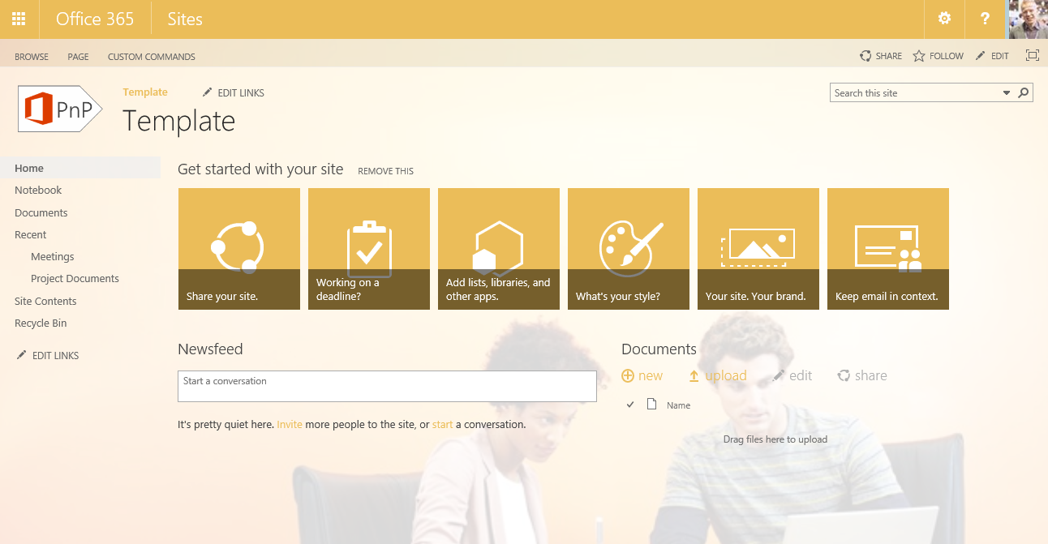
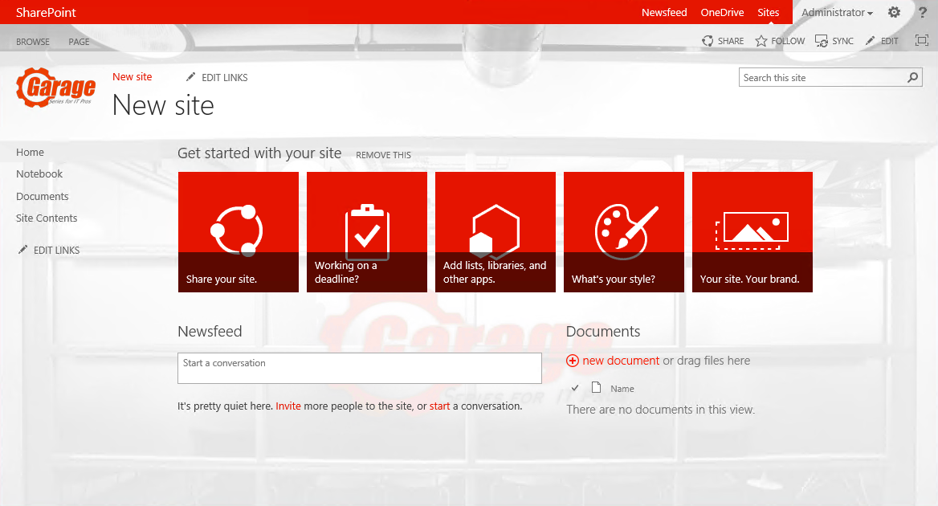
Business user driven templates
2
Modify with browser
1
3
Extract template
Provider Hosted App
Provisioning engine
Template sites
4
SharePoint Service
5
  Template details are being extracted from actual template sites during provisioning.
  Templates can be modified and crated using browser UI and all changes are reflected to the newly created and potentially modified sites.
https://xxx.sharepoint.com/sites/site

Slide 32
Agenda
1
Best Practices for Add-In Model
2
Best Practices – SPO Development
3
Business User Driven Template
4
CSOM Based Customization Strategy Checkpoints

Slide 33
SharePoint CSOM based Customization Strategy Checkpoints
# | Done | Checkpoint Description | Remarks, if any
1 |  | CSOM requires to use SQL-like programming pattern.
2 |  | Declare what data is required and then build either an ad hoc SQL query or a stored procedure , execute the query before accessing the data
3 |  | Identify value object returned from a method or property is not used until the query is executed.
4 |  | Keep track of the Object Path that the client object is created as this object can be used as a parameter to invoke other methods within the same query.
5 |  | Identify conditional scope to test for preconditions before loading data.
6 |  | Call Load and ExecuteQuery Before Accessing Value Properties
7 |  | Provide Group Data Retrieval on the Same SharePoint Client Object
8 |  | Identify properties of objects you want to return as Retrieving a SharePoint Client Object Does Not Retrieve All Properties
9 |  | Provide exception handling scope to catch exceptions.

Slide 34



