Slide 1
PowerConvert 2.0
SharePoint workflow migrations made easy
October 27, 2023

Slide 2

Agenda
Migration Drivers and Benefits | 1
Demo | 2
Our Approach | 3
Execution Details | 4
Appendix | 5

Slide 3
SharePoint Workflow
01
Migration – Key Drivers

Slide 4
Migration Drivers
01
Since Nov`20, Microsoft has removed the ability to run or create SharePoint 2010 workflows in all Office 365 tenants.
SharePoint 2010 OOTB workflows and SPD workflows created based on SharePoint 2010
will not work anymore. However, SharePoint 2013 workflows are deprecated but still
supported till 2026.
02
03
For existing Office 365 customers, workflow functionalities achieved using SharePoint 2010 workflows must be replaced with Power Automate Flows.
For customers migrating from SharePoint server to SharePoint Online, SharePoint 2010 workflows must be replaced with Power Automate Flows during migration.
04
05
SharePoint 2010 workflows are heavily used by customers to achieve workforce productivity solutions.
4

Slide 5
Why PowerConvert 2.0?
There were two flavors of the tool in two practices. They had their own strength and weakness. The objective was to fortify the tool and unify the offering.
To have the codebase in one place so it could be managed by ONE MBAP owner who manages all MBAP deployable IPs
Key Change | Reason for Change
New module added to create multiple Power Automate flows from existing Power Automate template and CSV input file | Merged the functionalities of SharePower in PowerConvert. SharePower is a separate SharePower was built using Power Automate Flows, and SharePoint which was time consuming process to configure in a new environment.
Deprecated: Automatic import of Power Platform solutions into Power Platform environment with transformed Power Automate flows. | Removed the PowerConvert dependencies on Power Platform connection references during workflow transformation. Instead, added place holder connection references in Power Platform solution during workflow transformation and desired connection references are selected during solution import.
UI Changes: PowerObjects logo replaced with HCLTech logo Settings button removed from Home Control pane and added icon to launch settings window Version number removed from App Title | Reflect organizational changes Focus on key functionalities of PowerConvert instead of administrative activities in Home Control pane Added in settings window with clickable link to release notes document
5

Slide 6
Demo
02

Slide 7

Demo
Click here to see the Demo Video
7

Slide 8
Our Approach
03
Consultative & Lean

Slide 9
Typical steps in discovery & migration
Connects to your SharePoint Site and auto-discovers all SharePoint 2010 workflows
You can selectively convert the workflows you would like to convert to Power Automate Flows.
Supports the conversion of most SharePoint workflow actions
Workflows with unsupported actions converted with place holder actions remediated manually.
Define workflow once and create multiple instances from CSV input
Power Automate flows are packaged into solutions to be imported seamlessly
1
2
3
4
5
6
9

Slide 10








Execution flow
Power Automate
Microsoft Dataverse
SharePoint Online
SharePoint Workflows
Migration specialist launch PowerConvert Tool and selects the Workflows for migration
PowerConvert tool fetches and process the SharePoint Workflow Schema
PowerConvert converts the SharePoint Workflow Schema into Power Automate and downloads Power Platform solution in file system
Migration specialist uploads the Power Platform solution into Power Platform environment
10

Slide 11
Replace SharePoint OOTB workflows with Power automate
PowerConvert enable automated Power Automate flow deployment from Power Automate template and CSV file input
Discover SP Workflows
Analyze SP Workflows
Submit Flow Deployment Request for each SP Workflows
Develop Power Automate Flow Templates for each OOTB Workflows
Deploy Power Automate Flow
New Power Automate Flow Deployed for each SP Workflows
11

Slide 12



Our technical approach
Discover
Transform
Import
  Extract workflow schema of SharePoint 2010/2013 workflows for selected site collection or from all site collections in a Tenant
  Inventorize SPD and OOTB workflows
  Rationalize the workflows to be migrated
  Migrate the SPD workflows to Power Automate Flows
  Analyze the detailed migration report and number of place holder actions added for non supported workflow actions
  Create CSV input file for OOTB workflows to be replaced by Power Automate Flows from predefined template
  Import the Power Platform solution into Power Platform environment
  Created and select Power Platform Connection reference during solution import
  Turn On the Power Automate Flows in Solution blade
1
1
2
3
12

Slide 13
PowerConvert – How is it different?
Features | Available Tools in Market | HCLTech’s PowerConvert
Discovery of workflows to understand the its schema and non supported actions in Power Automate
Tools to migrate SharePoint Workflows to Power Automate
Comprehensive report on passed and failed cases (along with reasons)
Create Power Automate flows from template and CSV input
Rerun failed cases
Not or partially available
Available
Sample screenshots
13

Slide 14
Elements of
Execution
04

Slide 15
Access requirement
The following access is required in order to be able to run, diagnose and manually convert workflows with PowerConvert
Access | Justification
Azure AD App Registration including Security Certificate | Required to allow PowerConvert to connect to the designated SharePoint sites using modern authentication in order to analyse the SharePoint workflows. Dynamics CRM: user impersonation Microsoft Graph: Directory.ReadAll SharePoint: Sites.FullControl.All
Application User System Administrator Access in Dataverse | An application user created using the above AAD App registration must be added to Dataverse and given the System Administrator role to be able to import Power Platform Solution.
Service Account or Named User Accounts with SharePoint Site Collection Admin Access with MFA turned off. | A named or service account is required for all sites which contain workflows that require conversion. This will allow the Solution Architect and Lead Developer to manually inspect workflows in the SharePoint 2010 designer which does not support modern oauth and therefore cannot be used with MFA.
Named User Account System Administrator Access in Dataverse | A named user account with the System Administrator role in the target Dataverse environment.
Office 365, Approvals, Planner, Outlook (Exchange) | Required for certain Power Automate actions.
15

Slide 16
Supported 2010 workflow actions
AddListItemPermissionsActivity | ExtractSubstringFromIndexActivity | TerminateActivity
AddTimeToDateActivity | ExtractSubstringFromIndexLengthActivity | TodoItemTask
CheckInItemActivity | ExtractSubstringFromStartActivity | UndoCheckOutItemActivity
CheckOutItemActivity | InheritListItemParentPermissionsActivity | UpdateItemActivity
CopyItemActivity | MathActivity | BuildStringActivity
CreateItemActivity | RemoveListItemPermissionsActivity | Approval Workflow
DateIntervalActivity | ReplaceListItemPermissionsActivity | Publishing Approval
DelayForActivity | SetFieldActivity
DelayUntilActivity | SetModerationStatusActivity
DeleteItemActivity | SetTimeFieldActivity
EmailActivity | SetVariableActivity
ExtractSubstringFromEndActivity | TerminateActivity
16

Slide 17
Un-supported 2010 workflow actions
CollectDataTask | Publishing Approval – OOB
GroupAssignedTask | CommentActivity
WaitForActivity | LogToHistoryList
WaitForDocumentStatusActivity | Collect Feedback
Disposition Approval - OOB | Three-State
Collect Signatures – SharePoint 2010 - OOB | Collect Feedback - SharePoint 2010
Collect Feedback – OOB | Approval 2010 Workflows
Three-state – OOB
17

Slide 18
Supported 2013 workflow actions
AddToDate | CheckOutItem | ExtractSubstringFromIndexLength
BuildDynamicValue | CopyItem | DateInterval
CallHTTPWebService | CreateListItem | IndexOfString
CountDynamicValueItems | DeleteListItem | ReplaceString
Calc | UndoCheckOutItem | Trim
GetDynamicValueProperty | SetModerationStatus
DelayFor | SetField
DelayUntil | TranslateDocument
Email | UpdateListItem
SetTimeField | ExtractSubstringFromEnd
Assign | ExtractSubstringFromIndex
CheckInItem | ExtractSubstringFromStart
18

Slide 19
Un-supported 2013 workflow actions
WorkflowInterop-List | CompositeTask
WorkflowInterop-site | WaitForItemEvent
Comment | WaitForFieldChange
WriteToHistory | SingleTask
SetWorkflowStatus
19

Slide 21
Appendix
05

Slide 22
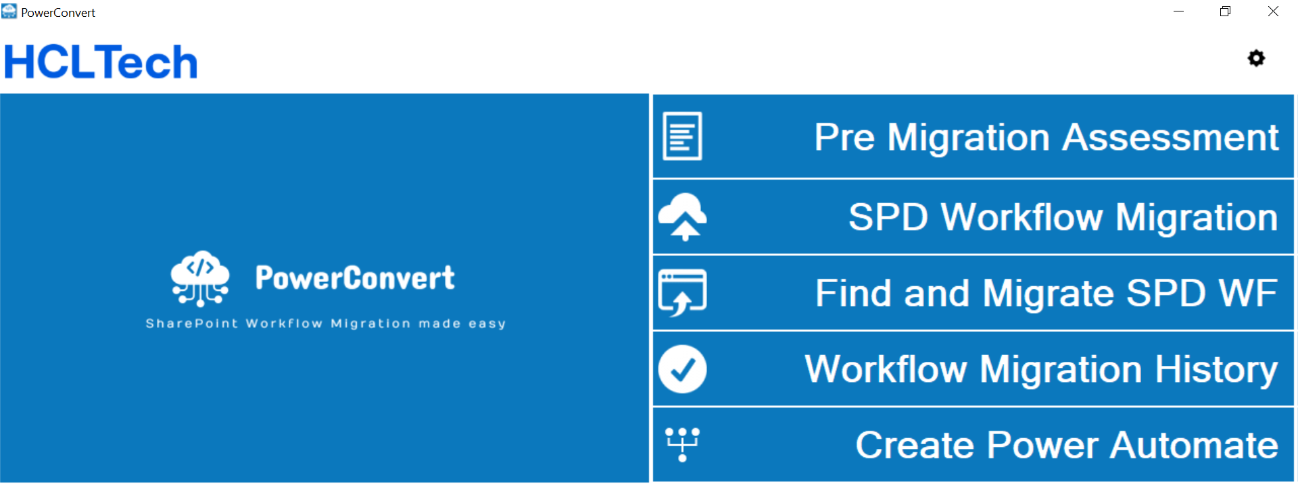
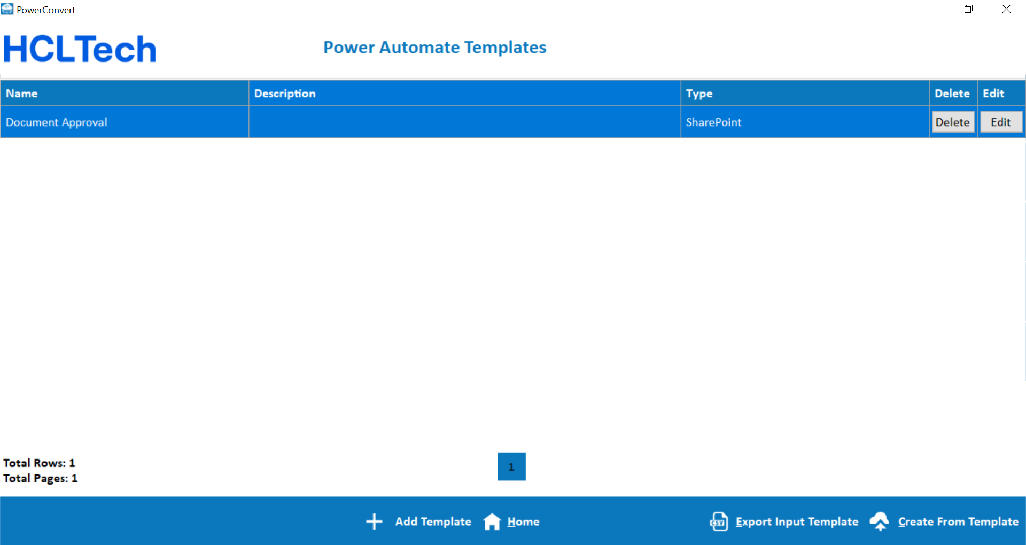
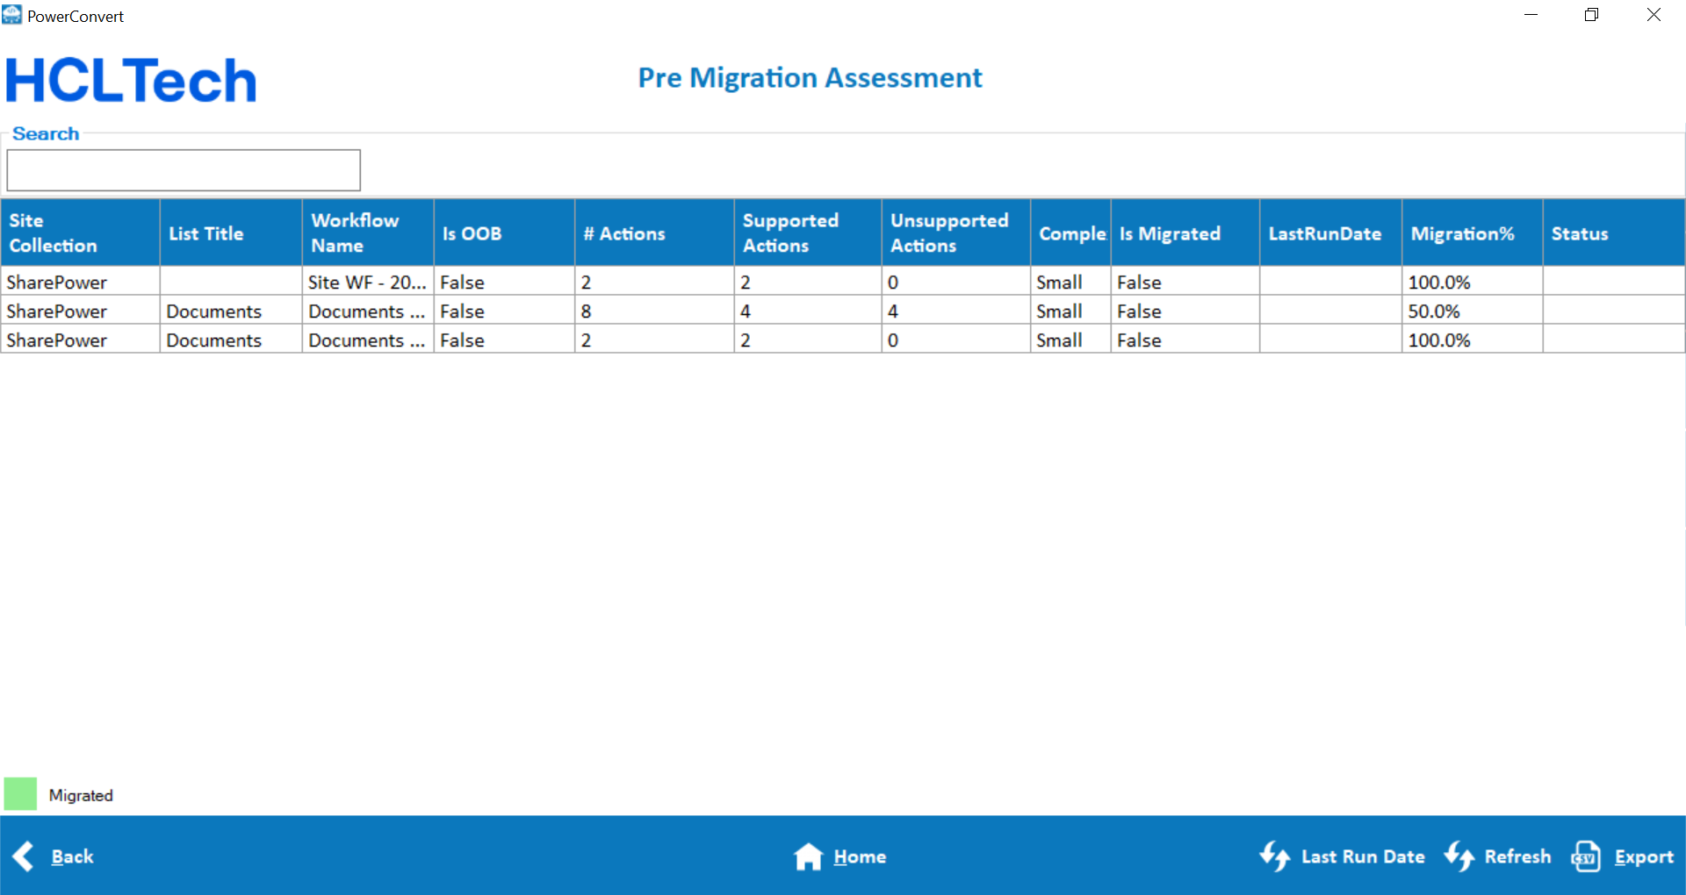
PowerConvert screenshots
Reference links
Demo
Deck
AppSource site
HCLTech site
22

