Slide 1

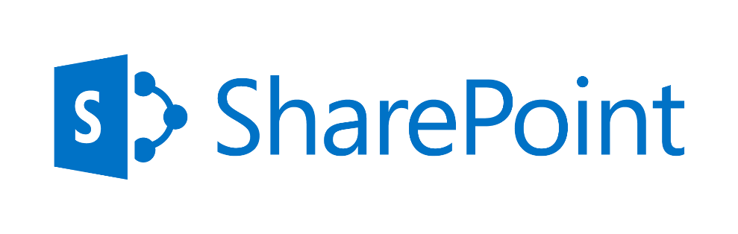
A Detailed View
May 2016

Slide 2
Contents
Why Upgrade
Our Solution Tenets
Upgrade Approach
Differentiators
Case Studies
Appendix

Slide 3


Typical Needs and Challenges – Business
Needs
Challenges
  Workplace productivity enhancement and avenues for innovation
  Contractual Obligation & alignment to newer legislation
  Business value and derivatives from Social initiatives
  Usability (including responsive UI & lack of mobility support) for business end users
  Search (accurate & relevant search results), “findability”
  Enhanced collaboration
  Obsolete/Outdated functionality
  Hard to maintain/improve/expand due to general lack of understanding of the system
  Highly expensive to maintain
  Inflexible/Difficult to adapt to changing business needs
  Lack of techniques or technology to fix legacy issues
  Cannot scale up to modern day needs of cloud, mobility and social
  Showing personalized contents across various sources (OneDrive, SharePoint, Exchange, Yammer etc.)
  Need to wait for a long time to give feedback / concerns about an application in target platform

Slide 4
Typical Needs and Challenges – Operational
Needs
Challenges
  Reduce Heavily customized environment & corresponding maintenance cost
  Manage 3rd party tools licensing cost and numerous duplicate unused applications
  Ensure minimum disruption to business, ensure governance
  Movement towards cloud (Microsoft & market trend) and seamless integration across a hybrid environment
  Many applications have common UI / functionalities / capabilities which can be at least be grouped in the target platform
  Communication Management (including Campaigning , Promotion , User Awareness etc.) across multiple geo & Stakeholder Management
  Infrastructure Availability, Platform Availability and Connectivity
  Security issues, incompatibility with new security, third party authentication approaches
  Product vendors have stopped support

Slide 5
Typical Needs and Challenges – Technical
Needs
Challenges
  Reduce Heavily customized environment & corresponding maintenance cost
  Manage 3rd party tools licensing cost and numerous duplicate unused applications
  Ensure minimum disruption to business, ensure governance
  Movement towards cloud (Microsoft & market trend) and seamless integration across a hybrid environment
  CSOM API limitation
    Implementing site provisioning, Applying site retention policy programmatically,
    Hide certain site template programmatically, Enabling site auditing programmatically and Creating complex properties for App part
  Provider Hosted App issues
    Provisioning of Apps programmatically, Trust Button Enablement & Ability to remove the web part instance during un-installation, ability to block harmful code from inserting into the website
  Capability changes across versions, Deprecated features e.g. FAB 40 templates, Meeting site templates etc.

Slide 6
O365 - Benefits
Benefits
  Reduce TCO
  Shift in ownership / focus of IT Governance
  Deployment of mobile friendly apps
  Showing personalized contents across various sources (OneDrive, SharePoint, Exchange, Yammer etc.)
  Usage of PowerApps to connect with any underlying source
  Benefit of using MS Graphs and Office Graphs
  Usage of MS flows for quick document/content approvals
  Anything to Anywhere - serve the portal to anywhere in the world with any network bandwidth

Slide 7
Contents
Why Upgrade
Our Solution Tenets
Upgrade Approach
Differentiators
Case Studies
Appendix

Slide 8
Our Solution Tenets
Workforce Productivity & Transformation
Optimization with Reusability
Industrialization of Processes
Future focused solutions
Reduce cost to maintain existing systems
Reduce heavily customized environment
Reduce effort with plug n play components
Technical - Manage CSOM API limitations
Keep it simple approach
Minimum disruption to business
Enhanced Collaboration
Improve Find-ability
Show personalized contents
Replace Obsolete functions
Adapt to Changing Business Needs
Key Tenets
Fix legacy issues
Infra, Platform, Connectivity
Communication Management
Agile Based Delivery
Capability based migration Approach
Governance
Movement towards cloud
Mobility, Social
Experience through Personas
Analytics-driven decision making

Slide 9
Migration Program Management Framework
TOM
Readiness
Management
Communications/
Rollout
Management
Conflict
Management
Change Management
Sponsorship
Model
User Centric
Design/Usability
User
Experience
Evangelization
Training
User Adoption
Mobility
Strategic
Performance/
Accessibility
Success Calibration
Success Factor
Definition
Tactical calibration
(e.g. Surveys, Polls etc.)
Usage calibration
(e.g. Usage Reports.)
Tactical
Technical Migration
User
Migration
Information/App
Architecture
Page
Facelift/
Migration
Technical
Excellence
Reports
Migration
Operational/
Technical
Performance
IT
Governance
(On-prem)
Content
Migration

Slide 10
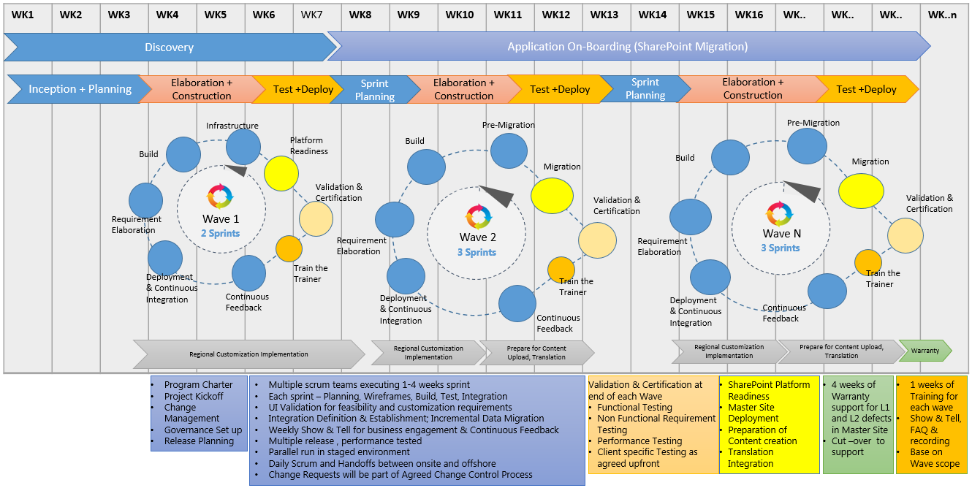
Agile Based Delivery – a typical Model

Slide 11
Solution Enablers
CAF
Being patented in USPTO
End-to-end coverage: strategy, roll-out & support
Quantitative framework
for optimal
Collaboration Adoption
in Enterprise enriching
Organization Balanced
Scorecard
SP Digitization
Fills gap of poor SP UX for Mobile
Purely Cloud centric Architecture
Platform and Device
independent
framework to surface
SharePoint Contents

Slide 12
Solution Enablers
Reusable assets
Addresses limitations in O365 and covers SP 2013 requirements
Nearly 40+ components that addresses all phases of SDLC
40+ Reusable
components
addressing common
needs of both
premise and cloud
ECP
3 Modes: Full, Components, API
Supports On-Premise & Cloud
Ready made SP
platform to launch
Enterprise Collaboration

Slide 13
Solution Value-adds
Governance Tools
A host of ready-made CMMi and HCL internal quality compliant tools
Improves Quality and performance
CAFPoint Estimation, Capacity Planning, Upgrade Hosting Decision Matrix, Automated Monitoring etc.
Upgrade Service
102 areas under 3 Governance segments – Info, IT and App
Powered by CAF Framework
A proposition to enable enterprises to achieve Operational Excellence and to design a robust Governance Model for SharePoint based ecosystem

Slide 14
Upgrade Services – Tools summary
O365 Compatibility
Checker
Automated Deployment Tool
Reads current source code
Reports code snippets not compatible with O365
Core Upgrade Execution Tool
Pre-defined deployment steps
Pre-defined deployment scripts
CAFPoint
Upgrade Estimator
Upgrade through High Sped Migration API
3rd Party Tool based Upgrade
OOB default MS recommendation based Upgrade mechanism
1-Click Estimator
Detailed Estimation Tool
Workforce Networking
Shows O365 Delve
personalized data
Consumes Office Graph
/ MS Graph REST API
Application Disposition Tool (ADT)
CAF Upgrade Test Factory
Pre-upgrade Analyzer
Owner Identification
Application Decommission WF
Application Archival WF
Application Migration WF
Web Content Migrator
Pre-defined test scenario
Pre-defined test cases
Pre-defined test strategy
Pre-defined test methodology
+
40 More
Reads source SharePoint Environment
Exports Schema in XML
Import Schema in PUA
Analyses schema
Reporting
Migrate from published web content
Web content migrated to target SharePoint site as web pages

Slide 15
Contents
Why Upgrade
Our Solution Tenets
Upgrade Approach
Differentiators
Case Studies
Appendix

Slide 16
Upgrade Life Cycle – Macro View
Kickoff
Application Disposition & rationalization
Pre Upgrade Analysis
Discovery
Planning
Upgrade Implementation
Verification & Validation
Cutover & Steady State
Deployment
Communication
Delta Migration
Handover to Support
Admin & Monitoring
Adoption
Upgrade Design Recommendation
Upgrade Estimation
Roadmap Finalization
Detailed design
Implementation of detailed Upgrade tasks and activities
Managing configuration and customization
Typical issues, checkpoints and troubleshooting
Testing approach
Post Upgrade Activities

Slide 17
Upgrade Life Cycle – Lifecycle View
Details in
Migration
Execution
slide
Discovery
Planning
Migration, & Re-Build
Verification & Validation
Cutover & Steady State
Pre-Migration
Analysis & Mapping
Migration Strategy & Phases Preparation
Site
Verification
Migration
Remediation
1 . . . n
Delta Run
Internal Testing
1 . . . n
Continuous Improvement
Base Platform Set-up, identify sites &customizations, business functions
Environment
Readiness
Plan Execution
Customization, Delta Sync, Downtime Management
UAT
Go-Live
HCL Reusable Assets
Reusable Assets created during Execution

Slide 18





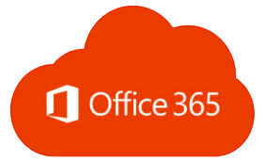
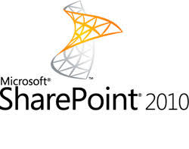
Migration Execution Process
Migration Steward
g
g
Migration Team
Remediation Team
Testing Team
Provisioning
Information
Architecture
Migration
Post
Migration
Governance
Provision Site on Target
Provision Yammer Groups on Target
Disable search at source
Remediate meta-data issues on the target
Migrate Lists & Items
Carry out Incremental Migration as needed
Migrate/Configure Pages/Navigation/Web Parts
Validate & remediate site titles
Configure Search
Add members to Yammer groups
Cross-check migrated sites
Define policies including Site Usage Policy, Information Management Policy, Security Policy, customization policy etc.

Slide 19








Migration Testing Process
Testing Process
Migration
Validation Report Tool
Data Mismatch – List/Libraries, Item Count, views & Permissions
Site’s Components Comparison
Content Types & their association with Document Libraries
InfoPath Forms & associated data List/Libraries
Workflows (SPD, VSD & PSD)
Web Parts (OOTB & custom)
Site Comparison
Sites & Site Collections
Root & Sub sites Pages – Home Page & Page Libraries
Links in all Pages & their associations
QI Point Tool
Test broken links
PowerShell Scripts
Generate reports of checked-out files & in-progress workflows
Migration Tool
For Migration & fixing of issues reported using tool/scripts
Custom scripts for additional insight of permissions & SP elements
Tested
Hyper-care

Slide 20
Migration Lifecycle – How HCL will Limit Disruption
Discovery
Planning
Migration, & Re-Build
Verification & Validation
Cutover & Steady State
Draw on HCL’s expertise on migration remediation – known issues and fixes
Use our custom tools and scripts for permission and user management – less interaction with site owners
Map typical pains during discovery
Deep discovery with custom tools
Minimal interactions with business
Leverage learning from experience – less transactions on design
Optimized implementation planning with end-to-end sprints
Address known challenges on customization migration
Address business concerns on delta sync and experience

Slide 21
Upgrade Activities – Detailed view
Detailed list of Upgrade activities are narrated in attached presentation deck

Slide 22

Lessons Learnt – Governance
Validate the customer business case for migration & recommendation
Be data driven: Use the existing information available about source applications deployed in the environment
Look for quick wins: Don’t wait to fully complete the assessment – it will be possible to quickly identify applications that can be decommissioned or re-plat formed
Structure communications to ensure requests are logical and create a single version of the truth that all parties can access and use workflow to drive the process
Consult support teams: Teams who administer the environment and support the source applications have a lot of useful information

Slide 23
Lessons Learnt – Technical
Every migration tool has limitations. Ensure alignment with requirements and conduct POCs on sample data
Social features in SharePoint – e.g. Mysite enablement are big changes that need business buy-in
Responsive UI & mobile platform targeted content leveraging SharePoint needs to be planned to keep end users engaged
Platform adoption – Trainings, pre-release awareness campaigns etc. are a must to ensure that end users are not alienated
O365 SLAs and feature availability need to be considered with SLAs kept in mind

Slide 24
Lessons Learnt – Discovery Phase
  Identification of SPD created pages at the root of site.
  Discovery of volume & complexity of JavaScript references on pages
  Discovery complexity of pages & JavaScripts
Issues
Our Solution
  A Set of PowerShell scripts to identify all types of objects from source MOSS2007 & SP2010 farm.
  Quality of customizations and complexity of customizations cannot be discovered.
  Better to de-scope all 3rd party and custom solutions and migrate collaboration sites & contents.
  Treat highly custom sites separately outside the main scope.
  Analyze & estimate them case to case basis and migrate them separately.
  Implement Disposition process at the beginning.
  Make a strategy so that once de-scoped never revert the decision.
Lessons Learnt

Slide 25
Lessons Learnt – Migration Phase
  Migration of SPD created pages at the root of site
  Migration of SPD customized pages
  Migration of List Items using high-speed approach.
  Migration of Library Documents using high-speed approach.
  Migration of items having null value in mandatory columns.
  Handling of documents at target that are in error and remained checked out at target.
  Migration of Items having MMD column pointing to a Term Set that does not exist at target (Term Set is decommissioned at target)
  Migrated data should not appear in Search until Go Live declared.
  Task List and Workflow history is not migrated.
Issues
  Identify checked out documents checked out by migration account and delete them
  Fix Missing MMD Term Set.
  Disable / Enable search at target site & sub site appropriately during migration phase
  Deploy Page Layout to multiple site collections.
  Add Site Collection Administrators to target site.
  PowerShell to Create Metalogix jobs
Our Solution
  Migration speed degrades if List / Library has many level nested folders and many folders.
  Migration Speed degrades if no. of columns increases in Lists/Libraries.
  Migration Speed degrades if no. of version to be migrated is high.
  Do not migrate List Items using High speed mode. Retain List Item IDs at target.
  If one/more list item fails to migrate, migrate entire list from scratch.
  Run Incremental using non-high-speed approach.
  Keep 1 migration account (separate from individual user account) for 2 migration VMs.
  Plan sites/site collections having large lists at the beginning.
  Create a proper view at target list if contains more than 5000 items at source.
Lessons Learnt

Slide 26
Lessons Learnt – Verification Phase
  Verification of Pages are manual.
  Verification of quality check is manual.
  Some AD Groups which are not synced in target Azure AD; they will not be migrated. They are reported as not migrated during verification. We cannot integrate verification process with Azure AD. We need to manually verify and it is time taking.
  List/library level verification is at count level.
  Verification of Workflow functionality - as it might trigger email to end users.
Issues
Our Solution
  A Set of PowerShell scripts to check migrated structure
  A Set of PowerShell scripts to verify list/library count and migrated permission
Lessons Learnt
  Ensure before starting verification that source and target AD is in sync.

Slide 27
Lessons Learnt – Remediation Phase
  Html files do not open in browser
  Remediation of SPD created pages at the root of site leads to recreation of those pages.
  Remediation of JavaScripts embedded with content editor Web Part might be a challenge.
  Remediation of XsltListView Web Part is a challenge.
Issues
  Identify Html and Htm files at target document libraries.
  Rename Html and Htm files at target document libraries to Aspx.
  Set Title from source site to target site.
  Create Yammer Group in bulk. Add members to Yammer Group in bulk
Our Solution
  Remediation takes time based on the following objects and not based on data volume.
    No. of site collections
    b. No. of sites & sub sites
    c. No. of lists & libraries
    d. No.. of pages
    e. No. of SP groups
    f. No. of site permissions
  Try to simplify functionality at target by implementing OOTB solutions.
  If required quickly develop some Apps
Lessons Learnt

Slide 28
Metalogix vs ShareGate
# | Area | Metalogix Content Matrix | ShareGate
1 | Migrate from Content DB to SPO | Supports but has issues. It did not work for P&G Content DB. | Not Supported
2 | Migration of Lists having Lookup Columns | Handles dependencies for all lookup columns and migrates source list first and migrates lists having lookup columns at last. | Does not handle automatically. We need to manually migrate dependant lists first then migrate lists having lookup columns.
3 | Migration of Views & Forms | It can be migrated as granular | Either both or none can be migrated.
4 | Incremental Migration for Lists | Has issues. Checks Item ID for finding Delta | Has issues. Checks Item Title for finding Delta
5 | Migrate using filter condition | Fully supports | Has limitation for complex conditions
6 | Distributed Factory Migration | Fully Supported. Easy to monitor and control from One Machine (Controller). Well structure and well architected. | Need to be developed as PowerShell JOB and to be scheduled in many machines using Windows Scheduler. Need to perform activity in all migration machines.
7 | Migration of Quick Launch | Fully Supported. | Has issues and limitations.
8 | SPD Workflow Migration | Fully Supported. | Fully Supported.
9 | Nintex Workflow Migration | Fully Supported. | Fully Supported.
10 | Migration of Master page/page layout | Cannot migrate | Cannot migrate

Slide 29
Contents
Why Upgrade
Our Solution Tenets
Upgrade Approach
Differentiators
Case Studies
Appendix

Slide 30



Upgrade Services – Overview
Strategic Guidance
Tactical Modelling
Upgrade Services
Business Case Justification
Automated Roadmap
Operational Excellence
Service Catalog based Offering
Application Rationalization
RACI Matrix
ROI Generator
Automated Testing
End to End Governance
Governance Guidance

Slide 31
HCL Differentiators
Business Architecture driven solution based on Capability
Proactive Issue Identification
Reusable Assets
Focus on Usability driven by Persona
Governance Framework
End-to-end Reference Architecture
Change & Program Management
Catalogue based offering based on initial inputs
Core-Flexi Resourcing model
Minimal Business Disruption through DevOps & Agile
Technology Differentiators
ML based assessment and what-if analysis of cost, migration wave plan
Strategic & Process Differentiators

Slide 32
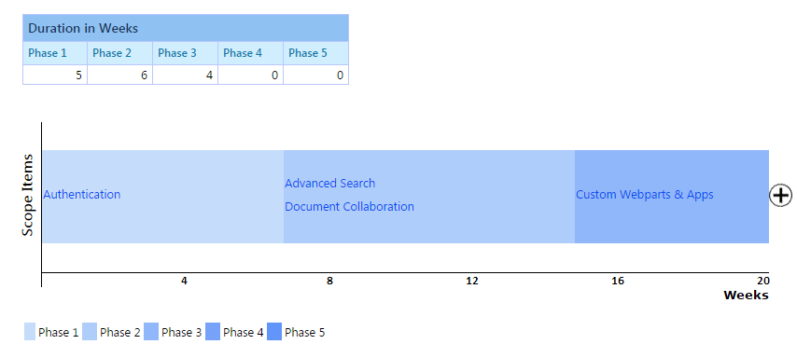
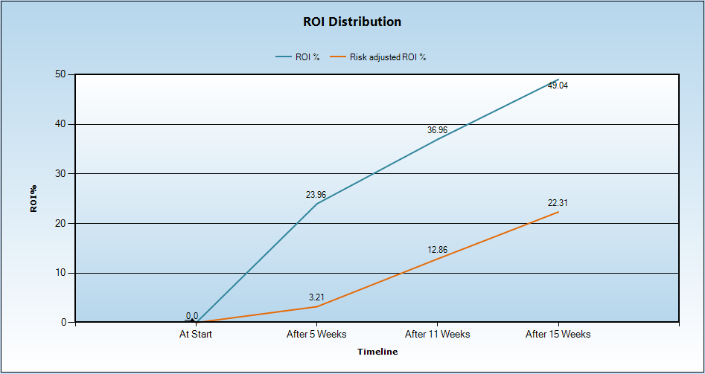
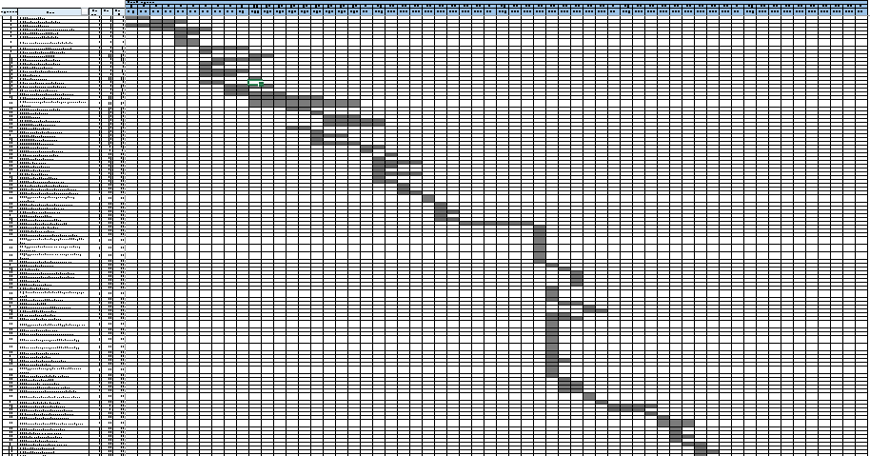
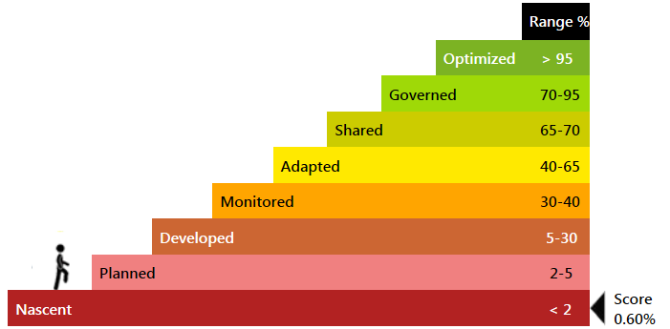
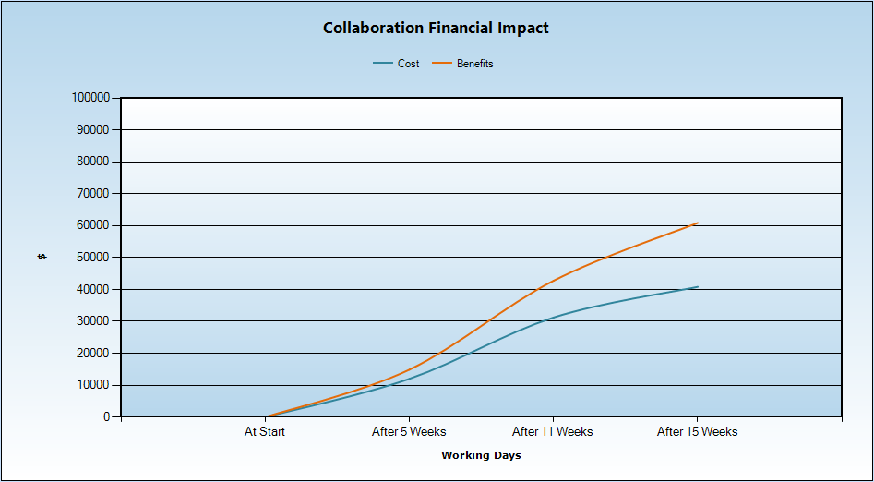
Strategic Differentiators
Roadmap Generation, ROI Calculation and Maturity Calculation
HCL uses an automated Blueprint and Roadmap Generator tool – an HCL IP - based on dependencies, feasibility, business demand, investment appetite and priority.
HCL owns a Cost-Benefit Analysis and ROI calculation tool that customers use to plan for investments and keep track of returns on investments at predefined intervals. This is useful to report benefits of the program to the CIO
HCL’s governance solution includes a SharePoint Platform Maturity Modeler which can assess SP maturity with respect to collaboration and other functionalities.
Responses to focused questions help this modeler to assess the Platform maturity of any enterprise and position it in a 8-stage maturity model.
HCL’s CAF (Collaboration Adoption Framework) can be used to create the roadmap to help organizations move up the value chain.

Slide 33
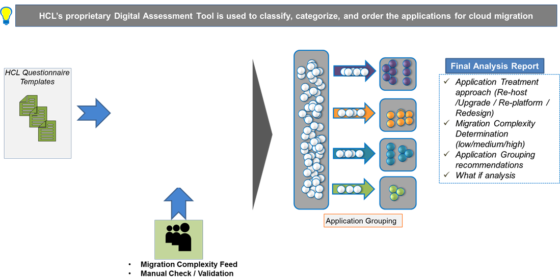
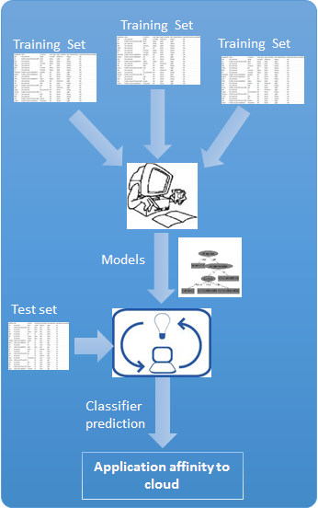
Strategic Differentiator DAT
DAT is highly recommended when Enterprise level analysis and grouping of applications is required.

Slide 34
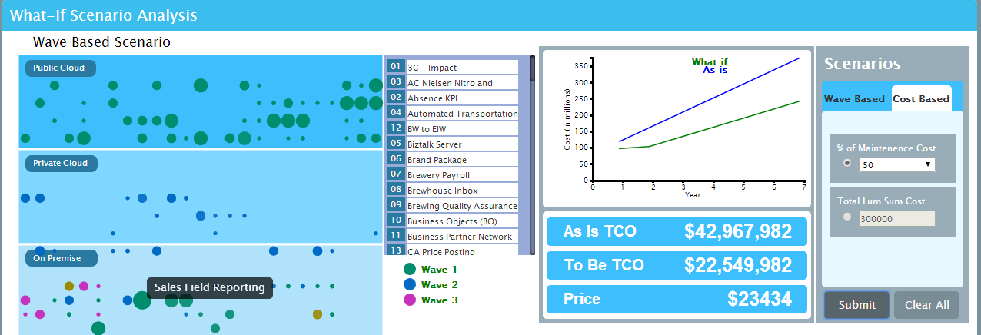
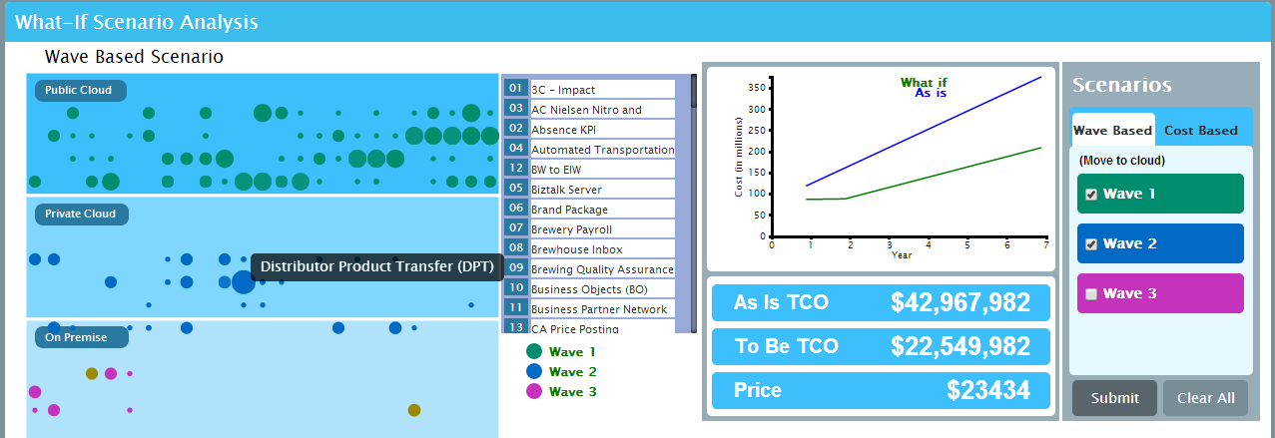
Strategic Differentiator DAT – What-if Analysis
Wave based What-if analysis
The sample screenshot depicts the As-is TCO and To-be TCO (on cloud) when Wave 1 and Wave 2 applications are migrated to cloud.
Cost based What-if analysis
The sample screenshot depicts the As-is TCO and To-be TCO (on cloud) if the available budget for migration is 50% of annual maintenance costs of the application portfolio.
HCL’s Proven and Standardized Assessment Tool – analysis of portfolio, migration recommendations and data driven business case creation

Slide 35
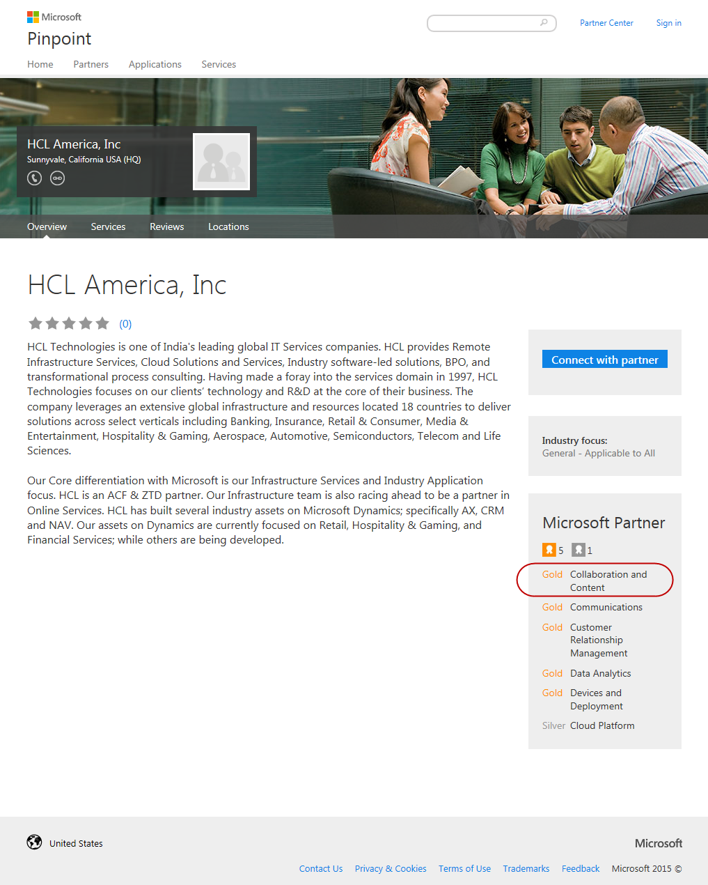

Strategic Differentiators – MS Relationship
GTM Partnership
OEM Partnership
Preferred Partner
IPs & Frameworks
End to End Services includes implementations, rollouts, upgrades and migration covering OS and Office, SharePoint, Dynamics CRM & AX, Azure, Office 365
Vertical solutions across Banking, Insurance, Healthcare – Payer – FinEdge Suite , Retail, Manufacturing
Horizontal Solutions across Share Point, Win 7 migrations
TAP Partner in key areas
PEAT Support in Proposals & Projects
HCL Group is one of the largest OEM Partner of Microsoft
R&D Partnership across products in the MS Stack
Services to MSIT across Infrastructure, CRM and other key applications
HCL is a key EA customer of Microsoft
HCL Training Academy enables internal training and certifications across the Microsoft stack
HCL Internal Productivity Platform, Collaboration and Wiki Portal run on Microsoft technologies
  Part of SharePoint Partner Advisory council (PAC)
One of the 28 Global alliances managed by global alliance group of MS
One among six managed Global System Integrators for MS Dynamics
Business Partnership in areas such as Dynamics CRM, SharePoint and Win7, Azure across geographies
  Structured training. Over 12000+ Microsoft professionals at HCL
Customer Experience Management Solutions – FinEdge CRM for Retail Banking, Insurance and Payer
GamEdge – CRM for Gaming Industry developed over Dynamics CRM
UCM tool for content migration from one platform to another platform
Xpress Migrate frameworks for migrations to Win7
Dot Net based solution for Loan Origination.
Azure based solutions

Slide 36
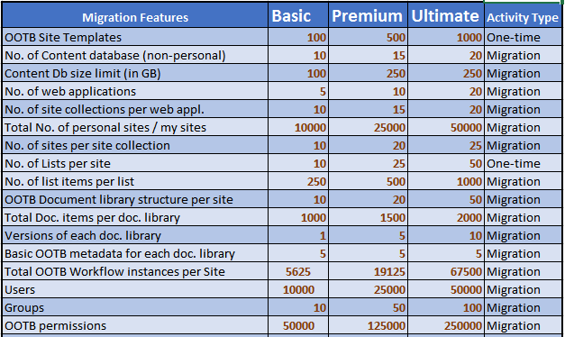
Strategic Differentiator - Catalogue-based Pricing

Slide 37
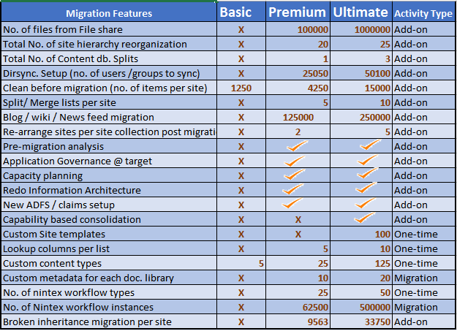
Strategic Differentiator - Catalogue-based Pricing

Slide 38
Strategic Differentiator - Core-Flexi Resourcing Model
Customer
CommunicationTeam
Flexi
HCL SharePoint COE
HCL
AMS Team
(L1 to L4)
Customer
Business
Base
Industry Best practice
Technical Leads
Core
Tools/ Framework
COE Core
Developers
Techno
Functional
Architects
Technical Leads
Microsoft Support
COE Manager
Architect
Techno-Functional
Core-Flexi Model
Developers
HCL
Dev Team
(Flexi)
Customer
IT
Thought Leadership
Technology Partners and Tool Vendors
Best Practice Guidelines, Knowledge base, Processes, Templates and Checklist

Slide 39
Core-Flexi typical Team composition
Core Team
1 Change Manager
1 Program Manager
Change Mgmt. Team
1 Business Analyst
1 SharePoint Architect
Project Mgmt. Team
1 Comm.s Manager
1 Scrum Master
Shared
1 Migration/Development Lead
Flexi Team
1 Migration Consultant/Developer
1 Migration/Development Lead
Migration Team
1 Migration/Development Tester
1 Migration Consultant/ Developer
Migration Team
1 UI/UX Developer
1 Migration/ Development Tester
*Core team is fixed for the entire program
1 UI/UX Developer

Slide 40
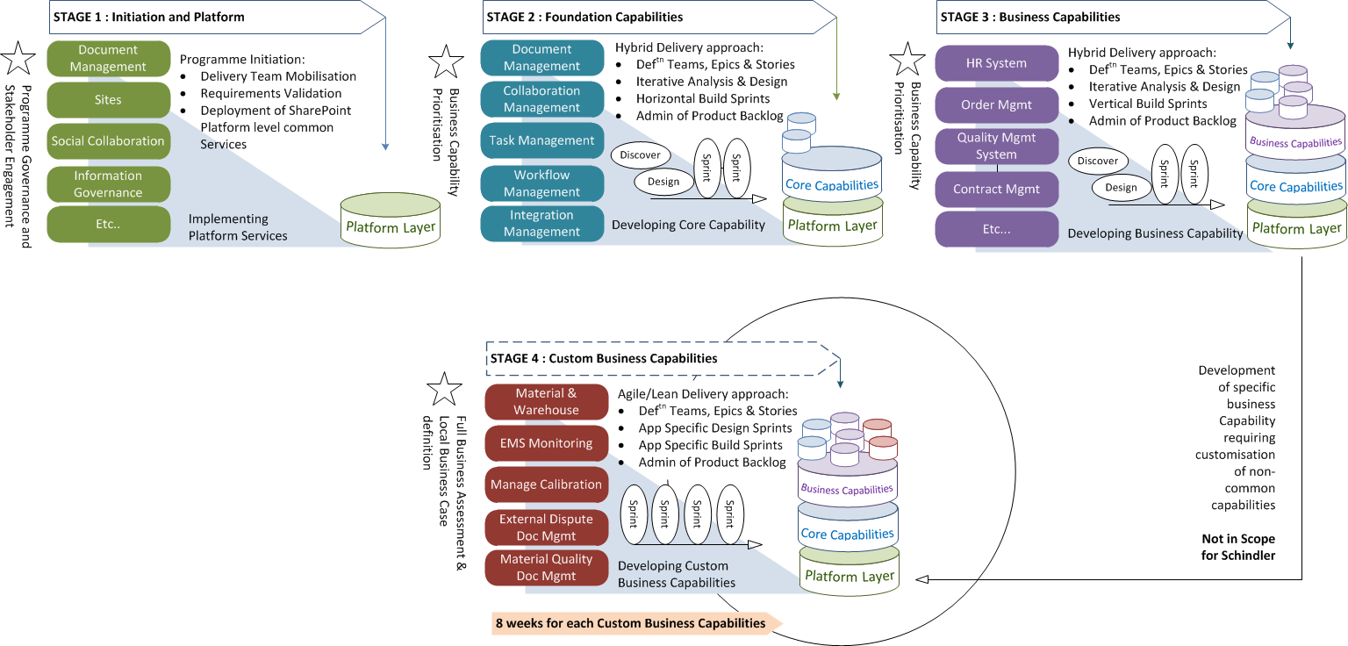
Operational Differentiator - Capability Driven Migration
Stage by stage execution
Each capability getting
matured by end of each stage
Multiple sprints will be executed
with each sprint focusing on a
specific core/ business capability.
Epics and stories created in each
stage for each capability –
validated with business within the
release cycle of that stage
30-40% of apps transformed from
source to target at stage 2
(with lot of common features)
85-90% of source applications
transformed to target at end of
stage 3
Only 15-20% left for stage 4 -
individual appl. specific (critical
applications only) capabilities are
developed

Slide 41
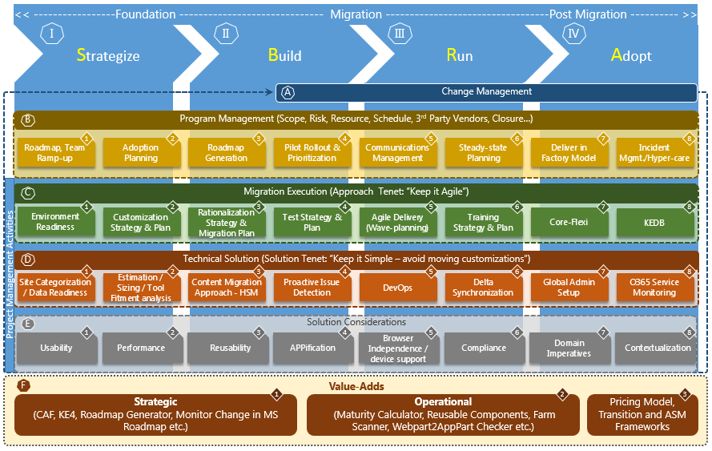
Technology Differentiator – HCL RA

Slide 42
Technology Differentiator – Reusable Assets
O365 Compatibility
Checker
Automated Deployment Tool
Reads current source code
Reports code snippets not compatible with O365
Core Upgrade Execution Tool
Pre-defined deployment steps
Pre-defined deployment scripts
CAFPoint
Upgrade Estimator
Upgrade through High Sped Migration API
3rd Party Tool based Upgrade
OOB default MS recommendation based Upgrade mechanism
1-Click Estimator
Detailed Estimation Tool
Workforce Networking
Shows O365 Delve
personalized data
Consumes Office Graph
/ MS Graph REST API
Application Disposition Tool (ADT)
CAF Upgrade Test Factory
Pre-upgrade Analyzer
Owner Identification
Application Decommission WF
Application Archival WF
Application Migration WF
Web Content Migrator
Pre-defined test scenario
Pre-defined test cases
Pre-defined test strategy
Pre-defined test methodology
+
40 More
Reads source SharePoint Environment
Exports Schema in XML
Import Schema in PUA
Analyses schema
Reporting
Migrate from published web content
Web content migrated to target SharePoint site as web pages

Slide 43
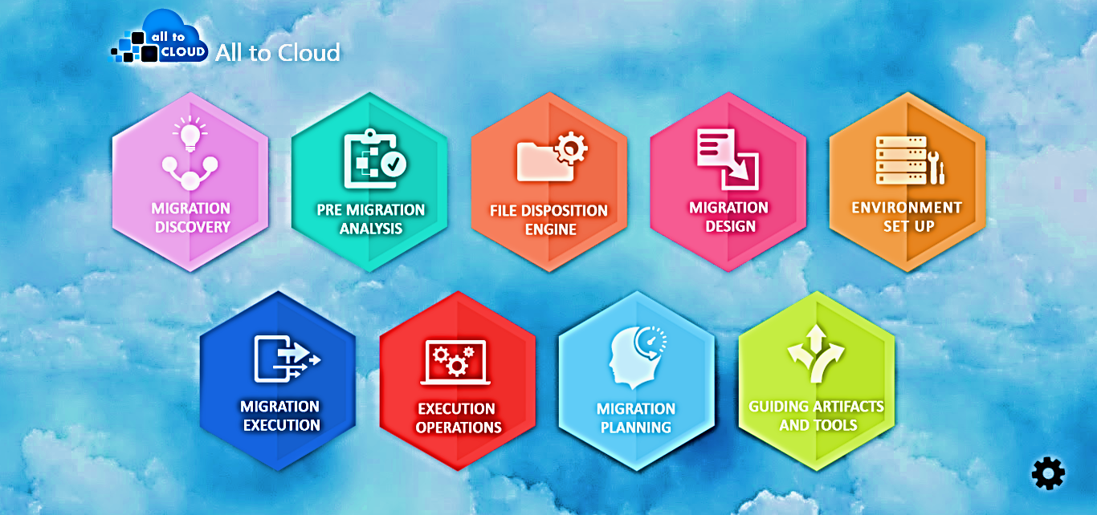
All to Cloud Migration Suite – A Sneak Peak
Move contents from any On-premise file share to Cloud File Share

Slide 44
Contents
Why Upgrade
Our Solution Tenets
Upgrade Approach
Differentiators
Case Studies
Appendix

Slide 45
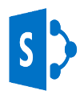
Case Study 1: Resources & Energy Major, Australia
Customer Profile
The Client delivers projects, provides expertise in engineering, procurement and construction and offers a wide range of consulting and advisory services. the company covers the full lifecycle, from creating new assets to sustaining and enhancing operating assets, in the hydrocarbons, mineral, metals, chemicals and infrastructure sectors.
Domain
Energy & Utilities
Business Area
Migration
GEO
APAC
SharePoint Generation
Upgrade from MOSS 2007/SP 2010 to SP 2013/O365
Project Description
SharePoint migration using MetaVis, which is a third party tool and automation scripts for reduction in migration time
MetaVis based Content Migration Project from MOSS 2007/ SP 2010 environment to SharePoint 2013/Office 365 environment
Maintain site lists where we get the information of source sites as well as the target site location
HCL’s Solution
Requirement analysis, developing Use Cases and Knowledge transfer
Migrating sites using third Party MetaVis Tool
Developing scripts to avoid manual efforts for SharePoint 2007/2013/O365
Research and Development activities in some complex migration scenarios
Challenges
Migrating Custom workflows, Out of the box Workflows, third Party solution (e.g.KwizCom)
Providing alternative solutions for the functionalities which are available in MOSS but not available in O365/SharePoint 2013 On-Premise
DataView WebParts migration challenges.
Re-migrate the site again on SharePoint 2013 On-premise as the functionalities required by business is not available in O365
Benefits / Value Added
Developed some scripts which is reducing Migration time
Good Work appreciation mail from the Client
So far, no escalation in this project

Slide 46
Case Study 2: Manufacturing Major, USA
Customer Profile
The Client is an American multinational conglomerate that produces a variety of commercial and consumer products, engineering services and aerospace systems for a wide variety of customers, from private consumers to major corporations and governments.
Domain
Hi-Tech & Manufacturing
Business Area
Migration
GEO
USA
SharePoint Generation
Upgrade from MOSS 2007 to SP 2013/O365
Project Description
Migration of Legacy MOSS 2007 sites and custom applications to Azure Infrastructure (IaaS)
Software up gradation to SharePoint 2013 which will consolidate various custom .NET IIS & Java application and web services under the umbrella of SharePoint farm and scope
Re-engineering the sites which were dependent on Excel Macro sheets for data manipulation and synchronization
HCL’s Solution
One hop migration of data from MOSS 2007 to SP 2013 using tool called Metalogix Content Matrix
Moving the infra to Cloud from On premise to scale on demand with 64 bit in contrast to existing 32 bit
Using 3rd party Encryption Tools to encrypt data moved to Cloud
AS-IS Assessment of Custom component including web parts, web services and re-engineering to Cloud App Model
Proof of concept related to performance, utility of the migration tool, encryption option and cloud setup
Challenges
Legacy, unmanaged custom application impacting the performance and delivery of the change requests
Migration of InfoPath form as Microsoft not supporting in future
Instability of the farm due to unreliable server object model codes
Performance of the sites and custom applications due to existing 32 bit on premise infrastructure
Security of intellectual data storage in target Cloud set-up
Benefits / Value Added
Migration Strategy helped direct upgrade from MOSS 2007 to SP 2013
Reduced server side foot print to 30 percent and helping stability
Azure Infra usage removed the hosting and operational expenditure by 60%
Enhanced branding and user experience added values to the users
Reduced dependencies on 3rd party component thereby saving licensing cost
Reduced maintenance cost by 50 % due to new cloud app model re-engineering

Slide 47
Case Study 3: Telecom Major, Europe
Customer Profile
The Client is a leader in the fields of network infrastructure, location-based technologies and advanced technologies.
Domain
Telecom
Business Area
Upgrade
GEO
Europe
SharePoint Generation
SharePoint 2013
Project Description
Assessment of current state environment of SharePoint , formulation of requirement and establishment of roadmap for O 365, SharePoint 2013 upgrade
Roadmap includes to upgrade 9000+ sites including intranet, publishing, extranet, my sites and custom applications and 3 TB of content
Enable better user experience & improved usability
HCL’s Solution
High level assessment of all custom components owned and maintained by the SharePoint platform team
Recommendation for simplification of customization and applicability of new features available in SP 2013
Identification & Implementation of Proof of concept (POC) related to SharePoint 2013 upgrade
Solution framework designed to categorize custom applications into multiple baskets like candidates for decommission , simplification, to remain as is and those needs to be redesigned using CSOM
Challenges
The as is SharePoint environment was not scalable at an enterprise level with poor user adoption and overall customer experience
Lot of complex custom applications were to be replaced using the out of the box capability of SP 2013
Benefits / Value Added
The complete intranet portal was reinvented to make it more social with rich activity stream and focus on moving from pushing content to co-creating content resulting in increase in user adoption
Enhanced search with an enterprise wide search capability
Leveraging the cloud app model to reduce the server side customization footprint bringing reduction of 70-80% to maintenance cost and code by 10-15%
Provision of device and platform independent solution with HTML 5 and CSS 3
Integration with Yammer to provide rich social capability

Slide 48
Contents
Why Upgrade
Our Solution Tenets
Upgrade Approach
Differentiators
Case Studies
Appendix

Slide 49
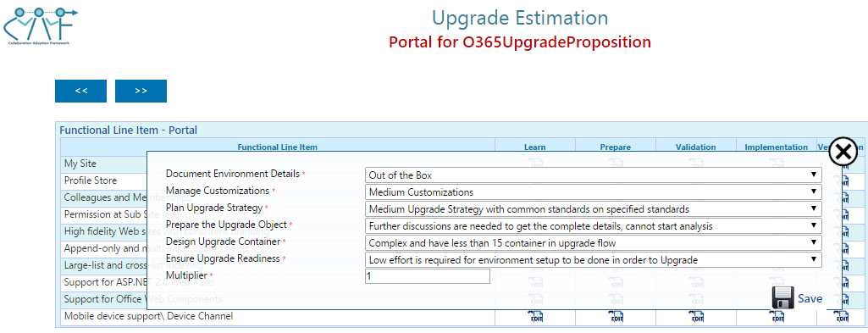
Upgrade Services – Tools – Estimation Tool [CAF Enabled]
Key Notes
CAF enabled Upgrade Estimation Tool provides the detailed approach for estimating upgrade effort to SharePoint 2013 / O365 platform from older SharePoint versions
End to end upgrade estimation effort can be calculated which includes requirement analysis, design, testing, implementation and deployment effort
Baseline data is already included based on HCL experience and from existing upgrade projects’ sampling. This can be modified as well
The estimation is done on the basis of defined parameters and on functional complexity

Slide 50
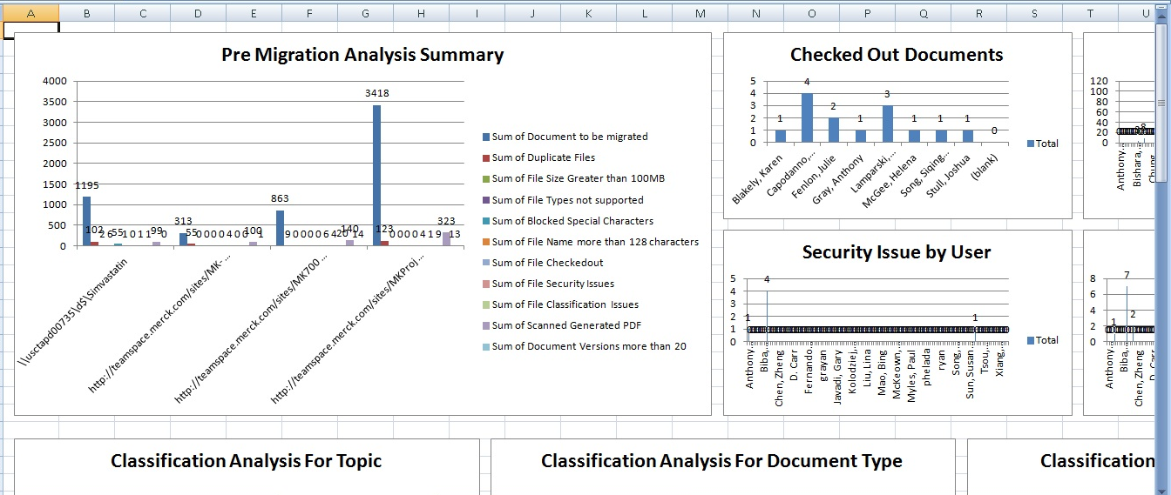
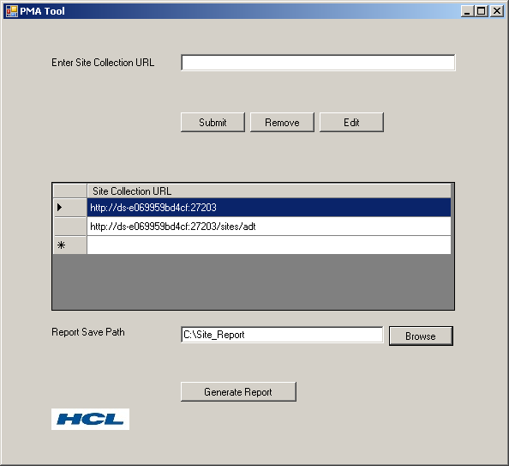
Upgrade Services – Tools – Pre Upgrade Analyzer
Key Notes
Pre Upgrade Analysis tool provides the detailed analysis report for the SharePoint sites in an excel file as output.
The user can run it against all the site collections which he wants to migrate.
It will generate the detailed information about the site collections/sites and documents.
It captures detailed information about the sites like name, owner name, creation date, modified date, documents libraries, document name, size, ownership, usage etc..
The site and documents level graphical charts are generated through this tool.
It will help organization to make better and quick decisions by seeing the complete report.
Key Features

Slide 51
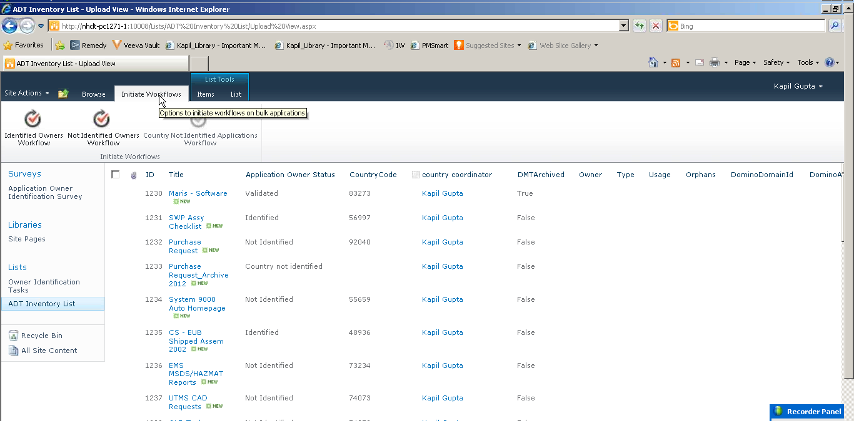
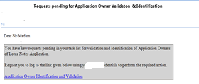
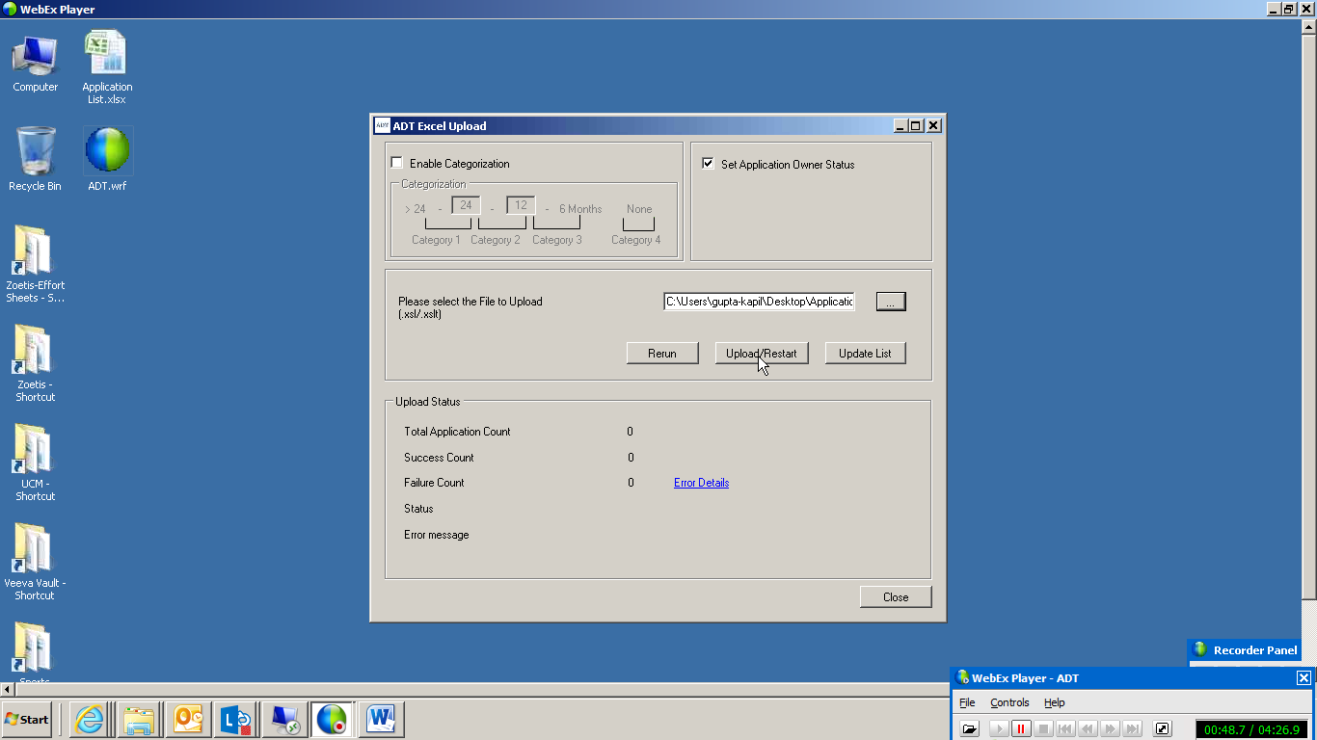
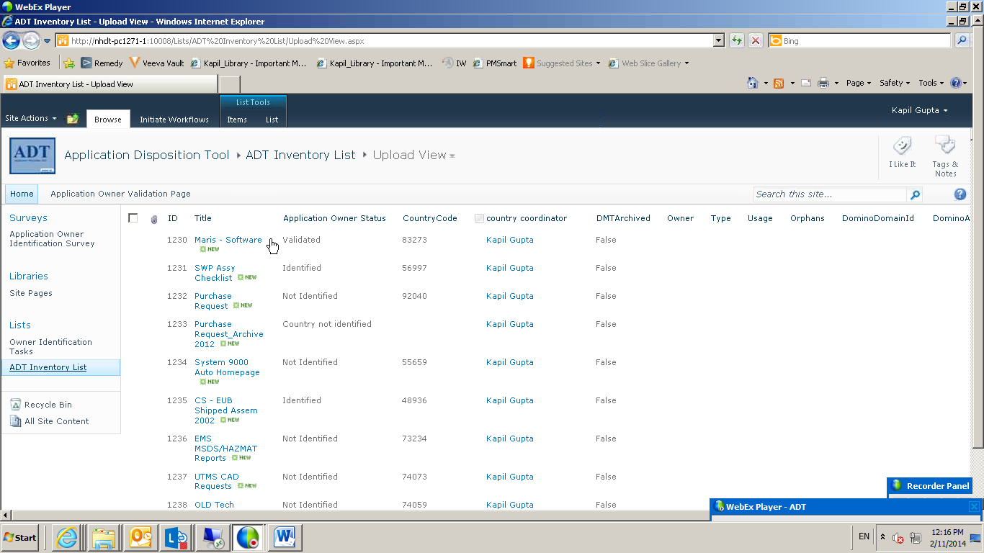
Upgrade Services – Tools – ADT
Key Notes
Inventorization
Maintaining Inventory of applications
Analysis
Grouping of applications
Stakeholder Communication
Migration Governance
Upload, filtering, record application details
Analysis, providing dashboard
Identifying duplicates, similar apps
Sending out surveys, questionnaires
Allowing direct entry of information from stakeholders into the tool
SLA's for response to surveys, decisions
RACI for view, update, responding to surveys
Escalation and exception paths
Notifications and reminders
Application Disposition and Rationalization

Slide 52
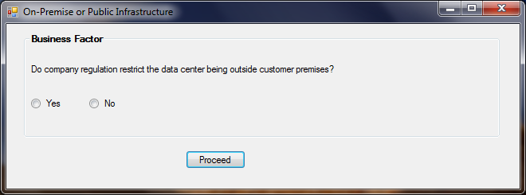
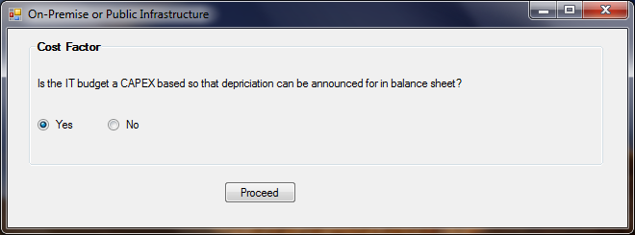
Upgrade Services – Tools – O365 Decision Maker
Key Notes
Enterprises often face a dilemma with respect to deciding on the correct hosting platform for their SharePoint environment.
The O365 Hosting Decision Matrix tool helps to provide guidance to enterprises and IT organizations in deciding whether an onpremise, cloud or a hybrid hosting architecture is suitable
This is done by asking a set of focused questions to the appropriate stakeholders and based on the responses the tool is able to provide a hosting decision
The algorithm and logic is in line with Microsoft approach

Slide 53
HCL’s 360° Partnership with Microsoft
GTM Partnership
OEM Partnership
Preferred Partner
IPs & Frameworks
End to End Services includes implementations, rollouts, upgrades and migration covering OS and Office, SharePoint, Dynamics CRM & AX, Azure, Office 365
Vertical solutions across Banking, Insurance, Healthcare – Payer – FinEdge Suite , Retail, Manufacturing
Horizontal Solutions across Share Point, Win 7 migrations
TAP Partner in key areas
PEAT Support in Proposals & Projects
HCL Group is one of the largest OEM Partner of Microsoft
R&D Partnership across products in the MS Stack
Services to MSIT across Infrastructure, CRM and other key applications
HCL is a key EA customer of Microsoft
HCL Training Academy enables internal training and certifications across the Microsoft stack
HCL Internal Productivity Platform, Collaboration and Wiki Portal run on Microsoft technologies
  Part of SharePoint Partner Advisory council (PAC)
One of the 28 Global alliances managed by global alliance group of MS
One among six managed Global System Integrators for MS Dynamics
Business Partnership in areas such as Dynamics CRM, SharePoint and Win7, Azure across geographies
  Structured training. Over 12000+ Microsoft professionals at HCL
Customer Experience Management Solutions – FinEdge CRM for Retail Banking, Insurance and Payer
GamEdge – CRM for Gaming Industry developed over Dynamics CRM
UCM tool for content migration from one platform to another platform
Xpress Migrate frameworks for migrations to Win7
Dot Net based solution for Loan Origination.
Azure based solutions

Slide 54
Additional Info – Pre Upgrade Analysis
Pre Upgrade Analysis Tools
Third Party
AvePoint
Metavis
Pros- Identify large site collections that can be difficult to migrate
provides insight into existing SharePoint farm, uncovering issues that could halt migration
Cons- Need to install MEWS in order to have full functionality of farm analysis, without MEWS full analyze of site collections can only be done.
Pros-Display the information of the Web applications, such as the database count, the total size, the site collection count, etc.
Display Farm Topology, Site collection information, Solution Information etc.
Cons – Requires agents on Prod, Licensing on per GB migrated
Pros-Discover, analyze, and manage users and permissions across multiple SharePoint site collections and farms
Identify orphaned SharePoint users, transfer permissions, and resolve potential security issues across sites and even farms.
Cons - Pre-analysis feature takes too long to analyze huge number of files and might fail to produce an excel spreadsheet.
HCL’s CAF
Metalogix

Slide 55
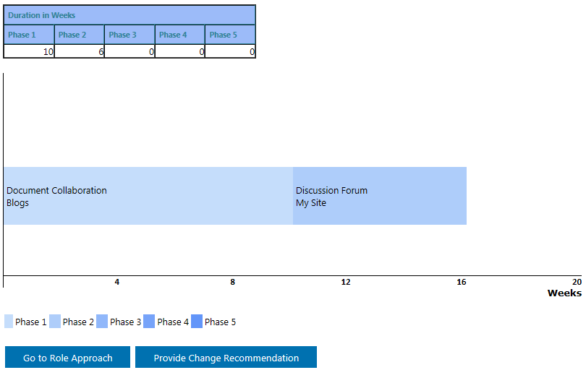
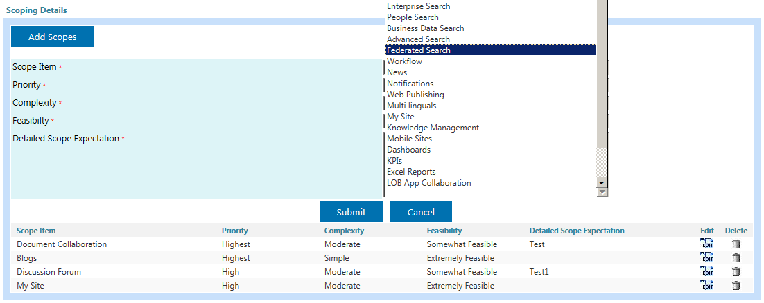
Additional Info – Upgrade Roadmap with CAF
Note:
This is the approach taken by most SharePoint 2010 On-Premise Customers
Move OOTB Sites to Online & upgrade the rest to SP 2013 On-Prem
Move minimally Customized Sites to Online with a Hybrid approach
Move all sites to Online
(Mitigate unsupported
Scenarios through App
Model)
Minimize
Impact
Prepare for
Future
Become
Scalable

Slide 56
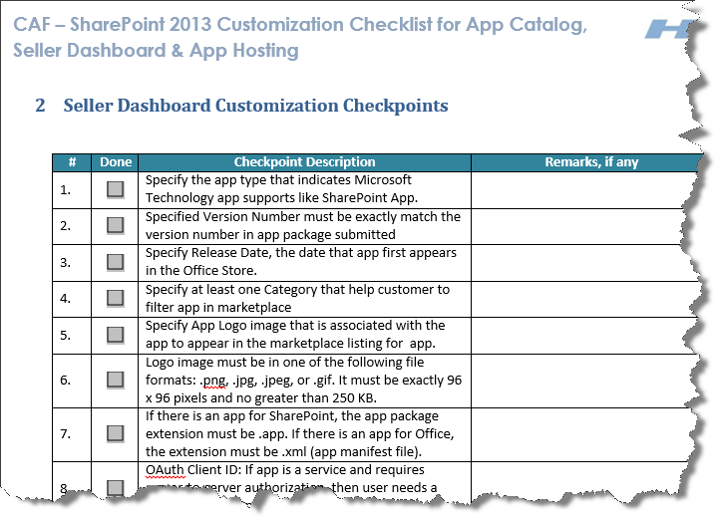
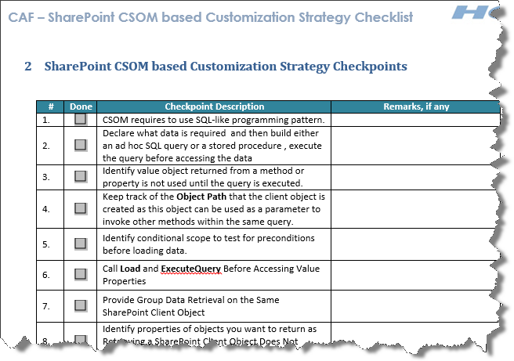



Additional Info – App Model Guidance with CAF
All elements in SP site is an App now including List and Libraries
No Custom code on SP Server, living on oAuth, REST and CSOM
Follows latest web standards for HTML, CSS, JS etc.
Flexibility to utilize hosting platform capability better using the distributed provisioning of Apps
Dynamic choice of Apps from Store based on the need and subscription choice
Less dependency on SharePoint Knowledge from configuration and development point of view
Easy Upgradability to future versions of SharePoint
SharePoint
App & Resources hosted on
  Separate server in same org
  App Developers’ Server
Existing Sites and Services
Non-SP Servers
Provider Hosted
App Web (optional)
SQL Azure
Existing Sites and Services
App & Resources hosted on Cloud utilizing
  Win Azure
  SQL Azure
Auto Hosted
App Web (optional)
Windows Azure
Existing Sites and Services
App & Resources hosted on SharePoint Server itself
SP Hosted
SP Servers
App Web

Slide 57
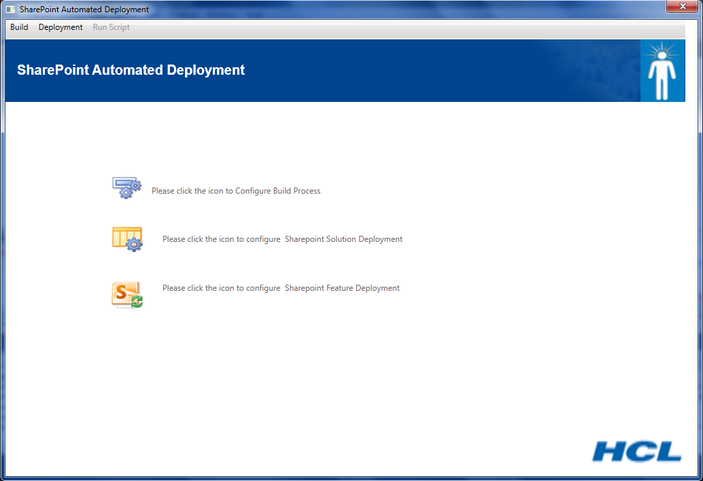
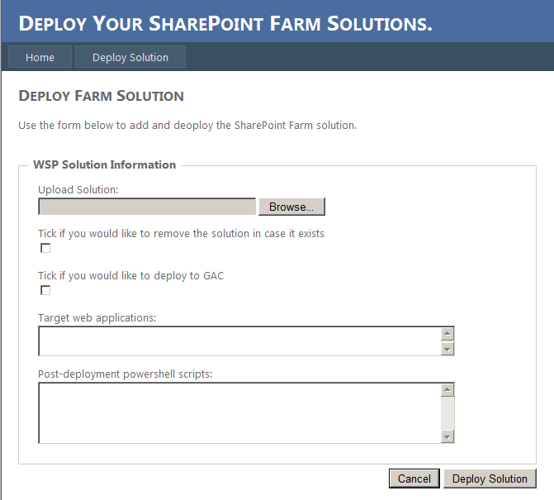
Additional Info – Deployment Approach using CAF
Deployment
Challenges
1 | Leveraging widely adopted deployment automation practices in the industry
2 | Using tools that enable the integration of automated deployment to the development phase
3 | Finding cost effective options to get to automation
Approaches
1 | TFS is a automated deployment option widely used across the industry but with no queue build priority. TFS can be combined with Third-party Schedulers, e.g. JAMS scheduler (www.jamsscheduler.com) to implement automated deployment & scheduling solutions.
2 | CAF’s Automated Deployment Tool & Remote Deployment Tool can also be used to drive cost effective deployment automation
Automated Deployment Tool: This is a SharePoint 2010 One Click Build and Packaging Tool which allows One Click Deployment and helps the customer by reducing dependency on a SharePoint SME. It supports both WSP deployment as well as all areas of feature deployment.
Remote Deployment Tool: Independent easy to deploy Asp.NET web application, allows Remote web based deployment. No need to remote login to SharePoint server, authenticated by AD and authorized by SP groups.

Slide 58
Additional Info – Other Enablers
  Social Sniffer
  Adoption Index Calculator (CAF)
  Quick conversion to Apps
  Code Checker
  Timer Job Migrator
  Compliance checker
  Migrating SP Communities and Social Conversations to Yammer feeds
  Externalization of Collaboration
  Professional Mapper

Slide 59
Thank You

