Slide 1

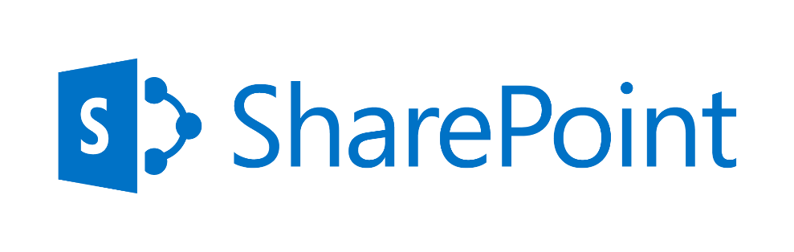
A Summary
May 2016

Slide 2
Contents
Why Upgrade
Our Solution Tenets
Upgrade Approach
Our Differentiators
Case Studies

Slide 3


O365 - Typical Needs and Benefits
Needs
Benefits
  Enabling People-centric Collaboration
  Usability (Responsive UI & lack of mobility support)
  Search (accurate & relevant search results), “findability”
  Reduce Heavily customized environment
  Reduce numerous duplicate or unused applications
  Movement towards cloud (Microsoft & market trend) and seamless integration across a hybrid environment
  Consolidation and rationalization of applications
  Support period expiry for legacy SharePoint platforms
  Increased Business Involvement
  App-centric experience; Mobile-friendly apps
  Showing personalized contents across various sources (OneDrive, SharePoint, Exchange, CRM, Yammer etc.)
  Benefit of using MS Graph and Office Graph
  Usage of PowerApps to connect with any underlying source
  Usage of MS Flow for quick document/content approvals
  Anything to Anywhere - serve the portal to anywhere in the world with any network bandwidth
  Reduce TCO; Pay as you go

Slide 4
Agenda
Why Upgrade
Our Solution Tenets
Upgrade Approach
Our Differentiators
Case Studies

Slide 5
Our Solution Tenets
Workforce Productivity & Transformation
Optimization with Reusability
Industrialization of Processes
Future focused solutions
Reduce cost to maintain existing systems
Reduce heavily customized environment
Reduce effort with plug n play components
Technical - Manage CSOM API limitations
Keep it simple approach
Minimum disruption to business
Enhanced Collaboration
Improve Find-ability
Show personalized contents
Replace Obsolete functions
Adapt to Changing Business Needs
Key Tenets
Fix legacy issues
Infra, Platform, Connectivity
Communication Management
Agile Based Delivery
Capability based migration Approach
Governance
Movement towards cloud
Mobility, Social
Experience through Personas
Analytics-driven decision making

Slide 6
Migration Program Management Framework
TOM
Readiness
Management
Communications/
Rollout
Management
Conflict
Management
Change Management
Sponsorship
Model
User Centric
Design/Usability
User
Experience
Evangelization
Training
User Adoption
Mobility
Strategic
Performance/
Accessibility
Success Calibration
Success Factor
Definition
Tactical calibration
(e.g. Surveys, Polls etc.)
Usage calibration
(e.g. Usage Reports.)
Tactical
Technical Migration
User
Migration
Information/App
Architecture
Page
Facelift/
Migration
Technical
Excellence
Reports
Migration
Operational/
Technical
Performance
IT
Governance
(On-prem)
Content
Migration

Slide 7
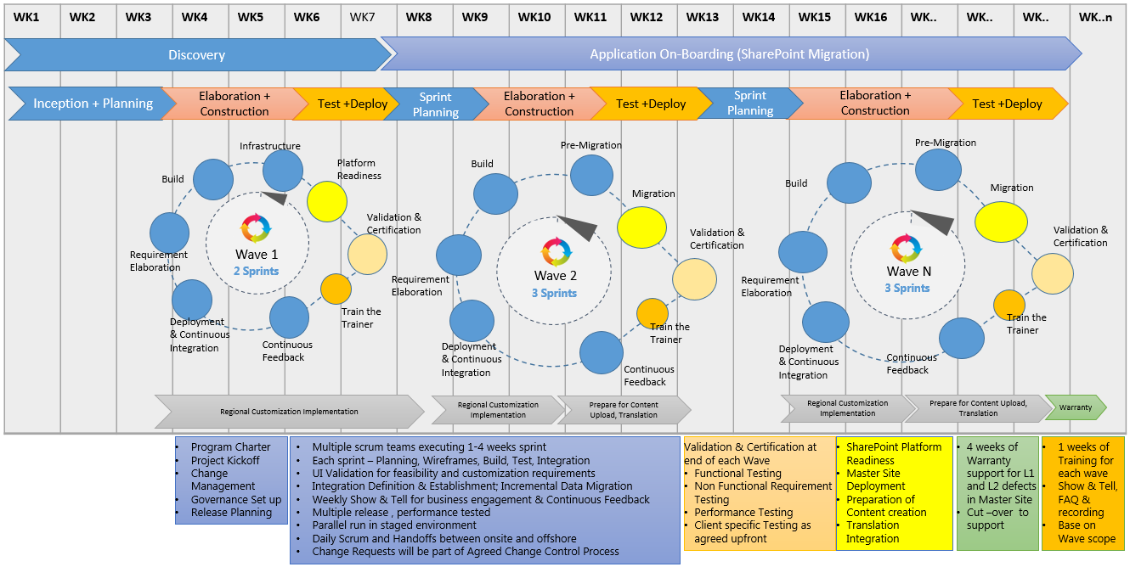
Agile Based Delivery – A Typical Model

Slide 8
Contents
Why Upgrade
Our Solution Tenets
Upgrade Approach
Our Differentiators
Case Studies

Slide 9
Upgrade Life Cycle – Macro View
Kickoff
Application Disposition & rationalization
Pre Upgrade Analysis
Discovery
Planning
Upgrade Implementation
Verification & Validation
Cutover & Steady State
Deployment
Communication
Delta Migration
Handover to Support
Admin & Monitoring
Adoption
Upgrade Design Recommendation
Upgrade Estimation
Roadmap Finalization
Detailed design
Implementation of detailed Upgrade tasks and activities
Managing configuration and customization
Typical issues, checkpoints and troubleshooting
Testing approach
Post Upgrade Activities

Slide 10
Upgrade Life Cycle – Lifecycle View
Details in
Migration
Execution
slide
Discovery
Planning
Migration, & Re-Build
Verification & Validation
Cutover & Steady State
Pre-Migration
Analysis & Mapping
Migration Strategy & Phases Preparation
Site
Verification
Migration
Remediation
1 . . . n
Delta Run
Internal Testing
1 . . . n
Continuous Improvement
Base Platform Set-up, identify sites &customizations, business functions
Environment
Readiness
Plan Execution
Customization, Delta Sync, Downtime Management
UAT
Go-Live
HCL Reusable Assets
Reusable Assets created during Execution

Slide 11





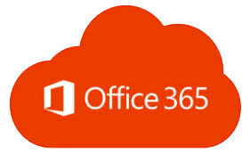

Migration Execution Process
Migration Steward
g
g
Migration Team
Remediation Team
Testing Team
Provisioning
Information
Architecture
Migration
Post
Migration
Governance
Provision Site on Target
Provision Yammer Groups on Target
Disable search at source
Remediate meta-data issues on the target
Migrate Lists & Items
Carry out Incremental Migration as needed
Migrate/Configure Pages/Navigation/Web Parts
Validate & remediate site titles
Configure Search
Add members to Yammer groups
Cross-check migrated sites
Define policies including Site Usage Policy, Information Management Policy, Security Policy, customization policy etc.

Slide 12








Migration Testing Process
Testing Process
Migration
Validation Report Tool
Data Mismatch – List/Libraries, Item Count, views & Permissions
Site’s Components Comparison
Content Types & their association with Document Libraries
InfoPath Forms & associated data List/Libraries
Workflows (SPD, VSD & PSD)
Web Parts (OOTB & custom)
Site Comparison
Sites & Site Collections
Root & Sub sites Pages – Home Page & Page Libraries
Links in all Pages & their associations
QI Point Tool
Test broken links
PowerShell Scripts
Generate reports of checked-out files & in-progress workflows
Migration Tool
For Migration & fixing of issues reported using tool/scripts
Custom scripts for additional insight of permissions & SP elements
Tested
Hyper-care

Slide 13
Migration Lifecycle – How HCL will Limit Disruption
Discovery
Planning
Migration, & Re-Build
Verification & Validation
Cutover & Steady State
Draw on HCL’s expertise on migration remediation – known issues and fixes
Use our custom tools and scripts for permission and user management – less interaction with site owners
Map typical pains during discovery
Deep discovery with custom tools
Minimal interactions with business
Leverage learning from experience – less transactions on design
Optimized implementation planning with end-to-end sprints
Address known challenges on customization migration
Address business concerns on delta sync and experience

Slide 14
Contents
Why Upgrade
Our Solution Tenets
Upgrade Approach
Our Differentiators
Case Studies

Slide 15
HCL Differentiators
Business Architecture driven solution based on Capability
Proactive Issue Identification
Reusable Assets
Focus on Usability driven by Persona
Governance Framework
End-to-end Reference Architecture
Change & Program Management
Catalogue based offering based on initial inputs
Core-Flexi Resourcing model
Minimal Business Disruption through DevOps & Agile
Technology & Operational Differentiators
ML based assessment and what-if analysis of cost, migration wave plan
Strategic & Process Differentiators

Slide 16
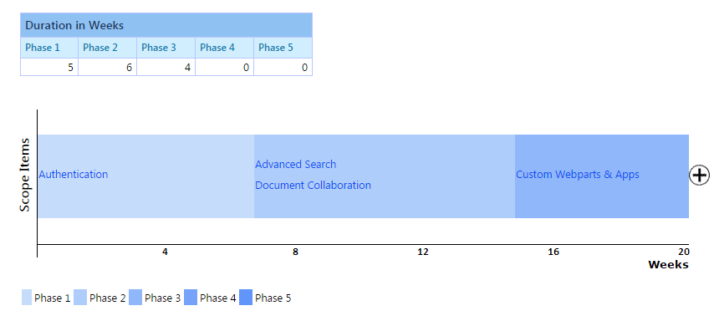
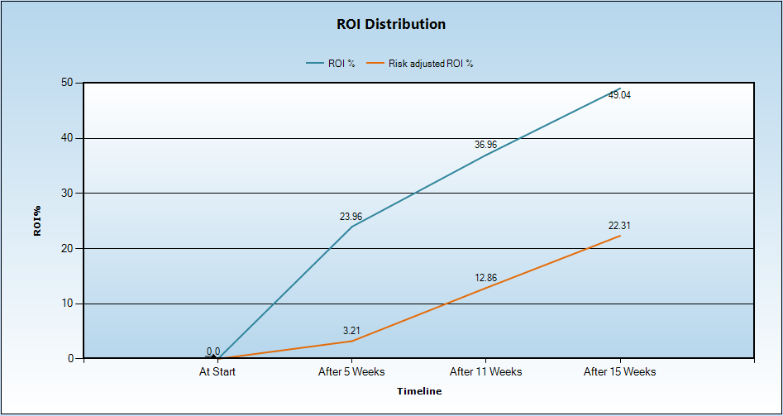
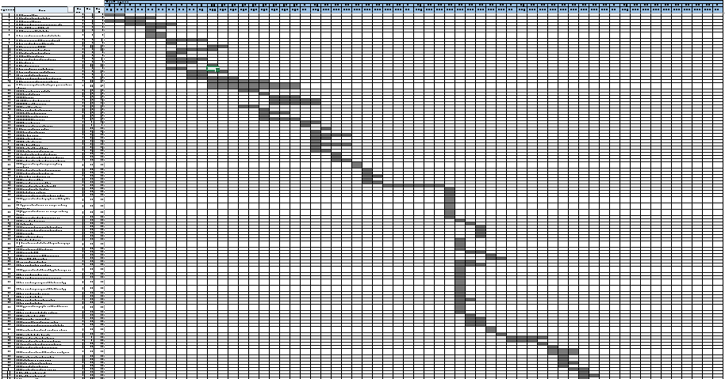
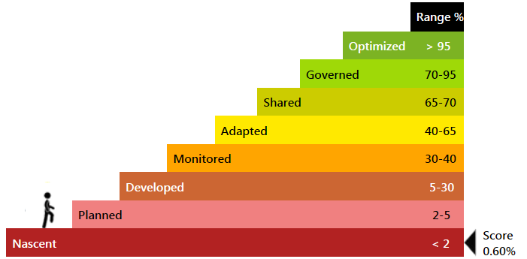
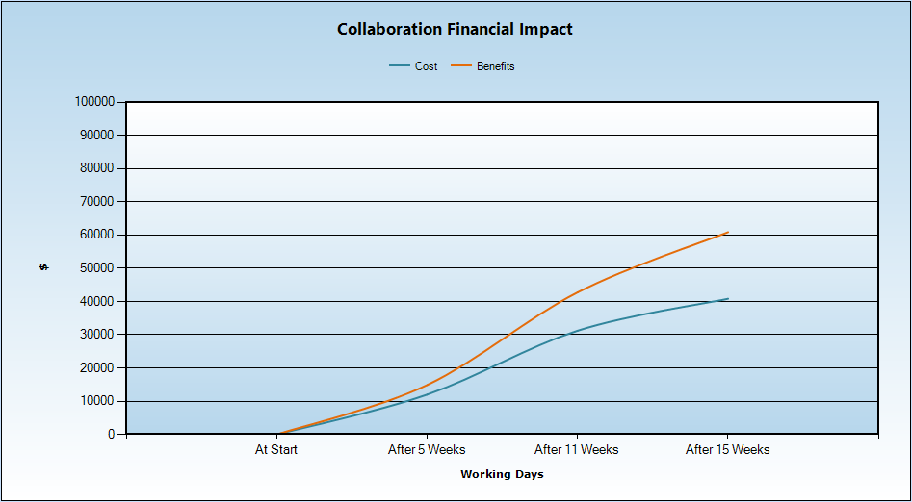
Strategic Differentiator
Roadmap Generation, ROI Calculation and Maturity Calculation
HCL uses an automated Blueprint and Roadmap Generator tool – an HCL IP - based on dependencies, feasibility, business demand, investment appetite and priority.
HCL owns a Cost-Benefit Analysis and ROI calculation tool that customers use to plan for investments and keep track of returns on investments at predefined intervals. This is useful to report benefits of the program to the CIO
HCL’s governance solution includes a SharePoint Platform Maturity Modeler which can assess SP maturity with respect to collaboration and other functionalities.
Responses to focused questions help this modeler to assess the Platform maturity of any enterprise and position it in a 8-stage maturity model.
HCL’s CAF (Collaboration Adoption Framework) can be used to create the roadmap to help organizations move up the value chain.

Slide 17
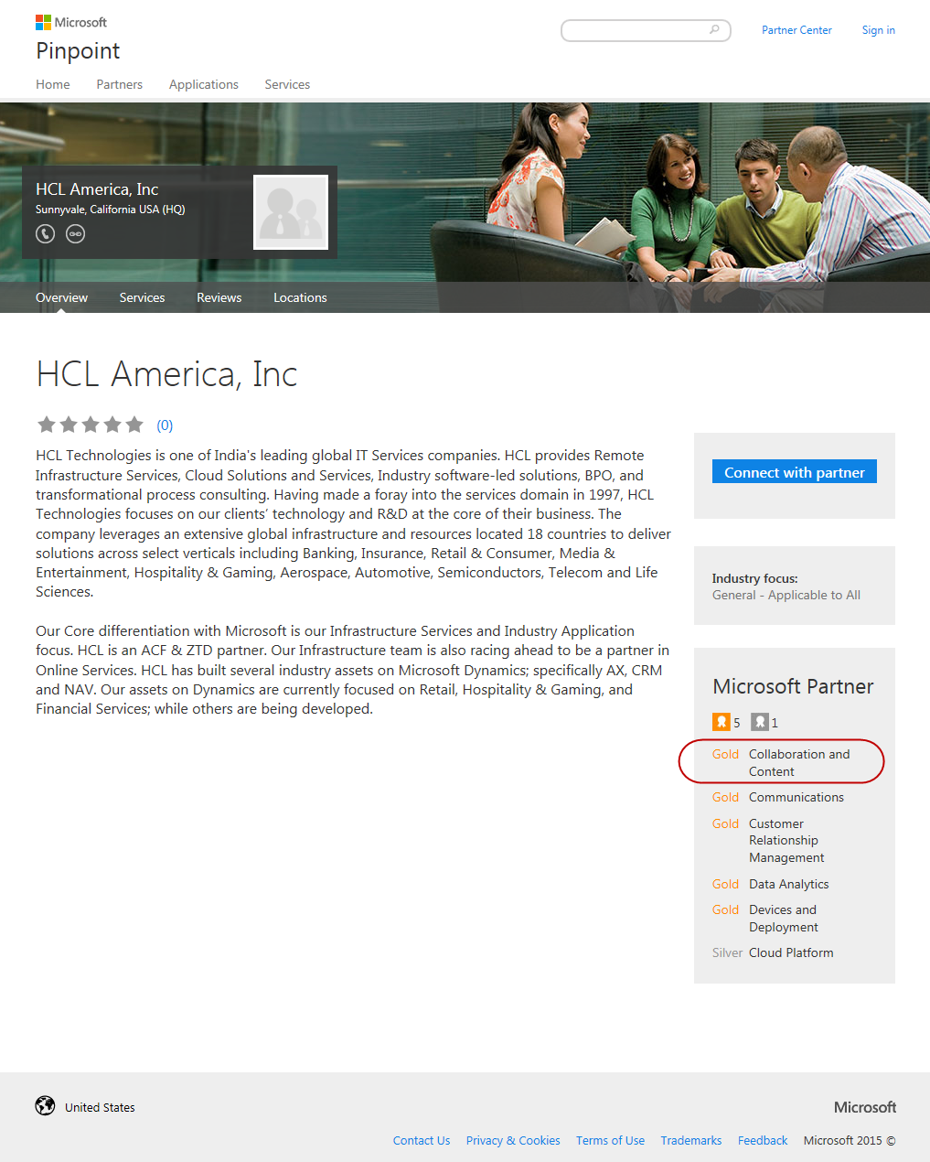

Strategic Differentiator – MS Relationship
GTM Partnership
OEM Partnership
Preferred Partner
IPs & Frameworks
End to End Services includes implementations, rollouts, upgrades and migration covering OS and Office, SharePoint, Dynamics CRM & AX, Azure, Office 365
Vertical solutions across Banking, Insurance, Healthcare – Payer – FinEdge Suite , Retail, Manufacturing
Horizontal Solutions across Share Point, Win 7 migrations
TAP Partner in key areas
PEAT Support in Proposals & Projects
HCL Group is one of the largest OEM Partner of Microsoft
R&D Partnership across products in the MS Stack
Services to MSIT across Infrastructure, CRM and other key applications
HCL is a key EA customer of Microsoft
HCL Training Academy enables internal training and certifications across the Microsoft stack
HCL Internal Productivity Platform, Collaboration and Wiki Portal run on Microsoft technologies
  Part of SharePoint Partner Advisory council (PAC)
One of the 28 Global alliances managed by global alliance group of MS
One among six managed Global System Integrators for MS Dynamics
Business Partnership in areas such as Dynamics CRM, SharePoint and Win7, Azure across geographies
  Structured training. Over 12000+ Microsoft professionals at HCL
Customer Experience Management Solutions – FinEdge CRM for Retail Banking, Insurance and Payer
GamEdge – CRM for Gaming Industry developed over Dynamics CRM
UCM tool for content migration from one platform to another platform
Xpress Migrate frameworks for migrations to Win7
Dot Net based solution for Loan Origination.
Azure based solutions

Slide 18
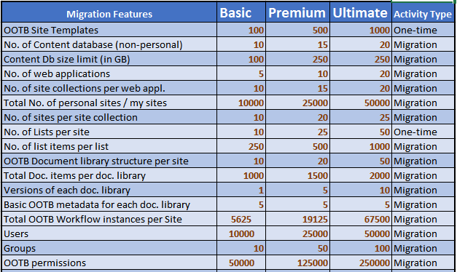
Strategic Differentiator - Catalogue-based Pricing

Slide 19
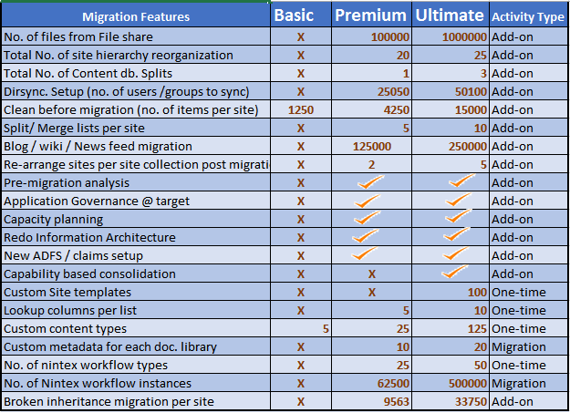
Strategic Differentiator - Catalogue-based Pricing

Slide 20
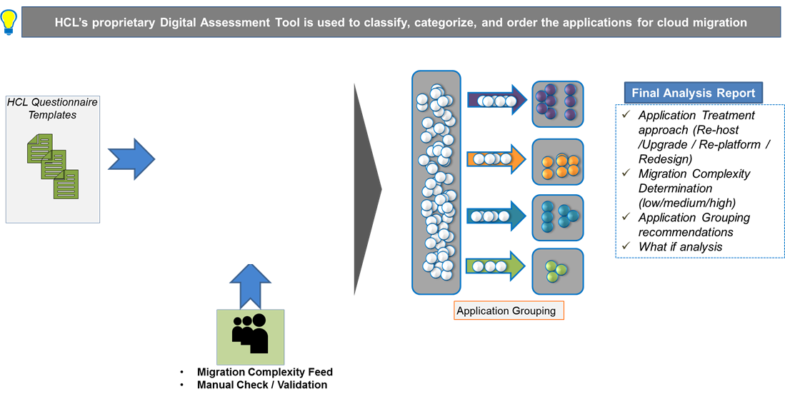
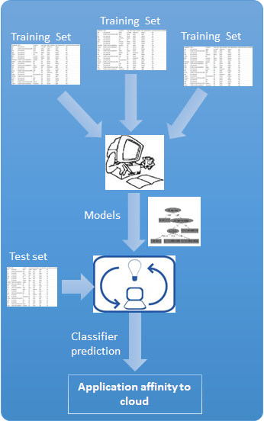
Strategic Differentiator DAT
DAT is highly recommended when Enterprise level analysis and grouping of applications is required.

Slide 21
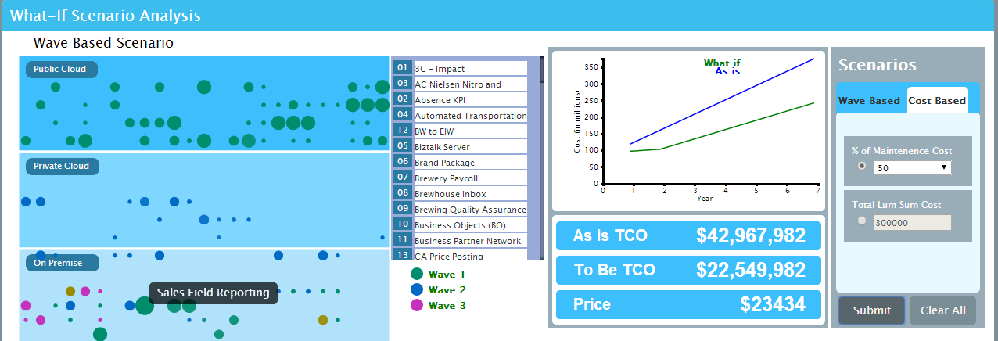
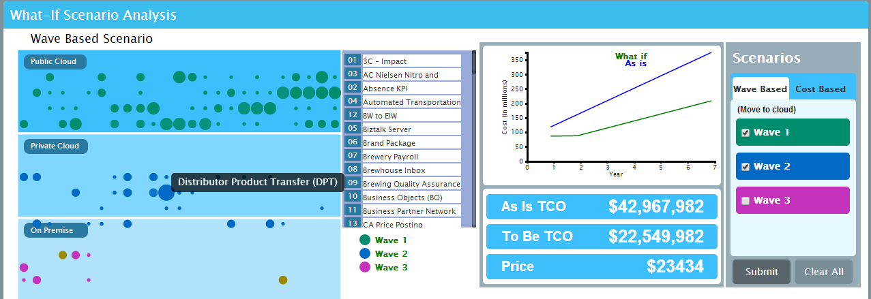
Strategic Differentiator DAT – What-if Analysis
Wave based What-if analysis
The sample screenshot depicts the As-is TCO and To-be TCO (on cloud) when Wave 1 and Wave 2 applications are migrated to cloud.
Cost based What-if analysis
The sample screenshot depicts the As-is TCO and To-be TCO (on cloud) if the available budget for migration is 50% of annual maintenance costs of the application portfolio.
HCL’s Proven and Standardized Assessment Tool – analysis of portfolio, migration recommendations and data driven business case creation

Slide 22
Strategic Differentiator - Core-Flexi Resourcing Model
Customer
CommunicationTeam
Flexi
HCL SharePoint COE
HCL
AMS Team
(L1 to L4)
Customer
Business
Base
Industry Best practice
Technical Leads
Core
Tools/ Framework
COE Core
Developers
Techno
Functional
Architects
Technical Leads
Microsoft Support
COE Manager
Architect
Techno-Functional
Core-Flexi Model
Developers
HCL
Dev Team
(Flexi)
Customer
IT
Thought Leadership
Technology Partners and Tool Vendors
Best Practice Guidelines, Knowledge base, Processes, Templates and Checklist

Slide 23
Core-Flexi typical Team composition
Core Team
1 Change Manager
1 Program Manager
Change Mgmt. Team
1 Business Analyst
1 SharePoint Architect
Project Mgmt. Team
1 Comm.s Manager
1 Scrum Master
Shared
1 Migration/Development Lead
Flexi Team
1 Migration Consultant/Developer
1 Migration/Development Lead
Migration Team
1 Migration/Development Tester
1 Migration Consultant/ Developer
Migration Team
1 UI/UX Developer
1 Migration/ Development Tester
*Core team is fixed for the entire program
1 UI/UX Developer

Slide 24
Contents
Why Upgrade
Our Solution Tenets
Upgrade Approach
Our Differentiators
Case Studies

Slide 25
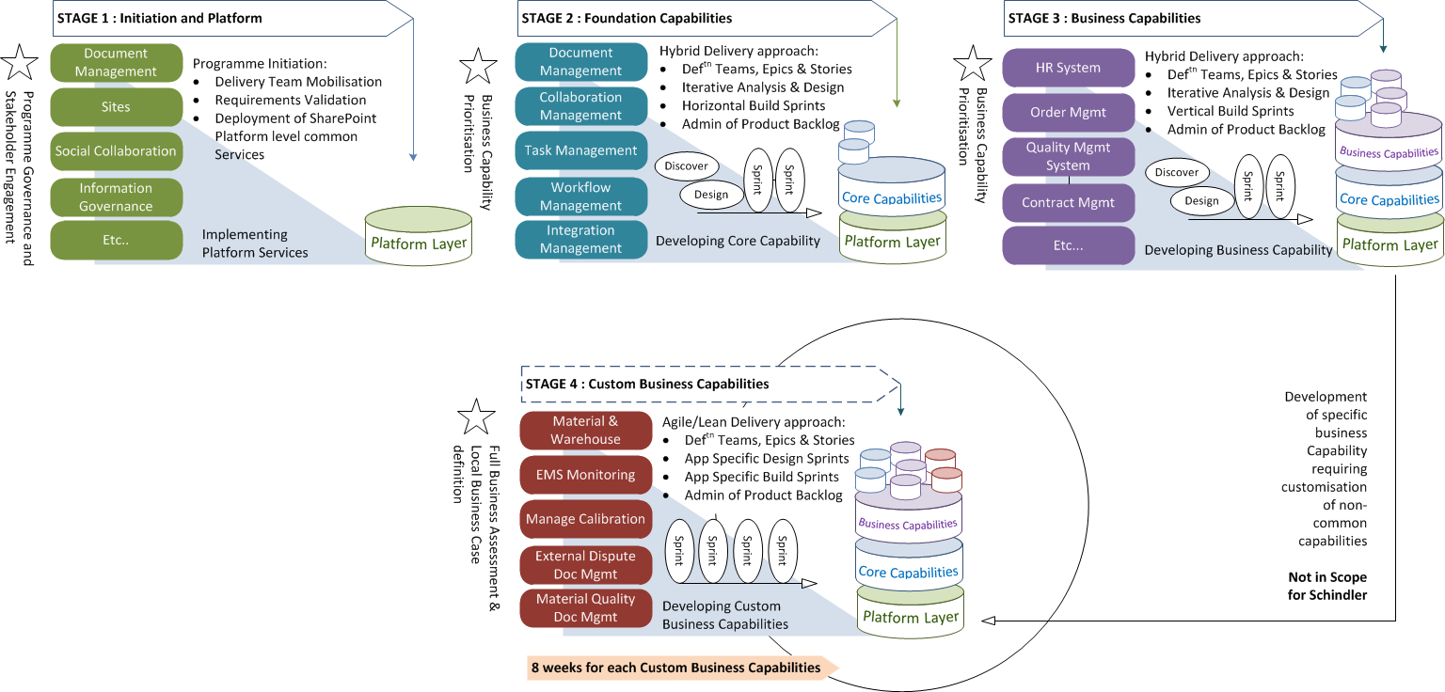
Operational Differentiator - Capability Driven Migration
Stage by stage execution
Each capability getting
matured by end of each stage
Multiple sprints will be executed
with each sprint focusing on a
specific core/ business capability.
Epics and stories created in each
stage for each capability –
validated with business within the
release cycle of that stage
30-40% of apps transformed from
source to target at stage 2
(with lot of common features)
85-90% of source applications
transformed to target at end of
stage 3
Only 15-20% left for stage 4 -
individual appl. specific (critical
applications only) capabilities are
developed

Slide 26
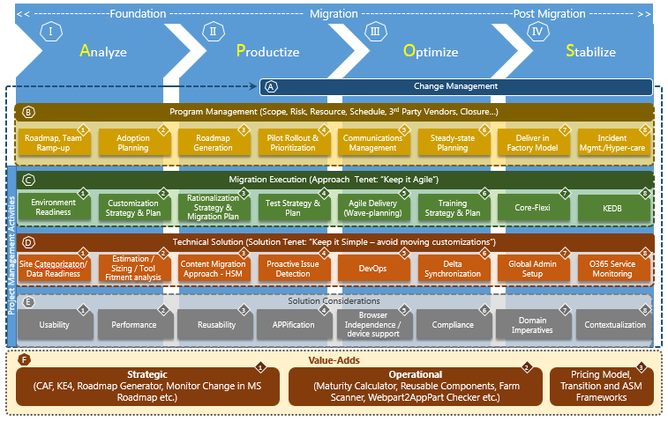
Technology Differentiator – HCL RA

Slide 27
Technology Differentiator – Reusable Assets
O365 Compatibility
Checker
Automated Deployment Tool
Reads current source code
Reports code snippets not compatible with O365
Core Upgrade Execution Tool
Pre-defined deployment steps
Pre-defined deployment scripts
CAFPoint
Upgrade Estimator
Upgrade through High Sped Migration API
3rd Party Tool based Upgrade
OOB default MS recommendation based Upgrade mechanism
1-Click Estimator
Detailed Estimation Tool
Workforce Networking
Shows O365 Delve
personalized data
Consumes Office Graph
/ MS Graph REST API
Application Disposition Tool (ADT)
CAF Upgrade Test Factory
Pre-upgrade Analyzer
Owner Identification
Application Decommission WF
Application Archival WF
Application Migration WF
Web Content Migrator
Pre-defined test scenario
Pre-defined test cases
Pre-defined test strategy
Pre-defined test methodology
+
40 More
Reads source SharePoint Environment
Exports Schema in XML
Import Schema in PUA
Analyses schema
Reporting
Migrate from published web content
Web content migrated to target SharePoint site as web pages

Slide 28
Lessons Learnt – Discovery Phase
  Identification of SPD created pages at the root of site.
  Discovery of volume & complexity of JavaScript references on pages
  Discovery complexity of pages & JavaScripts
Issues
Our Solution
  A Set of PowerShell scripts to identify all types of objects from source MOSS2007 & SP2010 farm.
  Quality of customizations and complexity of customizations cannot be discovered.
  Better to de-scope all 3rd party and custom solutions and migrate collaboration sites & contents.
  Treat highly custom sites separately outside the main scope.
  Analyze & estimate them case to case basis and migrate them separately.
  Implement Disposition process at the beginning.
  Make a strategy so that once de-scoped never revert the decision.
Lessons Learnt

Slide 29
Lessons Learnt – Migration Phase
  Migration of SPD created pages at the root of site
  Migration of SPD customized pages
  Migration of List Items using high-speed approach.
  Migration of Library Documents using high-speed approach.
  Migration of items having null value in mandatory columns.
  Handling of documents at target that are in error and remained checked out at target.
  Migration of Items having MMD column pointing to a Term Set that does not exist at target (Term Set is decommissioned at target)
  Migrated data should not appear in Search until Go Live declared.
  Task List and Workflow history is not migrated.
Issues
  Identify checked out documents checked out by migration account and delete them
  Fix Missing MMD Term Set.
  Disable / Enable search at target site & sub site appropriately during migration phase
  Deploy Page Layout to multiple site collections.
  Add Site Collection Administrators to target site.
  PowerShell to Create Metalogix jobs
Our Solution
  Migration speed degrades if List / Library has many level nested folders and many folders.
  Migration Speed degrades if no. of columns increases in Lists/Libraries.
  Migration Speed degrades if no. of version to be migrated is high.
  Do not migrate List Items using High speed mode. Retain List Item IDs at target.
  If one/more list item fails to migrate, migrate entire list from scratch.
  Run Incremental using non-high-speed approach.
  Keep 1 migration account (separate from individual user account) for 2 migration VMs.
  Plan sites/site collections having large lists at the beginning.
  Create a proper view at target list if contains more than 5000 items at source.
Lessons Learnt

Slide 30
Lessons Learnt – Verification Phase
  Verification of Pages are manual.
  Verification of quality check is manual.
  Some AD Groups which are not synced in target Azure AD; they will not be migrated. They are reported as not migrated during verification. We cannot integrate verification process with Azure AD. We need to manually verify and it is time taking.
  List/library level verification is at count level.
  Verification of Workflow functionality - as it might trigger email to end users.
Issues
Our Solution
  A Set of PowerShell scripts to check migrated structure
  A Set of PowerShell scripts to verify list/library count and migrated permission
Lessons Learnt
  Ensure before starting verification that source and target AD is in sync.

Slide 31
Lessons Learnt – Remediation Phase
  Html files do not open in browser
  Remediation of SPD created pages at the root of site leads to recreation of those pages.
  Remediation of JavaScripts embedded with content editor Web Part might be a challenge.
  Remediation of XsltListView Web Part is a challenge.
Issues
  Identify Html and Htm files at target document libraries.
  Rename Html and Htm files at target document libraries to Aspx.
  Set Title from source site to target site.
  Create Yammer Group in bulk. Add members to Yammer Group in bulk
Our Solution
  Remediation takes time based on the following objects and not based on data volume.
    No. of site collections
    b. No. of sites & sub sites
    c. No. of lists & libraries
    d. No.. of pages
    e. No. of SP groups
    f. No. of site permissions
  Try to simplify functionality at target by implementing OOTB solutions.
  If required quickly develop some Apps
Lessons Learnt

Slide 32
Metalogix vs ShareGate
# | Area | Metalogix Content Matrix | ShareGate
1 | Migrate from Content DB to SPO | Supports but has issues. It did not work for P&G Content DB. | Not Supported
2 | Migration of Lists having Lookup Columns | Handles dependencies for all lookup columns and migrates source list first and migrates lists having lookup columns at last. | Does not handle automatically. We need to manually migrate dependant lists first then migrate lists having lookup columns.
3 | Migration of Views & Forms | It can be migrated as granular | Either both or none can be migrated.
4 | Incremental Migration for Lists | Has issues. Checks Item ID for finding Delta | Has issues. Checks Item Title for finding Delta
5 | Migrate using filter condition | Fully supports | Has limitation for complex conditions
6 | Distributed Factory Migration | Fully Supported. Easy to monitor and control from One Machine (Controller). Well structure and well architected. | Need to be developed as PowerShell JOB and to be scheduled in many machines using Windows Scheduler. Need to perform activity in all migration machines.
7 | Migration of Quick Launch | Fully Supported. | Has issues and limitations.
8 | SPD Workflow Migration | Fully Supported. | Fully Supported.
9 | Nintex Workflow Migration | Fully Supported. | Fully Supported.
10 | Migration of Master page/page layout | Cannot migrate | Cannot migrate

Slide 33
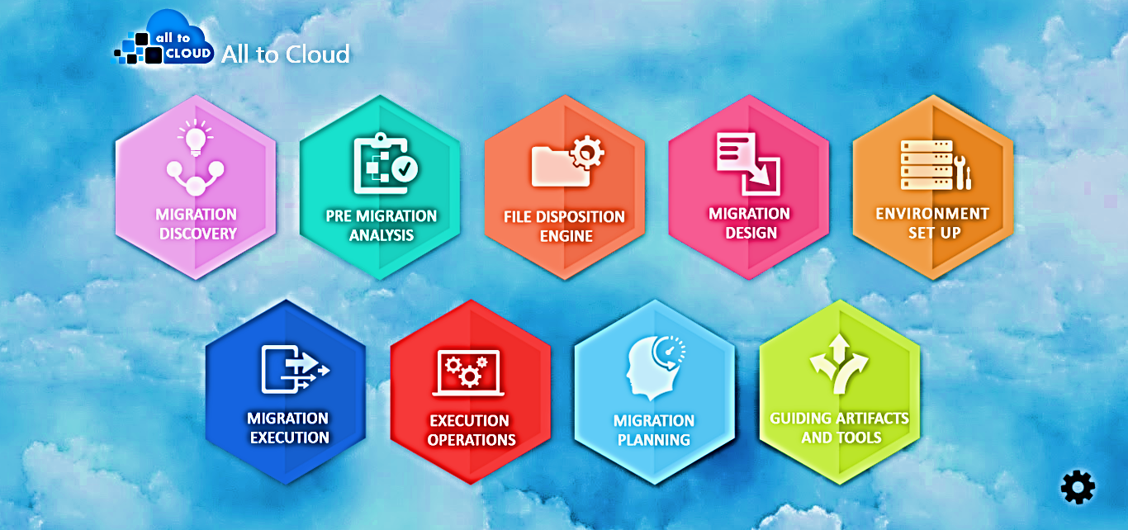
All to Cloud Migration Suite – A Sneak peek
Move contents from any On-premise file share to Cloud File Share

Slide 34
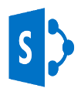
Case Study 1: Resources & Energy Major, Australia
Customer Profile
The Client delivers projects, provides expertise in engineering, procurement and construction and offers a wide range of consulting and advisory services. the company covers the full lifecycle, from creating new assets to sustaining and enhancing operating assets, in the hydrocarbons, mineral, metals, chemicals and infrastructure sectors.
Domain
Energy & Utilities
Business Area
Migration
GEO
APAC
SharePoint Generation
Upgrade from MOSS 2007/SP 2010 to SP 2013/O365
Project Description
SharePoint migration using MetaVis, which is a third party tool and automation scripts for reduction in migration time
MetaVis based Content Migration Project from MOSS 2007/ SP 2010 environment to SharePoint 2013/Office 365 environment
Maintain site lists where we get the information of source sites as well as the target site location
HCL’s Solution
Requirement analysis, developing Use Cases and Knowledge transfer
Migrating sites using third Party MetaVis Tool
Developing scripts to avoid manual efforts for SharePoint 2007/2013/O365
Research and Development activities in some complex migration scenarios
Challenges
Migrating Custom workflows, Out of the box Workflows, third Party solution (e.g.KwizCom)
Providing alternative solutions for the functionalities which are available in MOSS but not available in O365/SharePoint 2013 On-Premise
DataView WebParts migration challenges.
Re-migrate the site again on SharePoint 2013 On-premise as the functionalities required by business is not available in O365
Benefits / Value Added
Developed some scripts which is reducing Migration time
Good Work appreciation mail from the Client
So far, no escalation in this project

Slide 35
Case Study 2: Manufacturing Major, USA
Customer Profile
The Client is an American multinational conglomerate that produces a variety of commercial and consumer products, engineering services and aerospace systems for a wide variety of customers, from private consumers to major corporations and governments.
Domain
Hi-Tech & Manufacturing
Business Area
Migration
GEO
USA
SharePoint Generation
Upgrade from MOSS 2007 to SP 2013/O365
Project Description
Migration of Legacy MOSS 2007 sites and custom applications to Azure Infrastructure (IaaS)
Software up gradation to SharePoint 2013 which will consolidate various custom .NET IIS & Java application and web services under the umbrella of SharePoint farm and scope
Re-engineering the sites which were dependent on Excel Macro sheets for data manipulation and synchronization
HCL’s Solution
One hop migration of data from MOSS 2007 to SP 2013 using tool called Metalogix Content Matrix
Moving the infra to Cloud from On premise to scale on demand with 64 bit in contrast to existing 32 bit
Using 3rd party Encryption Tools to encrypt data moved to Cloud
AS-IS Assessment of Custom component including web parts, web services and re-engineering to Cloud App Model
Proof of concept related to performance, utility of the migration tool, encryption option and cloud setup
Challenges
Legacy, unmanaged custom application impacting the performance and delivery of the change requests
Migration of InfoPath form as Microsoft not supporting in future
Instability of the farm due to unreliable server object model codes
Performance of the sites and custom applications due to existing 32 bit on premise infrastructure
Security of intellectual data storage in target Cloud set-up
Benefits / Value Added
Migration Strategy helped direct upgrade from MOSS 2007 to SP 2013
Reduced server side foot print to 30 percent and helping stability
Azure Infra usage removed the hosting and operational expenditure by 60%
Enhanced branding and user experience added values to the users
Reduced dependencies on 3rd party component thereby saving licensing cost
Reduced maintenance cost by 50 % due to new cloud app model re-engineering

Slide 36
Case Study 3: Telecom Major, Europe
Customer Profile
The Client is a leader in the fields of network infrastructure, location-based technologies and advanced technologies.
Domain
Telecom
Business Area
Upgrade
GEO
Europe
SharePoint Generation
SharePoint 2013
Project Description
Assessment of current state environment of SharePoint , formulation of requirement and establishment of roadmap for O 365, SharePoint 2013 upgrade
Roadmap includes to upgrade 9000+ sites including intranet, publishing, extranet, my sites and custom applications and 3 TB of content
Enable better user experience & improved usability
HCL’s Solution
High level assessment of all custom components owned and maintained by the SharePoint platform team
Recommendation for simplification of customization and applicability of new features available in SP 2013
Identification & Implementation of Proof of concept (POC) related to SharePoint 2013 upgrade
Solution framework designed to categorize custom applications into multiple baskets like candidates for decommission , simplification, to remain as is and those needs to be redesigned using CSOM
Challenges
The as is SharePoint environment was not scalable at an enterprise level with poor user adoption and overall customer experience
Lot of complex custom applications were to be replaced using the out of the box capability of SP 2013
Benefits / Value Added
The complete intranet portal was reinvented to make it more social with rich activity stream and focus on moving from pushing content to co-creating content resulting in increase in user adoption
Enhanced search with an enterprise wide search capability
Leveraging the cloud app model to reduce the server side customization footprint bringing reduction of 70-80% to maintenance cost and code by 10-15%
Provision of device and platform independent solution with HTML 5 and CSS 3
Integration with Yammer to provide rich social capability

Slide 37
Thank You

